Slide 1

Unit 4: HOME
Lesson 1.3
Page 54

Slide 2
Lesson Outline
Warm-up
Practice
Speaking
Consolidation
Wrap-up

Slide 3
Objectives
By the end of this lesson, students will be able to ask where people are.
Vocabulary: Revision (bedroom, bathroom, living room, kitchen, yard).
Structure: Where’s Tom? He’s in the living room.
Where’s Grandma? She’s in the bathroom.

Slide 4

WARM UP

Slide 5
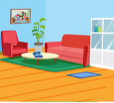

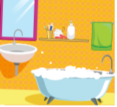

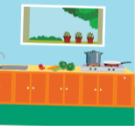


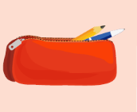

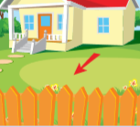

1
2
3
4
5
6
7
8
7
8
9
10
11
12
13
14
15
16
Notes:
T asks students to choose 2 squares (two numbers) to make a pair. Then students make sentences (I have…. or He’s in the ….). If not, close them and try again.

Slide 6

It’s time to learn …

Slide 7

Practice

Slide 8

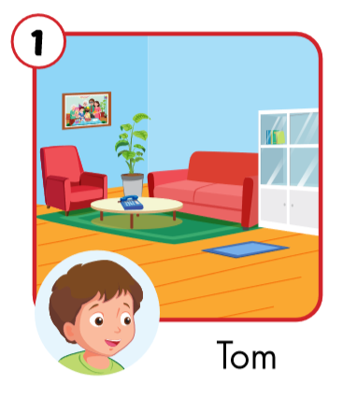
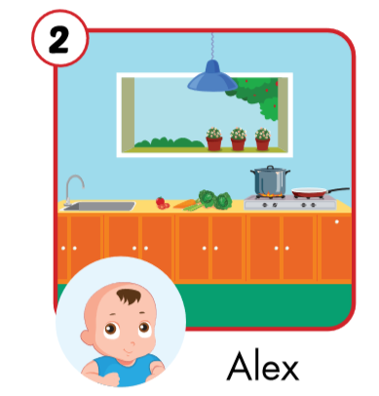
Where’s Tom?
Where’s Alex?
He’s in the living room.
He’s in the kitchen.

Slide 9
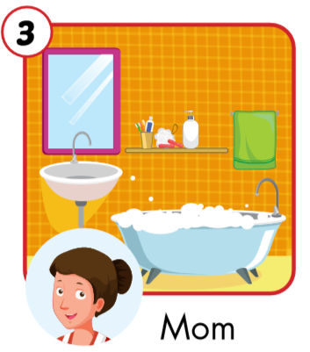
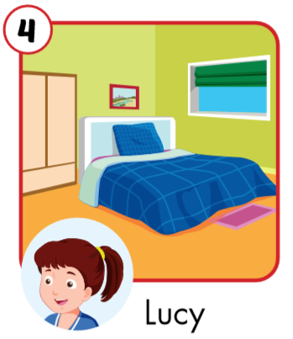
Where’s Mom?
Where’s Lucy?
She’s in the bathroom.
She’s in the bedroom.

Slide 10
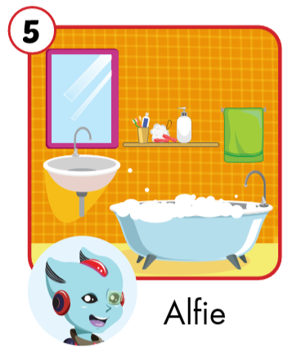
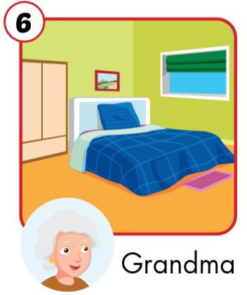
Where’s Alfie?
Where’s Grandma?
He’s in the bathroom.
She’s in the bedroom.

Slide 11
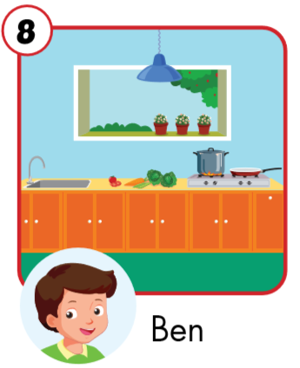
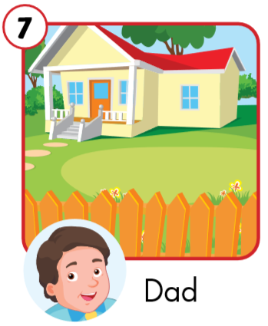
Where’s Ben?
Where’s Dad?
He’s in the yard.
He’s in the kitchen.

