Slide 1

Unit 4: HOME
Lesson 1.1
Page 52

Slide 2
Lesson Outline
Warm-up
Vocabulary
Structure
Consolidation
Wrap-up

Slide 3
Objectives
By the end of this lesson, students will be able to ask where people are.
Vocabulary: living room, bedroom, bathroom,
kitchen, yard.
Structure: Where’s Dad? He’s in the yard.
Where’s Grandma? She’s in the kitchen.

Slide 4

WARM UP

Slide 5




Make up sentences, using suggested pictures. pictures
Make up sentences, using pictures
I have
a green ruler.
a blue pencil.
I have

Slide 6

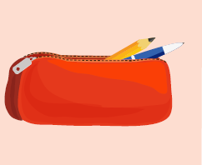
Make up sentences, using suggested pictures. pictures
I have
a yellow book.
I have
a red pencil case.

Slide 7

It’s time to learn …

Slide 8

New words
living room
bedroom
kitchen
bathroom
yard

Slide 9

Presentation

Slide 10


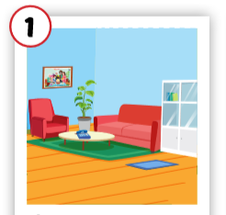
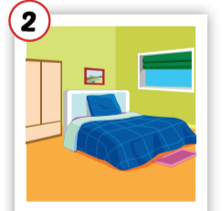
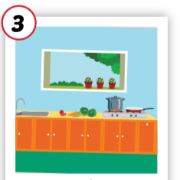
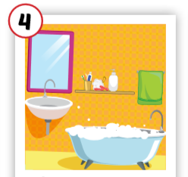
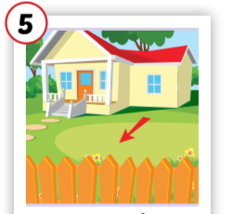
Click each English word to hear the sound.
living room
bedroom
kitchen
bathroom
yard
/ˈlɪvɪŋ ruːm/
phòng khách
/ˈbedruːm/ phòng ngủ
/ˈkɪtʃɪn/
nhà bếp
/ˈbæθruːm/ phòng tắm
/jɑːrd/
sân

Slide 11
Click each English word to hear the sound.
living room
/ˈlɪvɪŋ ruːm/
phòng khách

Slide 12
Click each English word to hear the sound.
bedroom
/ˈbedruːm/ phòng ngủ

Slide 13
Click each English word to hear the sound.
kitchen
/ˈkɪtʃɪn/
nhà bếp

Slide 14
Click each English word to hear the sound.
bathroom
/ˈbæθruːm/ phòng tắm

Slide 15
Click each English word to hear the sound.
yard
/jɑːrd/
sân

