Slide 1

Unit 2: Family
Lesson 3
Page 31

Slide 2
Lesson Outline
Warm-up
Listening
Consolidation
Wrap-up

Slide 3
Objectives
By the end of this lesson, students will be able to learn & use …
Vocabulary:
do your homework,
clean your room,
wake up,
go to bed
Structure:
Clean your room!
Imperative for giving command
Phonics:
/pl/ sound:
play,
please

Slide 4

WARM UP

Slide 5

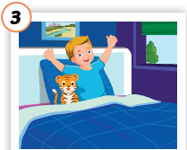
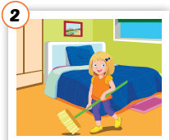
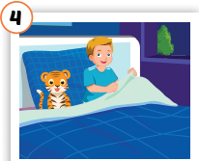
WARM UP
Look, match and say.
wake up
go to bed
____________________________
clean your room
______________________
do your homework
___________________________
______________________

Slide 6
WARM UP
Fill in the gaps.
room
homework
Wake
room
Go
1. Clean your _____!
Wake
2. _____up!
homework
3. Do your _________!
Go
4. ___ to bed!

Slide 7

It’s time to learn …

Slide 8

Phonics
/pl/ sound:
play,
please

Slide 9
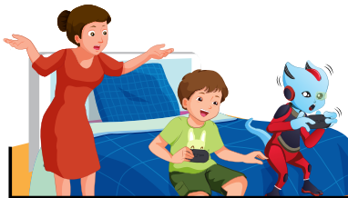

C. Listen and repeat
play /pleɪ/
pl
Sound
please /pliːz/

Slide 10

C.2. Chant.
/pl/, /pl/, /pl/,
/pl/, /pl/, /pl/,
play, please,
/pl/, /pl/, /pl/.

Slide 11

Listening

Slide 12
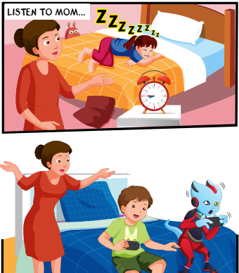
Pre-Listening
1. Who can you see?
Lucy
Mom/Mrs. Brown
Alfie
Tom
2. Does Mom look happy?
No

Slide 13
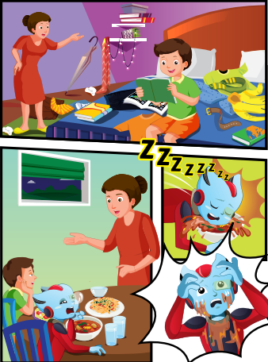
Pre-Listening
reading
3. What are the kids doing?
eating

Slide 14
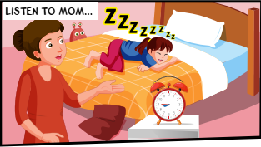


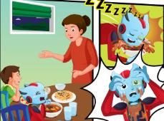
While Listening
D.1. Look and listen

Slide 15
Structures
Clean your room.
Wake up.
Do your homework.

