Slide 1

Unit 2: Family
Lesson 3.1
Page 30

Slide 2
Lesson Outline
Warm-up
Vocabulary
Structure
Consolidation
Wrap-up

Slide 3
Objectives
By the end of this lesson, students will be able to follow simple instructions.
Vocabulary: do your homework, clean your room, wake up, go to bed
Structure: Clean your room!

Slide 4

WARM UP

Slide 5

LET’S PLAY!
What’s missing?
Notes:
Put three or four FLASHCARDS (family members) on the board and tell your child to look at them. Ask them to close their eyes and take one card away. When your child opens their eyes, ask them to guess what is missing.

Slide 6

It’s time to learn …

Slide 7

New words
do your homework,
clean your room,
wake up,
go to bed

Slide 8


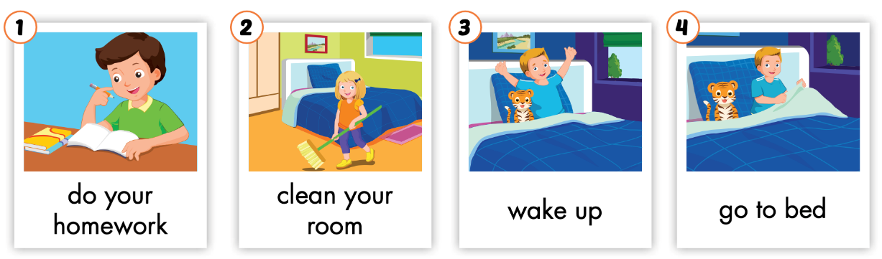
Listen and point.
Click the icon to hear the sound.

Slide 9


Listen and repeat.
Click each picture to hear the sound.
do your homework
/du jər ˈhəʊmwɜːrk/
làm bài tập về nhà

Slide 10
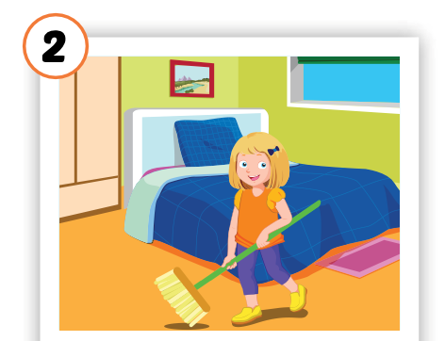
Listen and repeat.
Click each picture to hear the sound.
clean your room
/kliːn jər ruːm/
dọn phòng

Slide 11
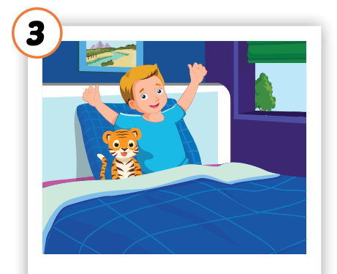
Listen and repeat.
Click each picture to hear the sound.
wake up
/weɪk ʌp/
thức dậy

Slide 12
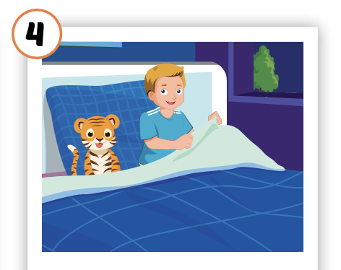
Listen and repeat.
Click each picture to hear the sound.
go to bed
/ɡəʊ tə bed/
đi ngủ

Slide 13

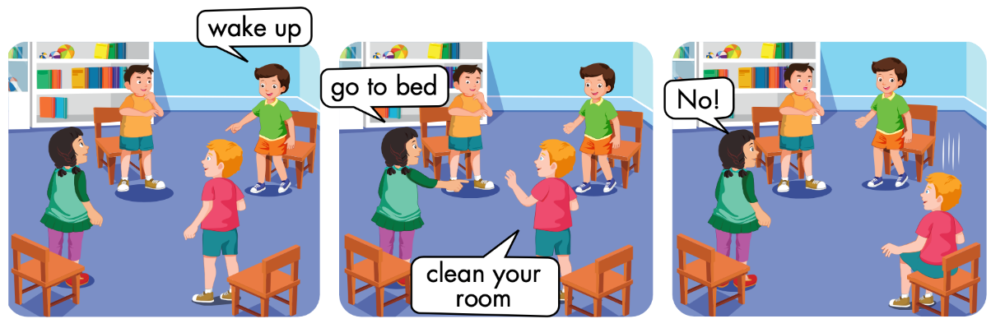

Slide 14
Let’s play!

Slide 15

Jigsaw Puzzle

