Slide 1

Unit 2: Family
Lesson 2.2
Page 28

Slide 2
Lesson Outline
Warm-up
Listening
Consolidation
Wrap-up

Slide 3
Objectives
By the end of this lesson, students will be able to introduce family members.
Phonics: /ð/
Structure: Who's he?
He’s my brother.
What's his name?
His name’s Alex.

Slide 4
Let’s chant!

Slide 5
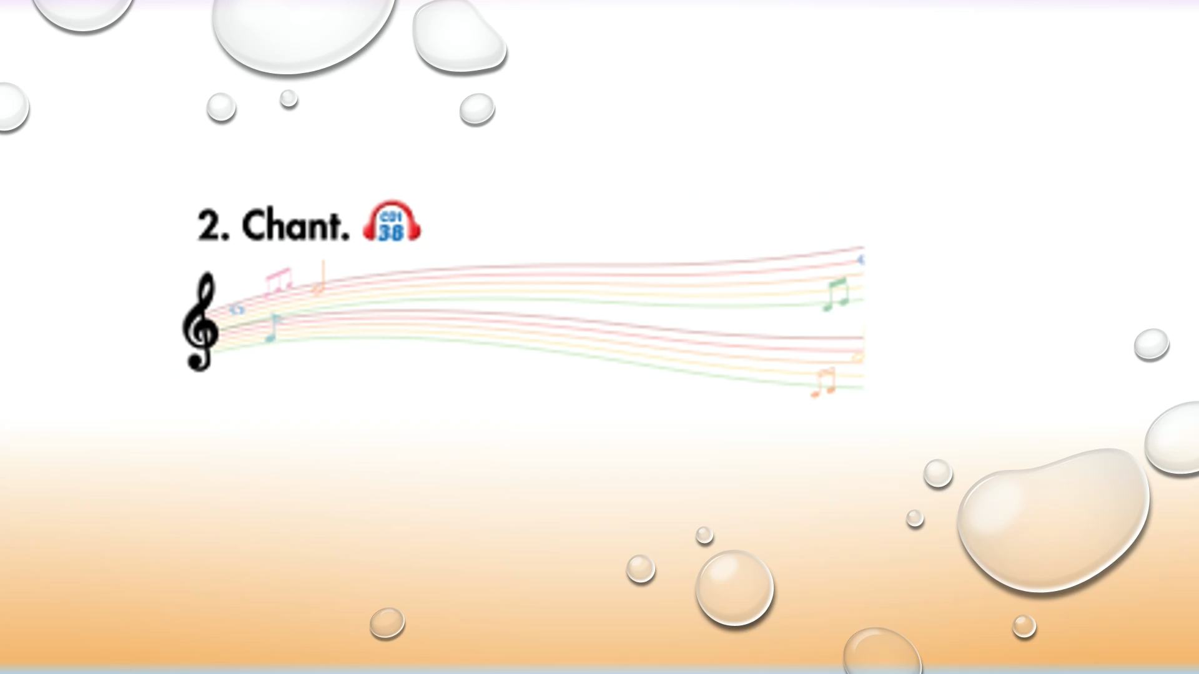

Slide 6

WARM UP

Slide 7
Let’s play!

Slide 8
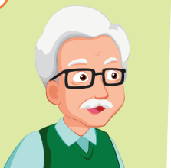
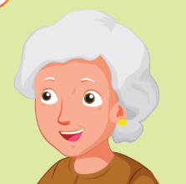

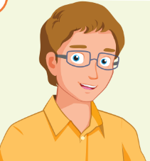
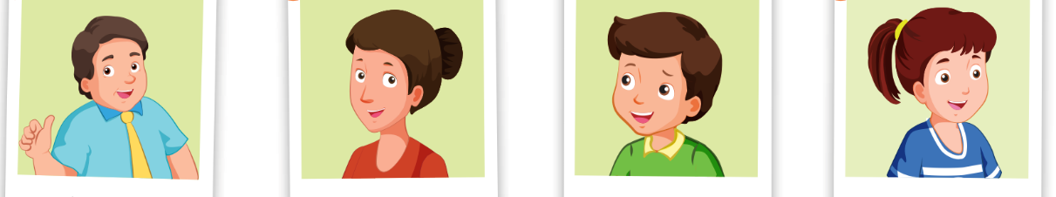

FAMILY

Slide 9
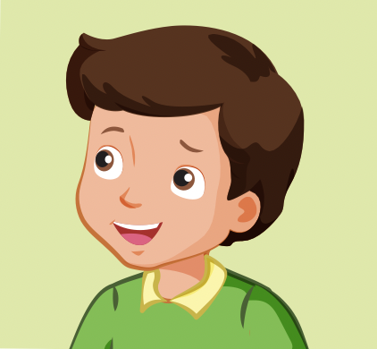


Who is he?
GREAT
brother
father
sister

Slide 10
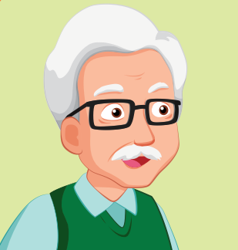
Who is he?
GREAT
father
grandfather
uncle

Slide 11


Who is she?
GREAT
father
sister
mother

Slide 12

Who is she?
GREAT
aunt
sister
mother

Slide 13

Who is he?
GREAT
brother
father
sister

Slide 14
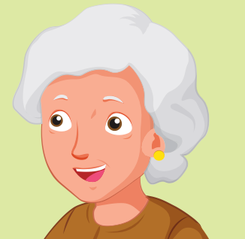
Who is she?
GREAT
aunt
grandmother
father

Slide 15

Who is she?
GREAT
father
mother
sister

