Slide 1

Unit 2: Family
Lesson 2.1
Page 27

Slide 2
Lesson Outline
Warm-up
Vocabulary
Structure
Consolidation
Wrap-up

Slide 3
Objectives
By the end of this lesson, students will be able to learn, practice and use …..
Vocabulary: grandfather, grandmother, uncle, aunt, cousin
Structure:
Who’s she? – She’s my aunt.
What’s her name? – Her name’s May.

Slide 4

WARM UP

Slide 5
Guessing game ☺☺

Slide 6

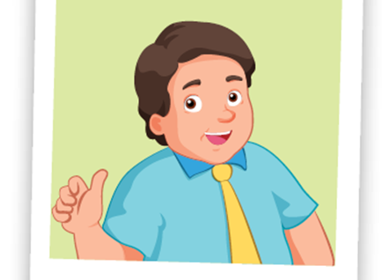
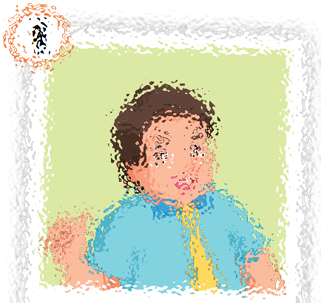
father

Slide 7
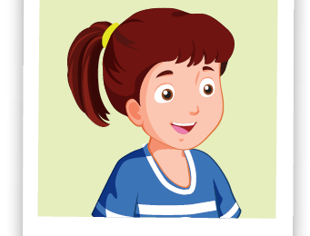
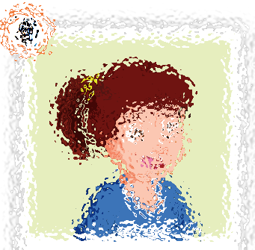
sister

Slide 8
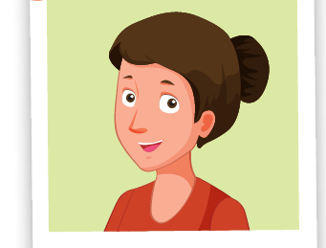
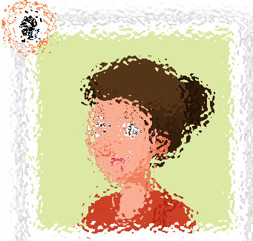
mother

Slide 9
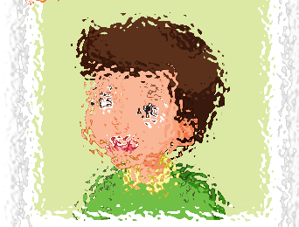
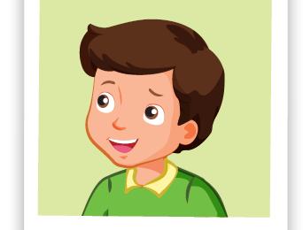
brother

Slide 10

It’s time to learn …

Slide 11
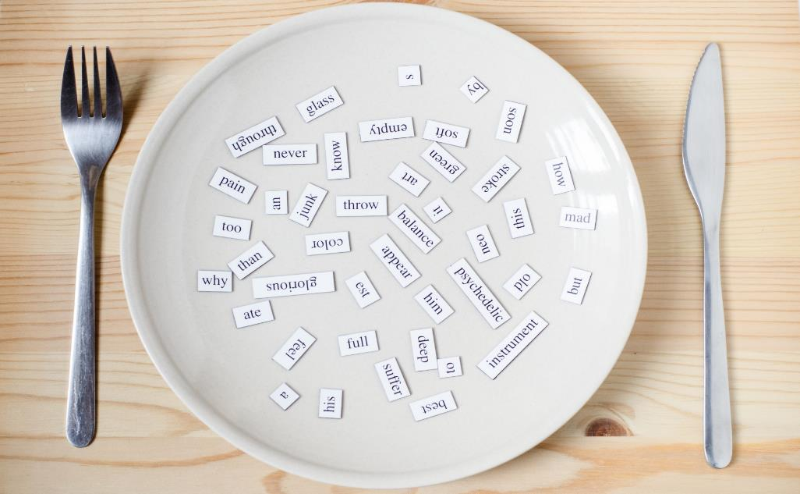
New words
grandfather
grandmother
uncle
aunt
cousin

Slide 12

Presentation

Slide 13

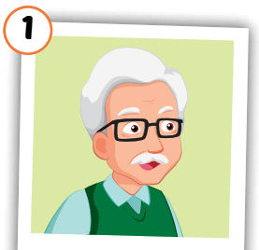
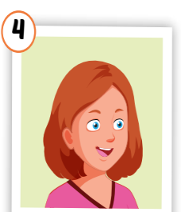
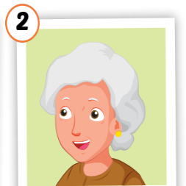
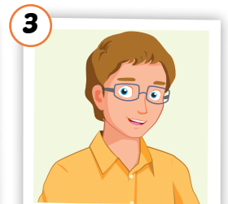
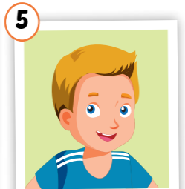
Click on each word to hear the sound.
grandfather
grandmother
uncle
aunt
cousin
/ˈɡrænfɑːðər/
ông nội, ông ngoại
/ˈɡrænmʌðər/
bà nội,
bà ngoại
/ˈʌŋkl/
chú, bác, cậu
/ænt/
cô, dì, mợ
/ˈkʌzn/
anh/chị/em họ

Slide 14

Practice

Slide 15

Choose a number and fill in the blank.
au_t
gr_nd_athe_
1
a
2
n
f
r
c _us_n
uncl_
Click on each word to hear the sound.
3
4
o i
e
g_an_mo_her
5
r d t
Click here to show answers.
1
2
3
4
5

