Slide 1

Unit 2: Family
Lesson 1.2
Page 25

Slide 2
Lesson Outline
Warm-up
Listening
Consolidation
Wrap-up

Slide 3
Objectives
By the end of this lesson, students will be able to introduce family members.
Phonics: /ʌ/
Structure: This is my (father).
Hello, I’m Alfie.
Hello Alfie.

Slide 4

WARM UP

Slide 5




How to play?
Read the questions
Look at the pictures
Click to choose the correct answers
FAMILY GAME

Slide 6




Who is this?
mother
father
brother

Slide 7

Who is this?
sister
mother
brother

Slide 8

Who is this?
father
mother
brother

Slide 9

Who is this?
father
sister
brother

Slide 10

It’s time to learn …

Slide 11

Presentation

Slide 12

Phonics
/ʌ/

Slide 13
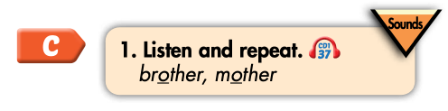

Click on the icon to hear the sound
brother
mother
/ʌ/
/ʌ/

Slide 14

Practice

Slide 15
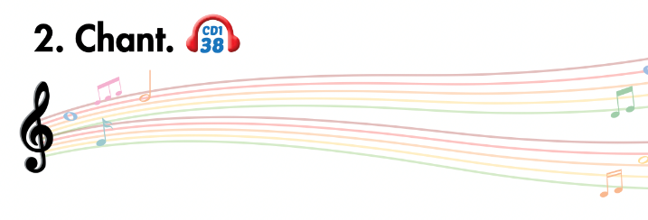
Listen and point
Listen and clap
Listen and chant

Slide 16
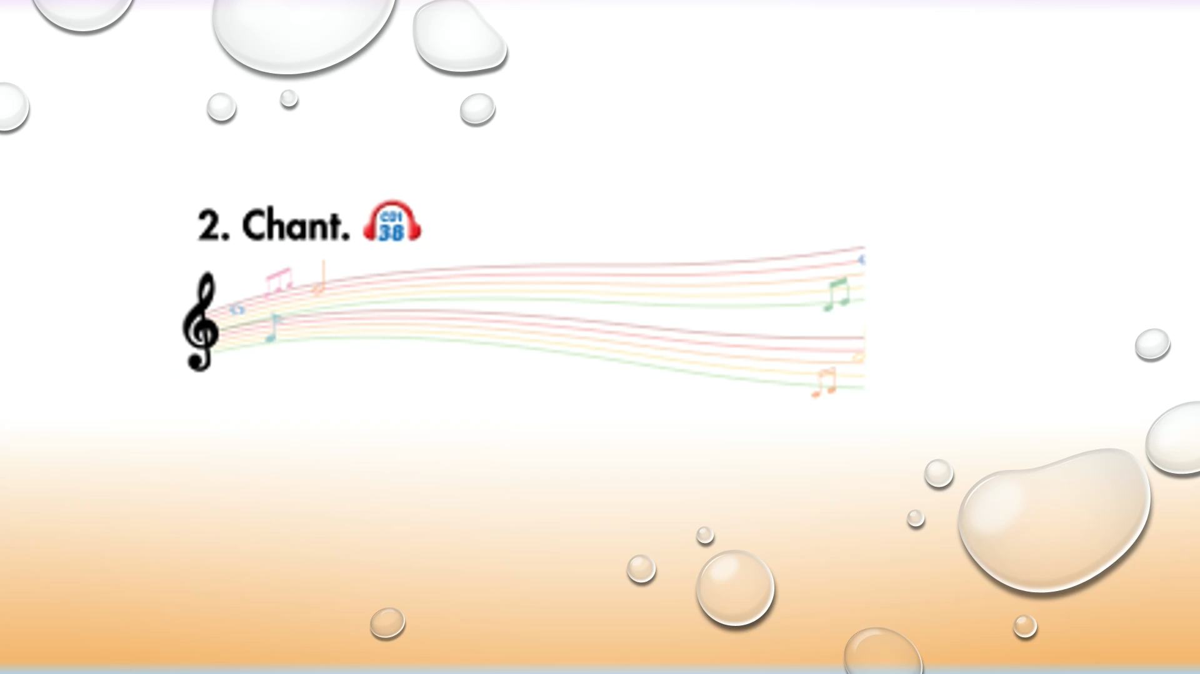

Slide 17

Listening

