Slide 1

Unit 2: My friends
Lesson 4.2
Page 20

Slide 2
Lesson Outline
Warm-up
Practice
Speaking
Consolidation
Wrap-up

Slide 3
Objectives
By the end of this lesson, ﻿students will be able to use polite greetings.
Vocabulary: hi, great, good.
Sentence patterns:
1. How are you?
=> I’m good.
2. It’s nice to meet you.
=> It’s nice to meet you, too.
﻿3. Thank you.
=> You're welcome.

Slide 4

WARM UP

Slide 5
Look and read. Then write the correct sentences.
Click each heart shape to give the question.
1
2
3
4
5
6
Click each question to show the answer.
Click each “NO” icon to hide showed answer.
It’s
how
you?
you?
great,
Do
to
Hi,
and
like
you.
are
you?
I’m
your
meet
How
nice
your
Do
like
are
friends
singing?
friends
drawing?
like
drawing?
Do
you?
Hi,
your
like
you?
It’s
How
singing?
I’m
nice
are
to
and
Do
your
great,
friends
meet
you?
how
friends
are
you.
Notes:
- Click “no” icon to hide showed question and answer.
- divide class into 3-4 groups. Ask ss write the correct sentences on their A4 papers or boards

Slide 6

It’s time to learn …

Slide 7

Structures
How are you?
I’m good, and you?
It’s nice to meet you.
It’s nice to meet you, too.
Thank you.
You’re welcome.

Slide 8

Practice

Slide 9

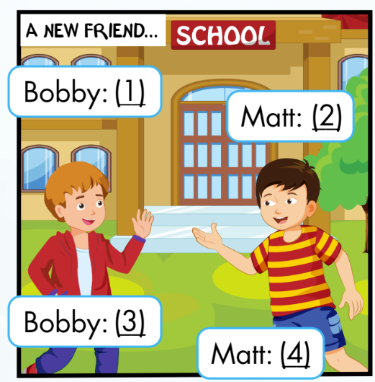
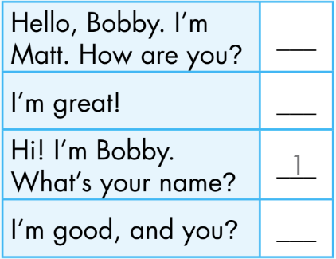
Activity 1
Click the numbers to show the answer
Hi! I’m Bobby.
What’s your name?
Hello, Bobby.
I’m Matt. How are you?
1
2
2
4
Matt
3
I’m good, and you?
I’m great!
4
3
Bobby
Notes:
Set context. Analyze picture.
Ask ss to guess ”what will say next?” and “what will he say?”
Show answer, practice with the whole class.
Explain the using of sentence patterns.
Ask ss practice in pairs and do the roleplay

Slide 10
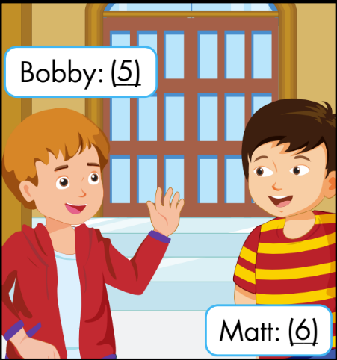
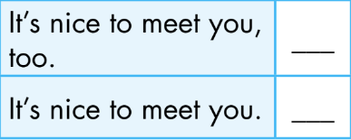
Activity 1
Click the numbers to show the answer
5
It’s nice to meet you.
6
It’s nice to meet you, too.
5
6
Notes:
Set context. Analyze picture.
Ask ss to guess ”what will say next?” and “what will he say?”
Show answer, practice with the whole class.
Explain the using of sentence patterns.
Ask ss practice in pairs and do the roleplay

Slide 11
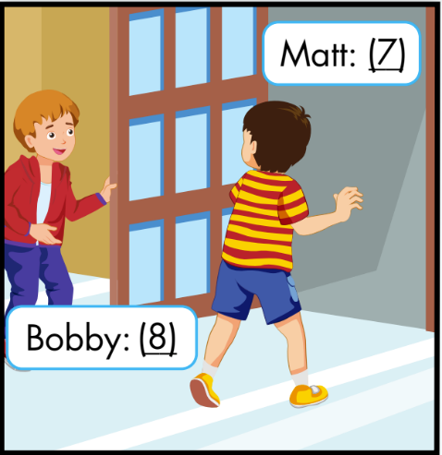
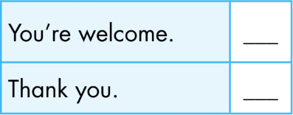
Activity 1
Click the numbers to show the answer
7
Thank you.
You’re welcome.
8
8
7
Notes:
Set context. Analyze picture.
Ask ss to guess ”what will say next?” and “what will he say?”
Show answer, practice with the whole class.
Explain the using of sentence patterns.
Ask ss practice in pairs and do the roleplay

Slide 12


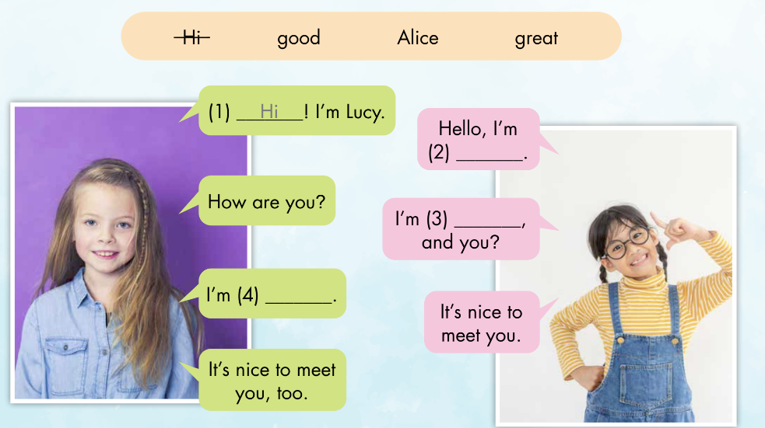
Activity 2
Alice
great
good
Notes:
Analyze pictures
Ask ss guess the words
Listen and check

Slide 13
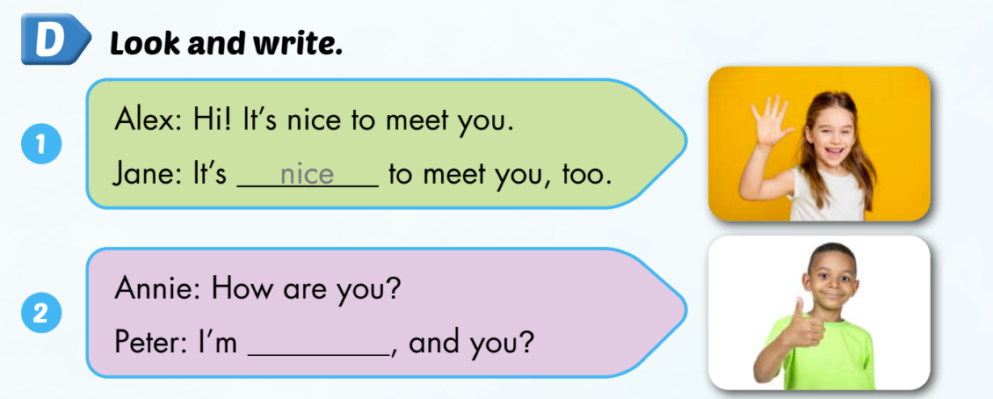
Extra activity
WB P. 15
good

Slide 14
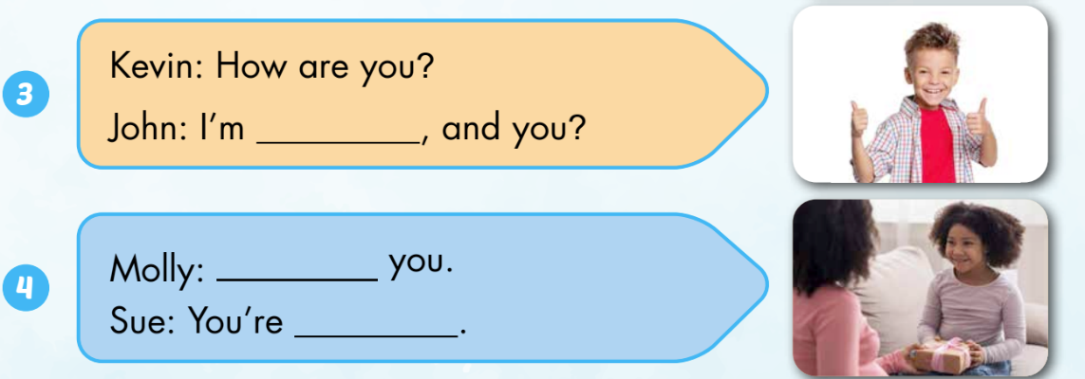
Extra activity
WB P. 15
great
Thank
welcome

Slide 15
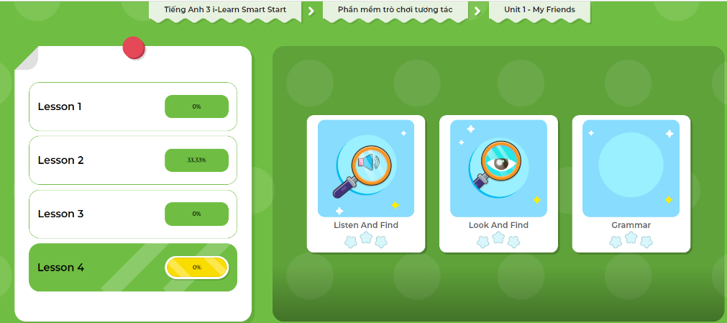
Extra Practice
DHA App
LET’S PLAY!
Click on the picture below

Slide 16

Production

