Slide 1

Unit 1: MY FRIENDS
Lesson 4.1
Page 19

Slide 2
Lesson Outline
Warm-up
Vocabulary
Structure
Consolidation
Wrap-up

Slide 3
Objectives
By the end of this lesson, ﻿students will be able to use polite greetings.
Vocabulary: hi, good, great
Sentence patterns:
1. How are you?
=> I’m good.
2. It’s nice to meet you.
=> It’s nice to meet you, too.
﻿3. Thank you.
=> You're welcome.

Slide 4

WARM UP

Slide 5
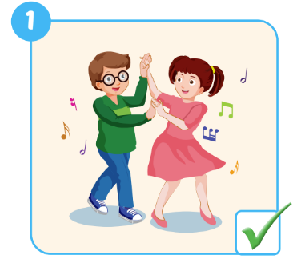
Look and read. Then write the correct words.
dancing
1. Do your friends like ……………….?
Yes, they do.
Notes:
Divide class into 2 groups. Make 2 lines
Show the picture and the structure with the missing words.
Ask ss write the words letter by letter in turn. 1st st writes ”D”, next st writes ”A” till they finish the word. When finishing the word, st needs to slap the board
Ask ss look at the tick/cross on the picture. Ask they say out loud the answer
Next round, the answer also has the missing words.

Slide 6
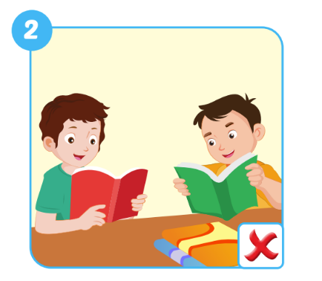
Look and read. Then write the correct words.
like reading
2. Do your friends …………… ……………….?
No
…….. , they don’t.
Notes:
Divide class into 2 groups. Make 2 lines
Show the picture and the structure with the missing words.
Ask ss write the words letter by letter in turn. 1st st writes ”D”, next st writes ”A” till they finish the word. When finishing the worss, st needs to slap the board
Ask ss look at the tick/cross on the picture. Ask they say out loud the answer
Next round, the answer also has the missing words.

Slide 7
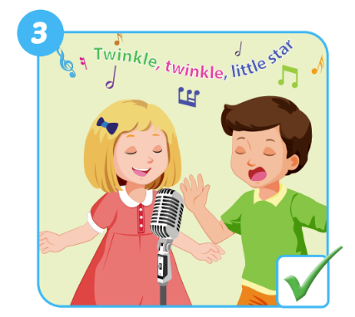
Look and read. Then write the correct words.
friends like singing
3. Do your …………… …………… ……………….?
they do
Yes , ………… ……… .
Notes:
Divide class into 2 groups. Make 2 lines
Show the picture and the structure with the missing words.
Ask ss write the words letter by letter in turn. 1st st writes ”D”, next st writes ”A” till they finish the word. When finishing the worss, st needs to slap the board
Ask ss look at the tick/cross on the picture. Ask they say out loud the answer
Next round, the answer also has the missing words.

Slide 8
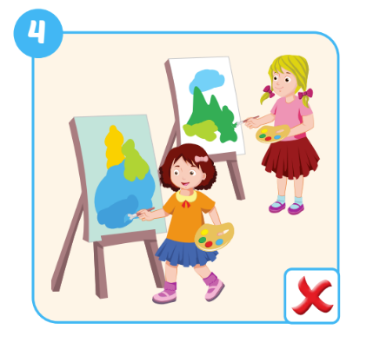
Look and read. Then write the correct words.
your friends like paiting
4. Do ………….. ………….. …………… ……………….?
No they don’t
….. , ………. .……. .
Notes:
Divide class into 2 groups. Make 2 lines
Show the picture and the structure with the missing words.
Ask ss write the words letter by letter in turn. 1st st writes ”D”, next st writes ”A” till they finish the word. When finishing the worss, st needs to slap the board
Ask ss look at the tick/cross on the picture. Ask they say out loud the answer
Next round, the answer also has the missing words.

Slide 9
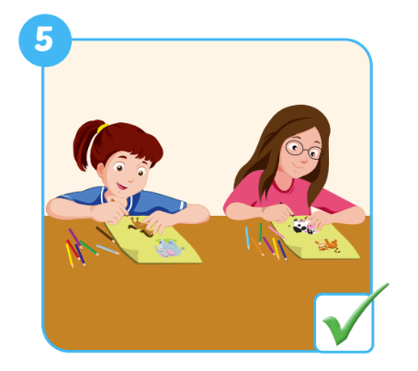
Look and read. Then write the correct words.
Do your friends like drawing
5. ………. ………….. ………….. …………… ……………….?
Yes they do
….. , ………. .……. .
Notes:
Divide class into 2 groups. Make 2 lines
Show the picture and the structure with the missing words.
Ask ss write the words letter by letter in turn. 1st st writes ”D”, next st writes ”A” till they finish the word. When finishing the worss, st needs to slap the board
Ask ss look at the tick/cross on the picture. Ask they say out loud the answer
Next round, the answer also has the missing words.

Slide 10
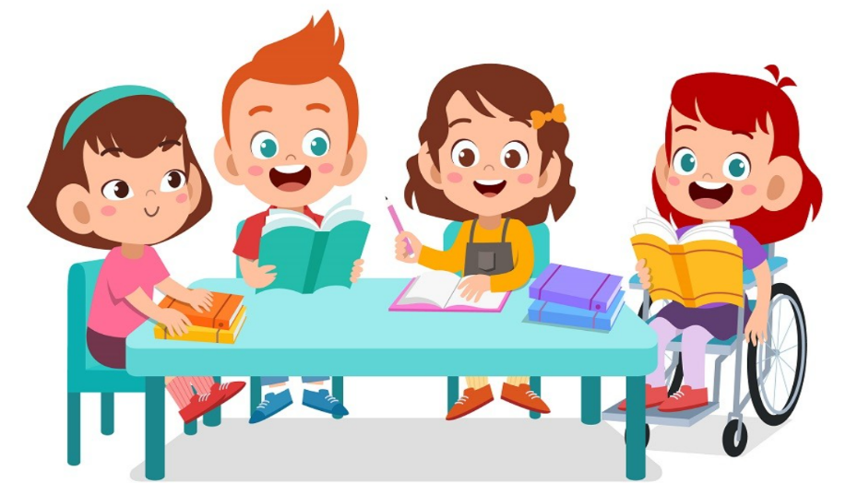
It’s time to learn …

Slide 11

New words
hi
good
great

Slide 12

Presentation

Slide 13


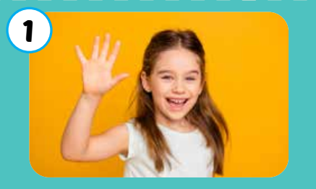

Click each English word to hear the sound.
hi
﻿/haɪ/
﻿xin chào

Slide 14
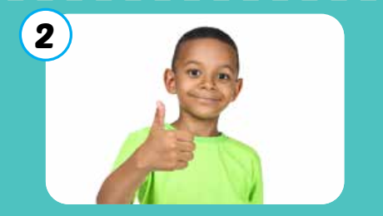
Click each English word to hear the sound.
good
﻿/ɡʊd/
﻿﻿khỏe, tốt

Slide 15
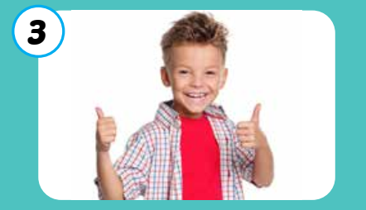
Click each English word to hear the sound.
great
﻿﻿/ɡreɪt/
﻿﻿﻿tuyệt vời, rất tốt

Slide 16
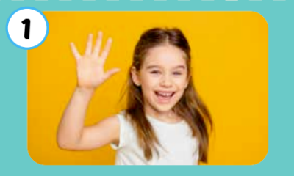

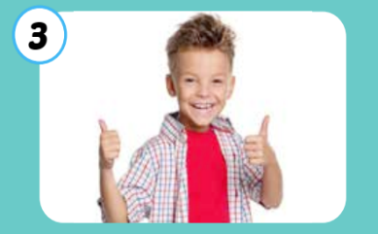
Click each English word to hear the sound.
hi
good
great
﻿/haɪ/
﻿xin chào
﻿/ɡʊd/
﻿﻿khỏe, tốt
﻿﻿/ɡreɪt/
﻿﻿﻿tuyệt vời, rất tốt

