Slide 1

Unit 1: My Friends
Lesson 2
Page 16

Slide 2
Lesson Outline
Warm-up
Vocabulary
Structure
Consolidation
Wrap-up

Slide 3
Objectives
By the end of this lesson, students will be able to learn ….
Vocabulary: dancing, singing, drawing, reading, painting
Structure: Do your friends like dancing?
Yes, they do./No, they don't.
Aim: Students will be able to ask what their friends like doing.

Slide 4

WARM UP

Slide 5






Memory Cards!



😐


Japan
India
The UK
1
2
3
4
5
6






Italy
Alpha
The USA
7
8
9
10
11
12
Notes:
Instruction:
There are 6 pictures with 6 names of them.
Students have to choose 2 numbers to open. If the picture and the name match, they get1 point.
If the picture and the name don’t match, close the picture and let them choose again.
Click on the big square to open.
Click on the smaller square with numbers to close.

Slide 6
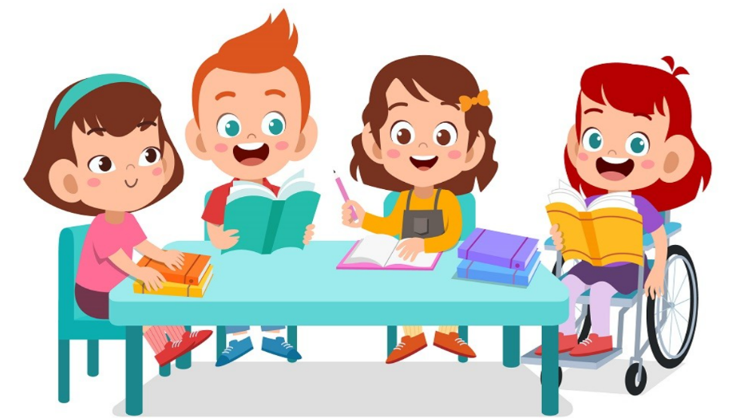
It’s time to learn …

Slide 7

Vocabulary
Dancing
Singing
Drawing
Reading
Painting

Slide 8


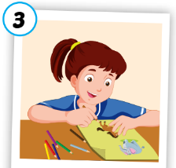
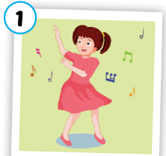
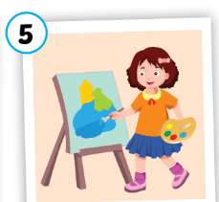
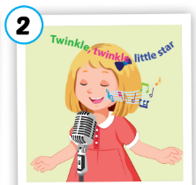

A
1. Listen, point and repeat.
3
5
1
4
2
drawing
dancing
painting
singing
reading
/drɑːɪŋ/
vẽ
/dænsɪŋ/
nhảy, nhảy múa
/peɪntɪŋ/
vẽ bằng cọ
/sɪŋɪŋ/
hát, ca hát
/riːdɪŋ/
đọc
Notes:
Click numbers to show pictures
Click the words to listen
Click to show meanings

Slide 9

Activity 1
Slow Motion

singing
Notes:
Click to open the picture under the cover slowly.
Click the star to show answer.

Slide 10

Activity 1
Slow Motion

painting
Notes:
Click to open the picture under the cover slowly.

Slide 11

Activity 1
Slow Motion

dancing
Notes:
Click to open the picture under the cover slowly.

Slide 12

Activity 1
Slow Motion

drawing
Notes:
Click to open the picture under the cover slowly.

Slide 13
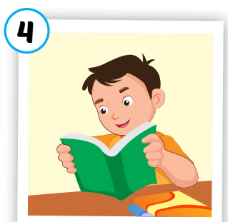
Activity 1
Slow Motion

reading
Notes:
Click to open the picture under the cover slowly.

Slide 14
Activity 2
Say the right pictures.
dancing
singing
reading
painting
singing
drawing
reading
dancing
singing
STOP
Notes:
Click to show the new words.
Students say the numbers of the pictures.

Slide 15
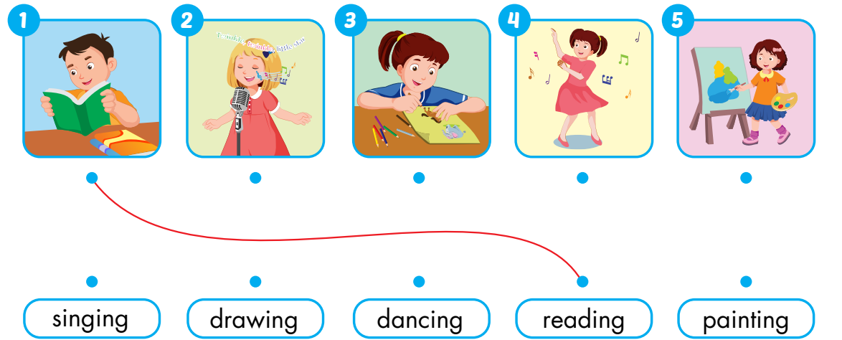
Extra Activity
WB 12
A
Draw lines.

Slide 16
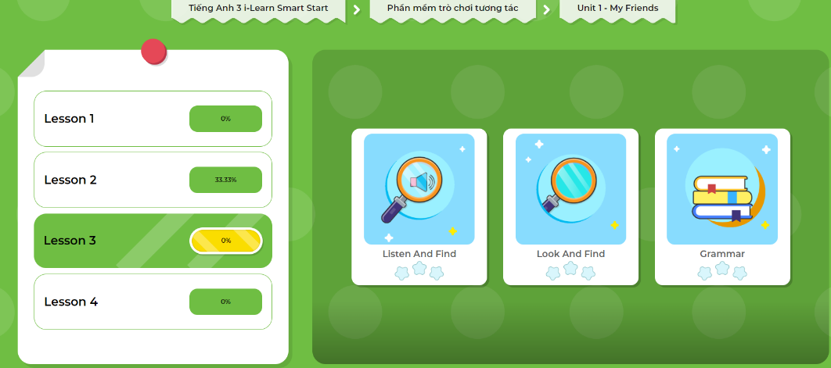
Extra- DHA app.
Click here to play the games

