Slide 1

Unit 1: My Friends
Lesson 2
Page 14

Slide 2
Lesson Outline
Warm-up
Phonics
Listening
Consolidation
Wrap-up

Slide 3
Objectives
By the end of this lesson, students will be able to use ….
Vocabulary: the USA, the UK, Italy, India, Japan, Alpha
Structure: Where are you from?
I'm from the USA.
Where's she from?
She's from Japan.
Aim: Students will be able to ask where people are from.

Slide 4

WARM UP

Slide 5



GUESSING GAMES!
Where are you from?
I’m from the USA.

Slide 6


GUESSING GAMES!
Where are you from?
I’m from the UK.

Slide 7
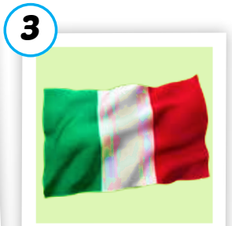

GUESSING GAMES!
Where’s he from?
He’s from Italy.

Slide 8
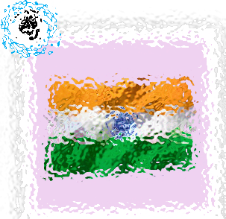
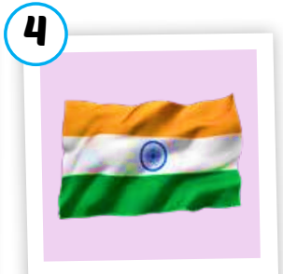
GUESSING GAMES!
Where’s he from?
He’s from India.

Slide 9

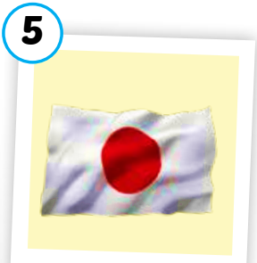
GUESSING GAMES!
Where’s she from?
She’s from Japan.

Slide 10
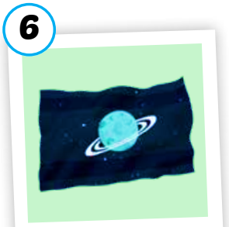

GUESSING GAMES!
Where’s she from?
She’s from Alpha.

Slide 11

Phonics
/ə/ sound

Slide 12




c
1. Listen and repeat
India
Alpha

Slide 13











c
2. Listen and chant.
/ə/, /ə/, /ə/,
/ə/, /ə/, /ə/,
India, Alpha,
/ə/, /ə/, /ə/.
(x2)

Slide 14




Activity 1
Listen and repeat.
1
2
3
4
Japan
Italy
India
Alpha

Slide 15
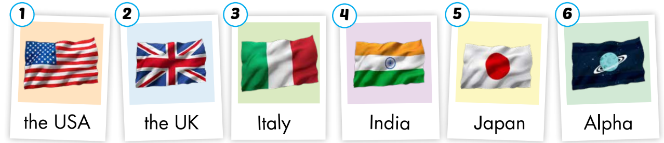
Activity 2
Look, read and circle the words with / ə / sound.

Slide 16

Listening
Where are you from?
I’m from….
Where’s he from?
He’s from….

Slide 17

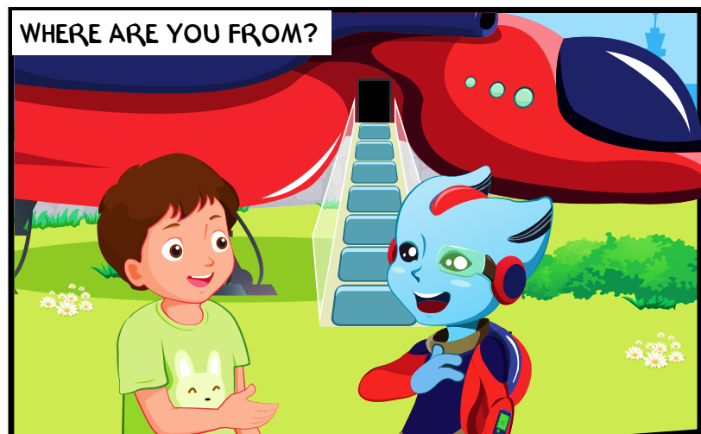
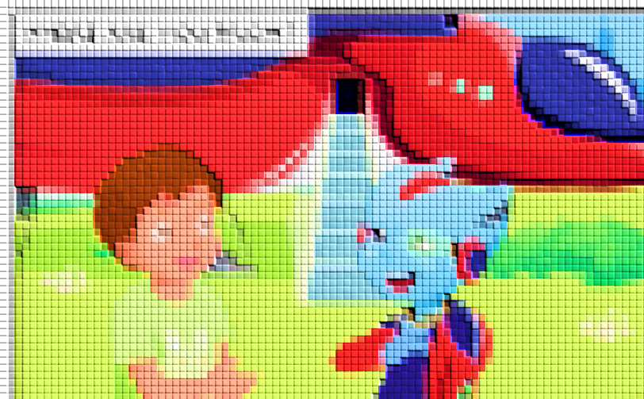
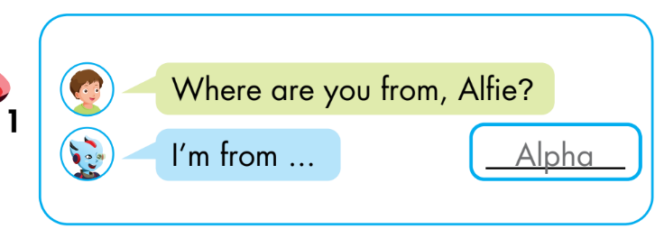

Slide 18
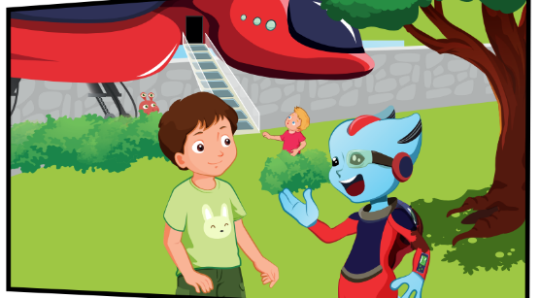
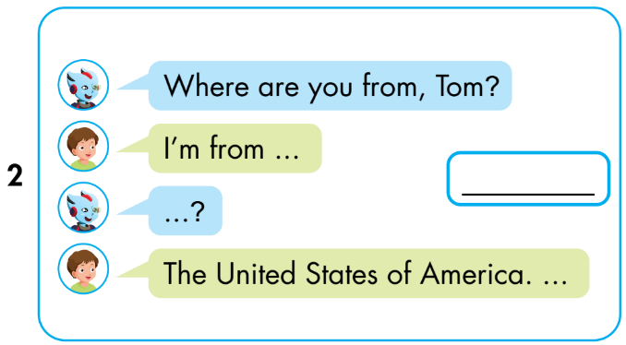
the USA.
U-S-A?
Notes:
Instructions:
Let students guess who are in the picture. Then click on the picture to open it. Say their names.
Ask:
What are they doing? ( talking)
Can you read the question? (Where are you from?)
- Click to show the conversation. Read and then listen. (click the conversation to listen) Explain to students what they have to do.

Slide 19
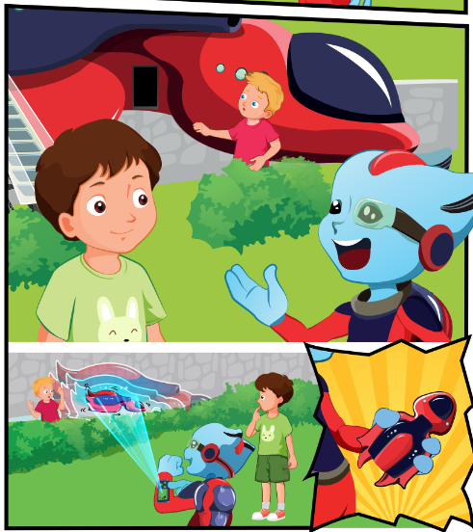
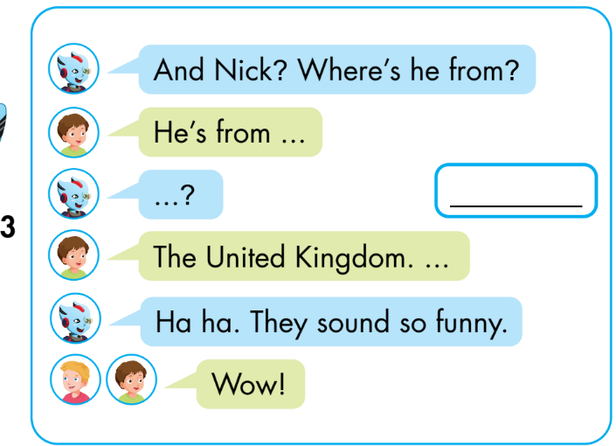
U-K?
the UK.
the UK.
Notes:
Instructions:
Let students guess who are in the picture. Then click on the picture to open it. Say their names.
Ask:
What are they doing? ( talking)
Can you read the question? (Where are you from?)
- Click to show the conversation. Read and then listen. (click the conversation to listen) Explain to students what they have to do.

Slide 20
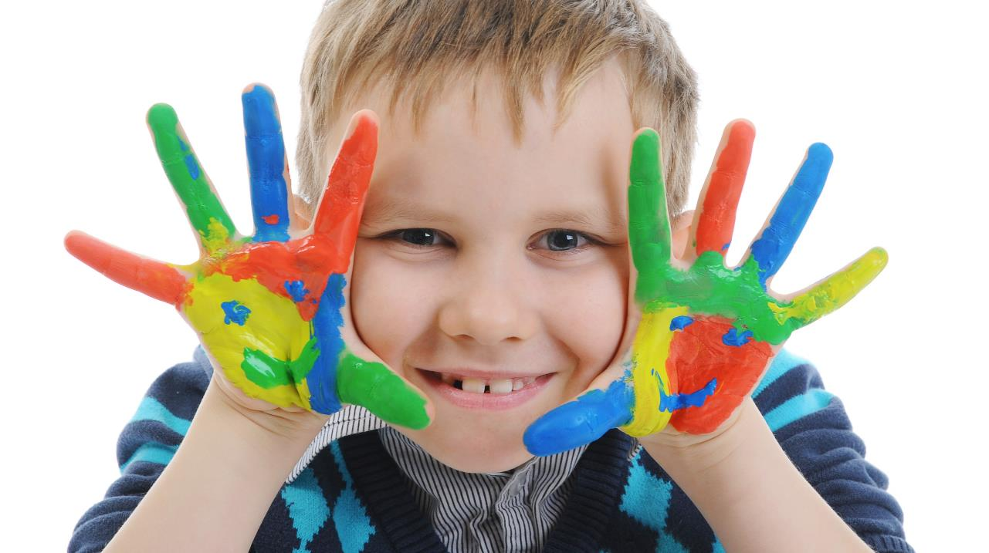
Enjoy your day!

