Slide 1

Unit 3: School
Review 2
Page 51

Slide 2
Lesson Outline
Warm-up
Speaking
Consolidation
Wrap-up

Slide 3
Objectives
By the end of this lesson, students will be able to review asking who owns different school supplies, asking what subjects people like, and talking about their school timetables.

Slide 4

WARM UP

Slide 5

Let’s play!
Hot seat

Slide 6

Hot seat
How to play:
Divide the class into 4 teams.
Elect one person from each team to sit in the Hot Seat,
facing the classroom with the board behind them.
Write a word on the board (days, school things, subjects).
One of the team members of the student in the hot seat
must help the student guess the word by describing it (but he/she cannot say, spell or draw the word).

Slide 7

LET’S CHANT!

Slide 8


Slide 9

It’s time to learn …

Slide 10

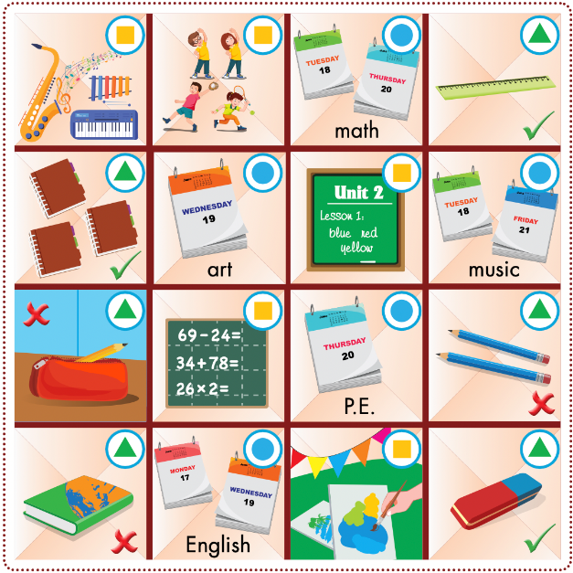

Slide 11
How to play
Divide the class into groups of four with two pairs in each group.
Have pairs play rock, paper, scissors to see which pair goes first.
Have the winning pair choose a space, match the symbol to the useful language, then ask and answer.
Have the pair mark that space as theirs if they use the useful language correctly.
The pair that gets three spaces in a horizontal, vertical, or diagonal line wins the game.

Slide 12



Example:

Slide 13


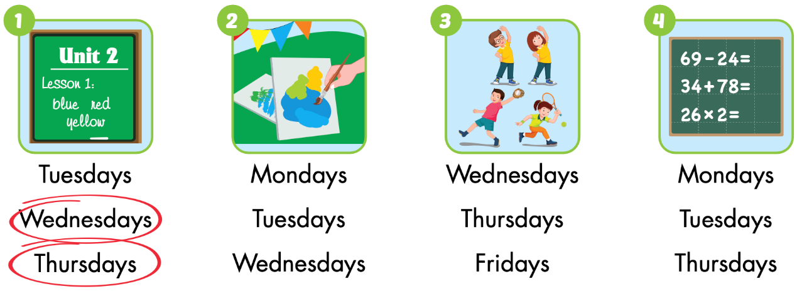
Extra Practice
WB p. 37

Slide 14
