Slide 1

Unit 3: School
Review 1
Page 50

Slide 2
Lesson Outline
Warm-up
Reading
Listening
Consolidation
Wrap-up

Slide 3
Objectives
By the end of this lesson, students will be able to review asking who owns different school supplies, asking what subjects people like, and talking about their school timetables.

Slide 4

WARM UP

Slide 5
Let’s play!
The hangman

Slide 6
The hangman
How to play..
Think of a word and write the dashes on the board to show how many letters there are.
Ask students to suggest a letter. If it appears in the word, write it in all of the correct spaces. If the letter does not appear, write it off to the side and begin drawing the image of a hanging man.
Continue until the students guess the word correctly (they win).

Slide 7

It’s time to learn …

Slide 8

Listening

Slide 9
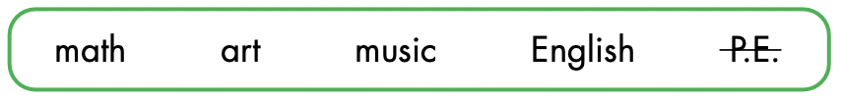
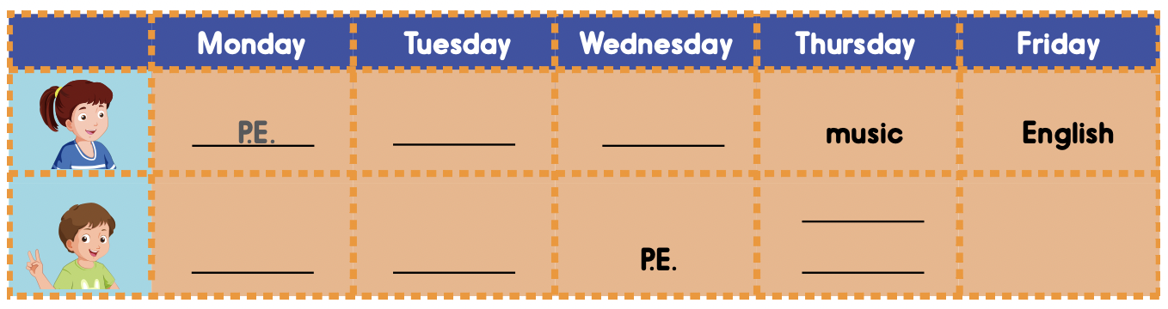
Look at the table and call out the days and subjects.

Slide 10



Slide 11
Listen and check.
math
math
art
English
music
English

Slide 12

Writing

Slide 13
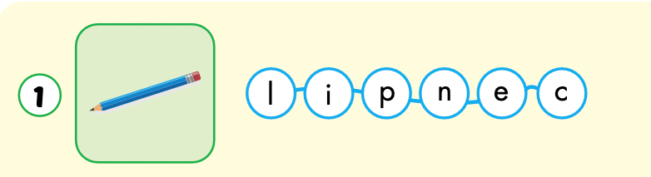
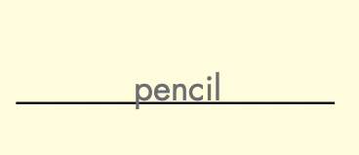

Slide 14
Have students individually look at the mixed up letters.
Have students write the words in the spaces provided.

Slide 15
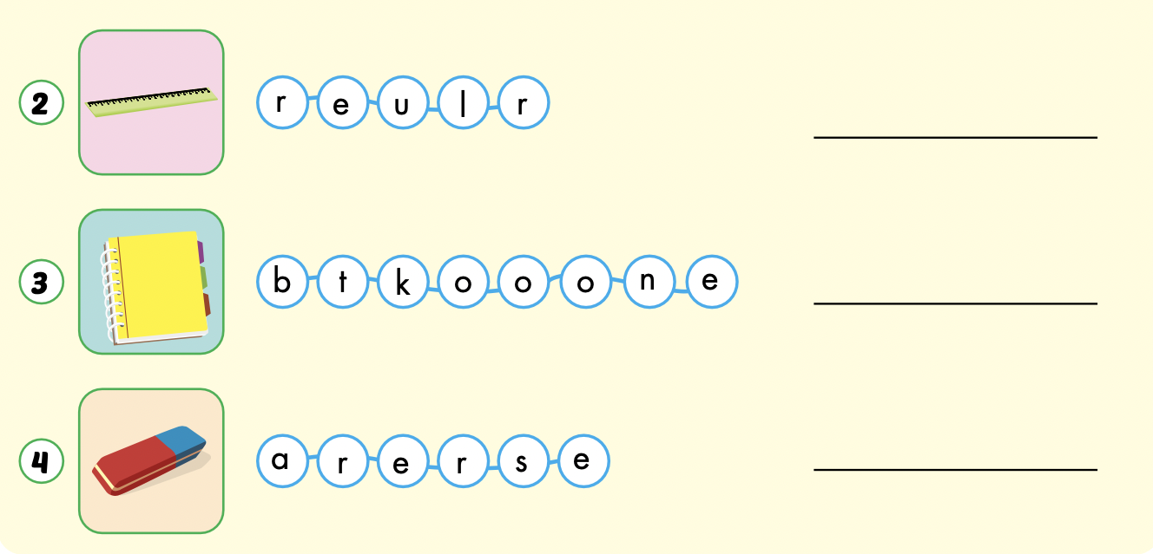
ruler
notebook
eraser

