Slide 1
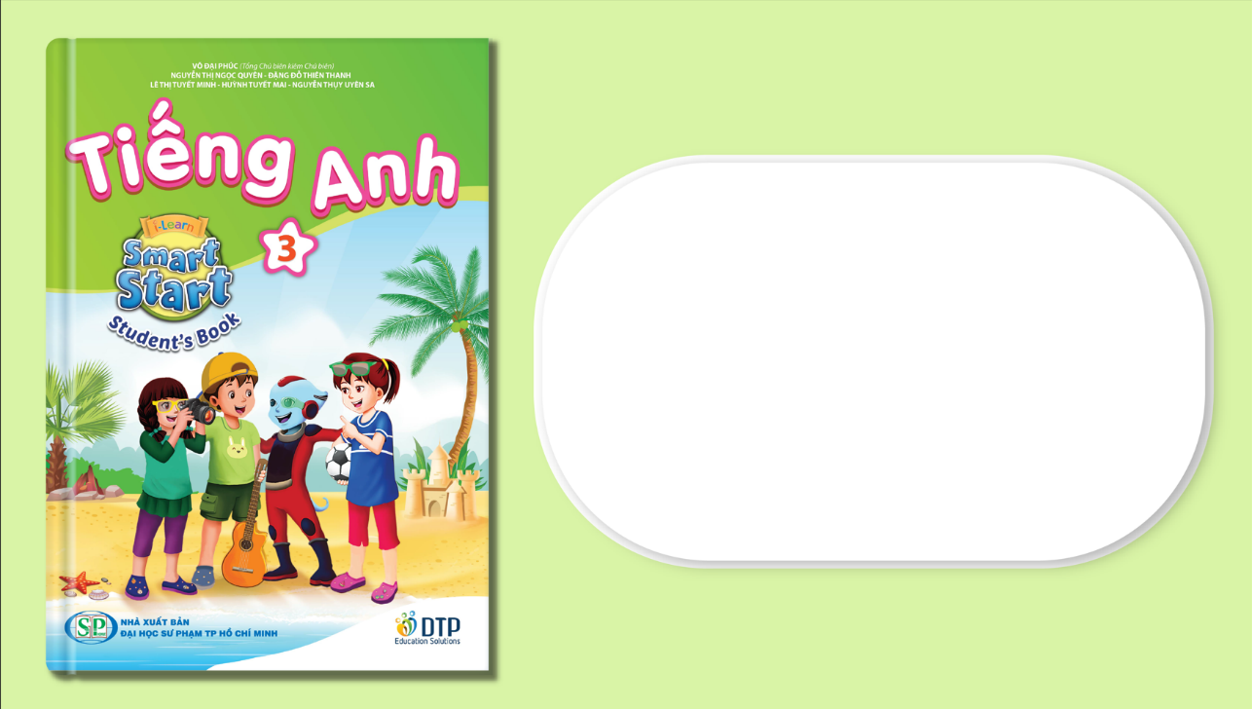
Unit 3: School
Lesson 4.2
Page 48

Slide 2
Lesson Outline
Warm-up
Reading
Listening
Consolidation
Wrap-up

Slide 3
Objectives
By the end of this lesson, students will be able to understand a paragraph about color making and know how to make some new colors from certain ones.
Vocabulary: green, orange, pink, purple, gray, favorite
Structure: What's your favorite color?
- My favorite color is orange.
I can make orange with yellow and red.

Slide 4

WARM UP

Slide 5
Telepathy Game
?

Slide 6
How to play
Make 2 teams.
Students read and choose the corect answers.
- They get 1 point for each corect answer.

Slide 7
Telepathy Game
1

Slide 8
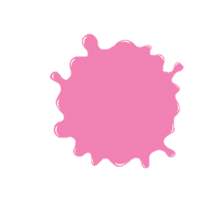

Red and white make….
pink
yellow

Slide 9
The answer is…
PINK

Slide 10
Telepathy Game
2

Slide 11


Blue and yellow make…
orange
green

Slide 12
The answer is…
GREEN

Slide 13
Telepathy Game
3

Slide 14

Blue and red make…
purple
pink

Slide 15
The answer is…
PURPLE

Slide 16
Telepathy Game
4

Slide 17
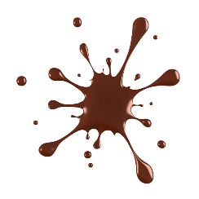

Black and white make….
brown
gray

Slide 18
The answer is…
GRAY

Slide 19
Telepathy Game
5

Slide 20
Red and yellow make….
orange
purple

Slide 21
The answer is…
ORANGE

