Slide 1
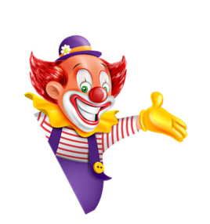

I always get up early.
How about you?
Unit
02
Lesson 3

Slide 2
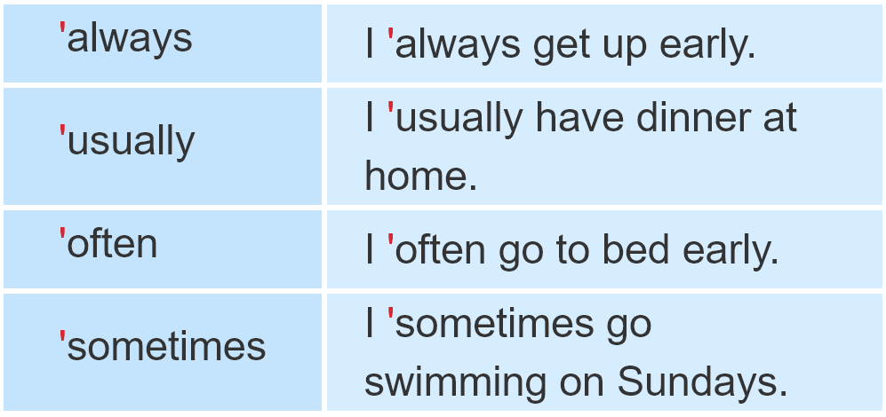
1. Listen and repeat

Slide 3

2. Listen and circle a or b. Then say the sentences aloud.
1. I___________ go to bed early.
a. always b. sometimes
2. He ___________ plays football after school.
a. sometimes b. often
3. She ___________ goes shopping on Sundays.
a. usually b. always
4. We___________ go camping at the weekend.
a. often b. sometimes

Slide 4
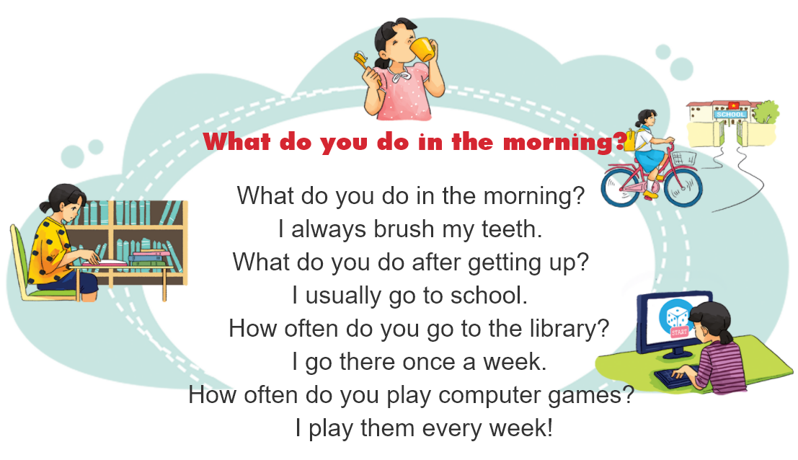

3. Let’s chant.

Slide 5
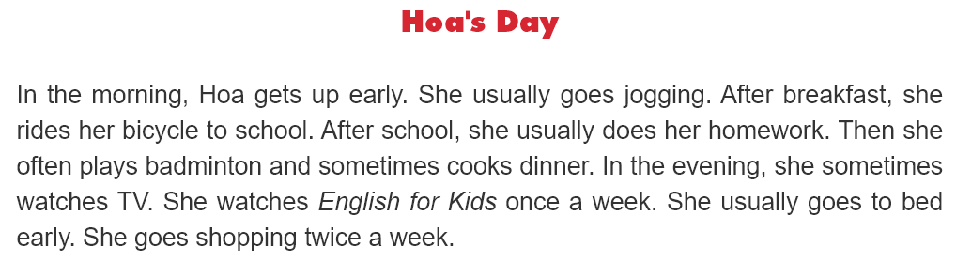
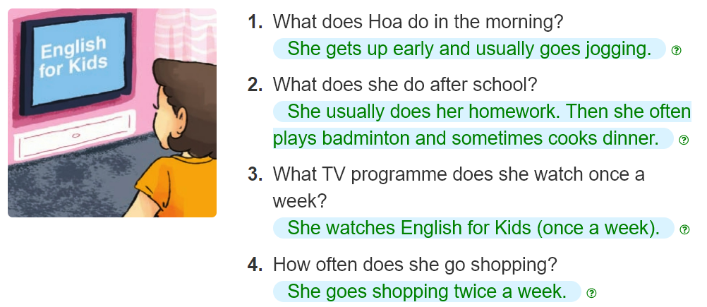
4. Read and answer.
______________________________________.
________________________________________.
______________________________________.
______________________________________.

Slide 6
5. Write about your day.
My name is ____________.
In the morning, I always____________.
In the afternoon, I usually ____________.
In the evening, I ____________.
I ____________a week.

Slide 7
6. Project.
Interview two of your classmates about their daily routines.

