Slide 1
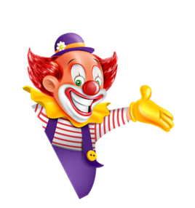

I always get up early.
How about you?
Unit
02
Lesson 2

Slide 2









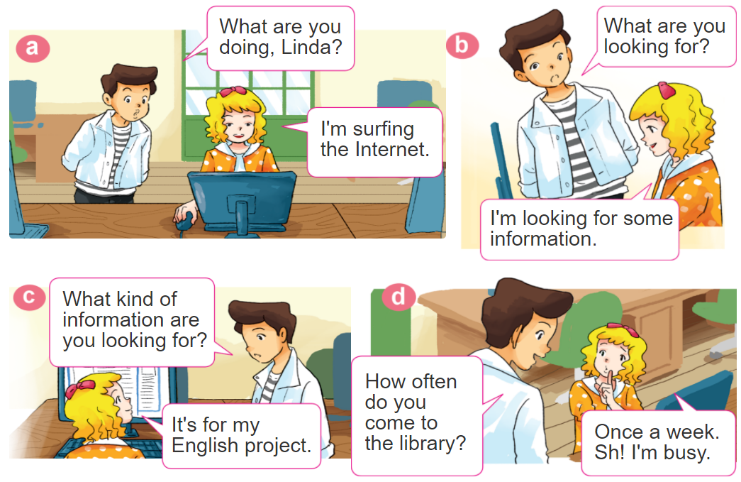
1. Look, listen and repeat

Slide 3

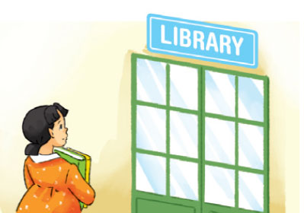
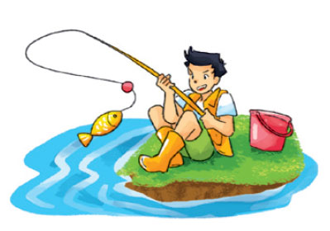
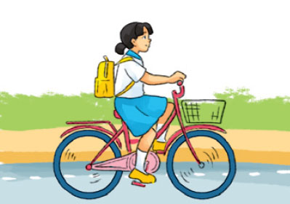
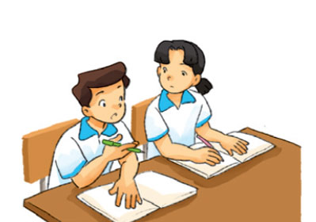




2. Point and say
study with
a partner
every day
go to the library
once a week
go fishing
once a month
ride a bicycle
to school
twice a week
How often do you ____?
I _____ _____________.

Slide 4
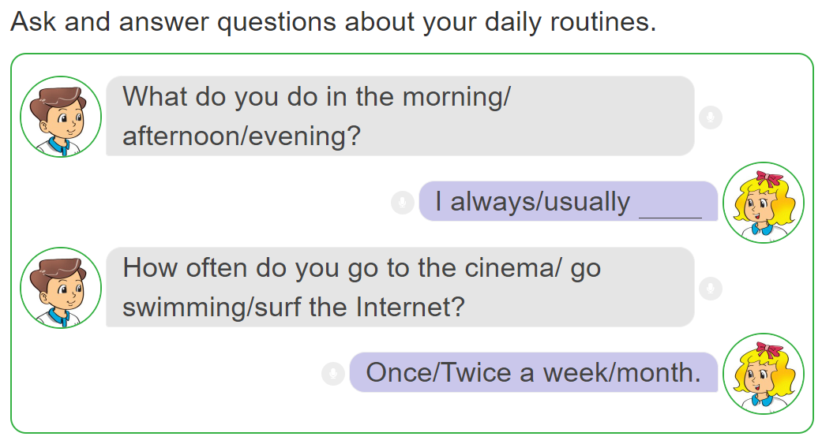
3. Let’s talk.

Slide 5
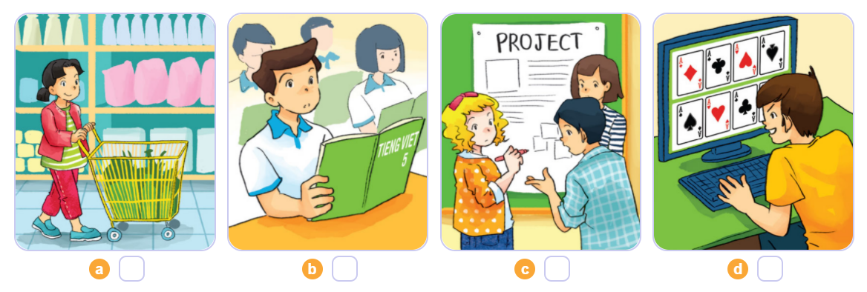
4. Listen and number
4
1
2
3
1
2
3
4

Slide 6
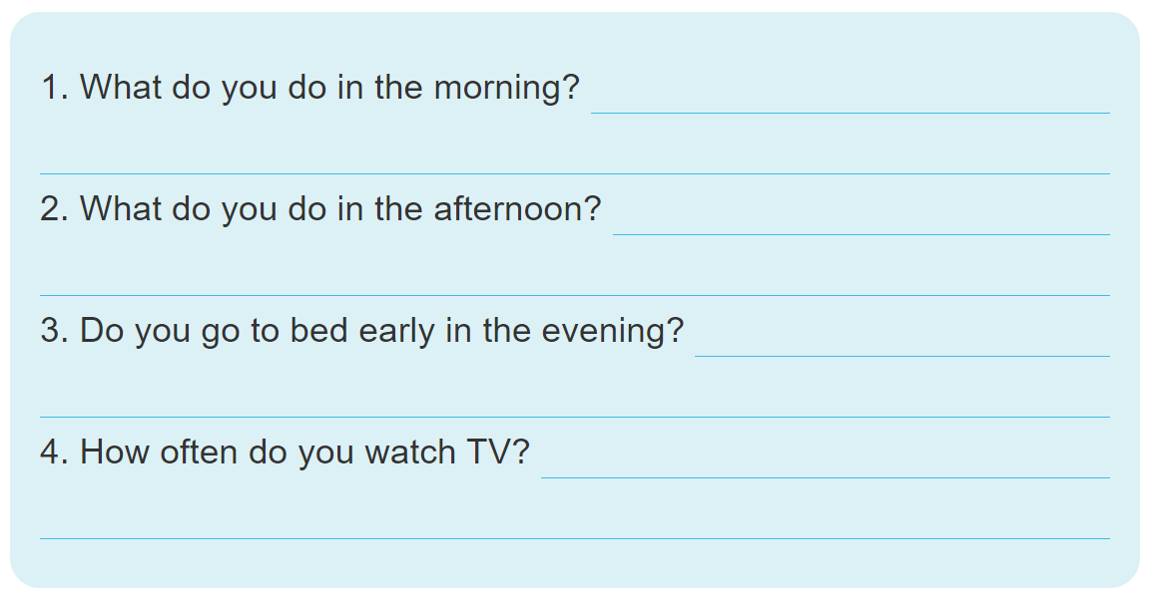
5. Write about your daily routines.

Slide 7
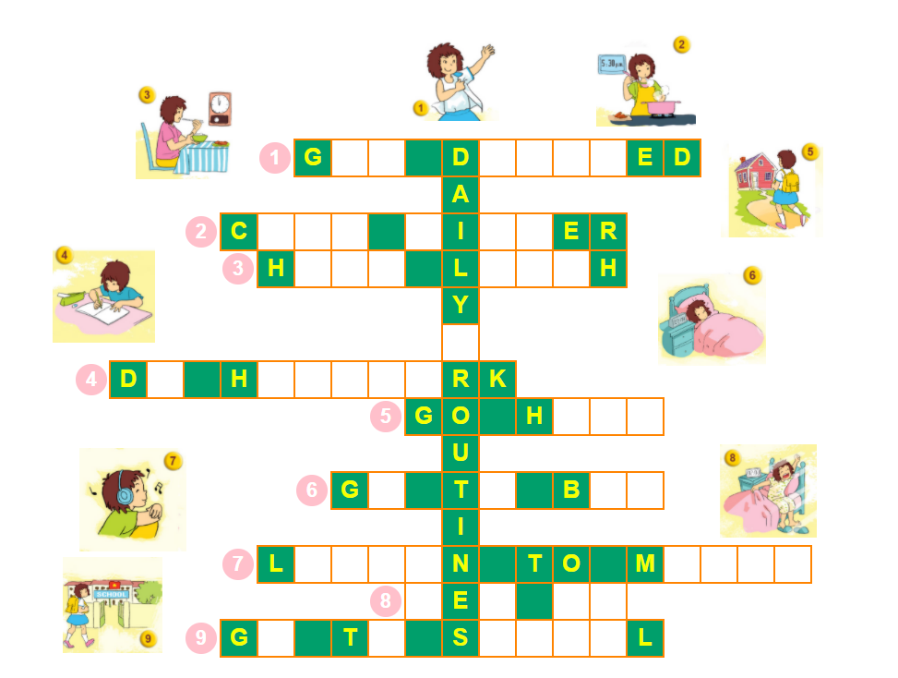
6. Let’s play.

