Slide 1
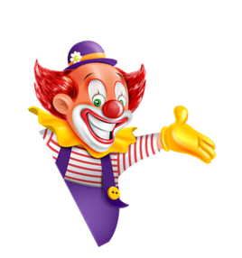

I always get up early.
How about you?
Unit
02
Lesson 1

Slide 2










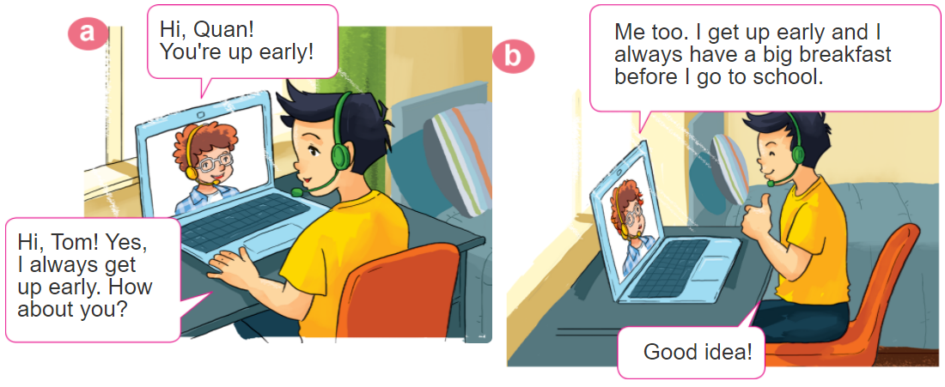
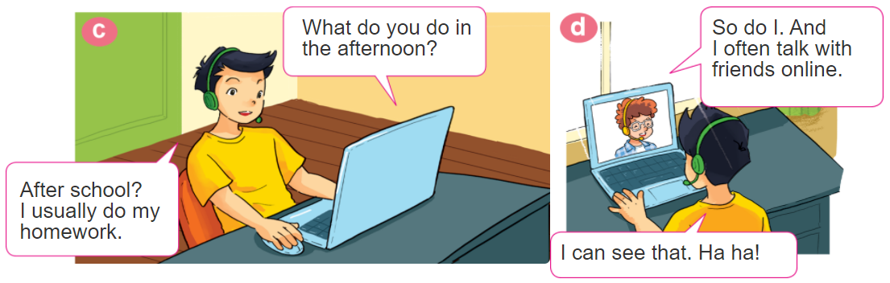
1. Look, listen and repeat

Slide 3
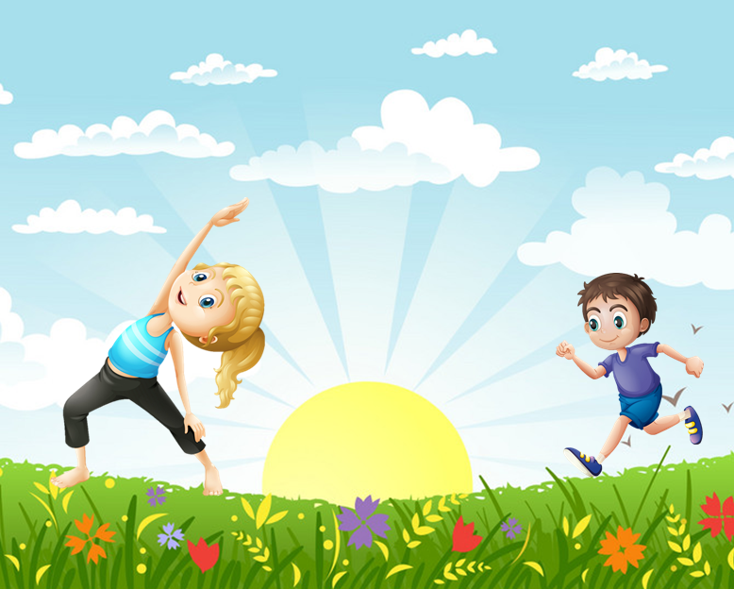
2. Point and say
What do you do in the _________?
I usually _____________________.
morning
do morning exsercise

Slide 4
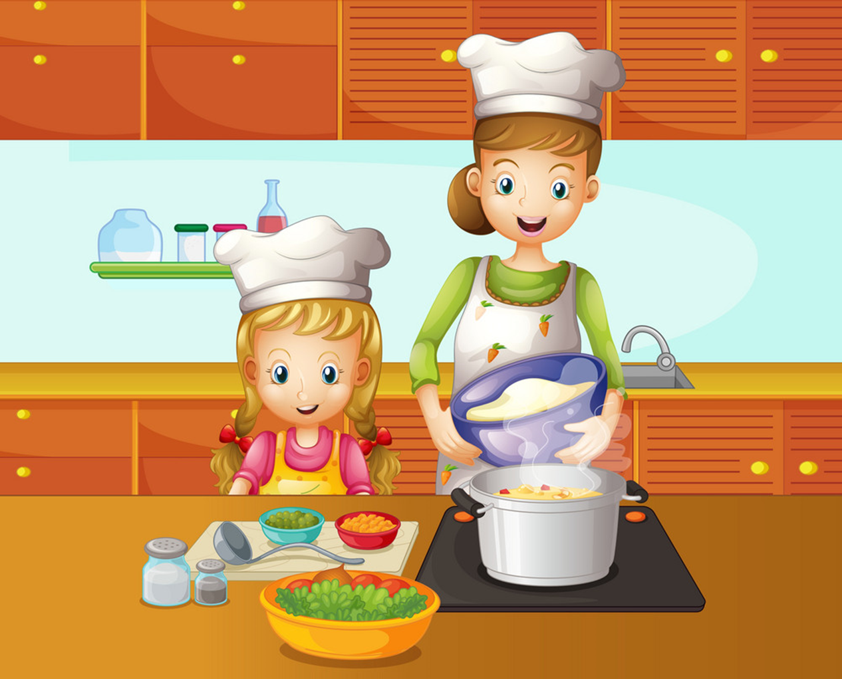
2. Point and say
What do you do in the _________?
I often ____________.
afternoon
cook dinner

Slide 5
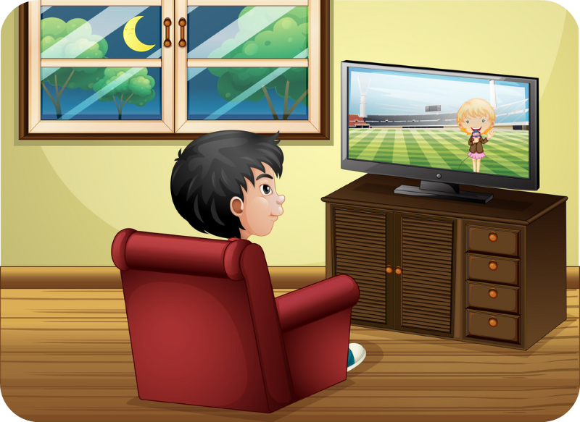
2. Point and say
What do you do in the _________?
I sometimes ____________.
evening
watch TV

Slide 6
2. Point and say
What do you do in the _________?
I usually _____________________.
morning
do morning exsercise

Slide 7
2. Point and say
What do you do in the _________?
I often ____________.
afternoon
cook dinner

Slide 8
2. Point and say
What do you do in the _________?
I sometimes ____________.
evening
watch TV

Slide 9
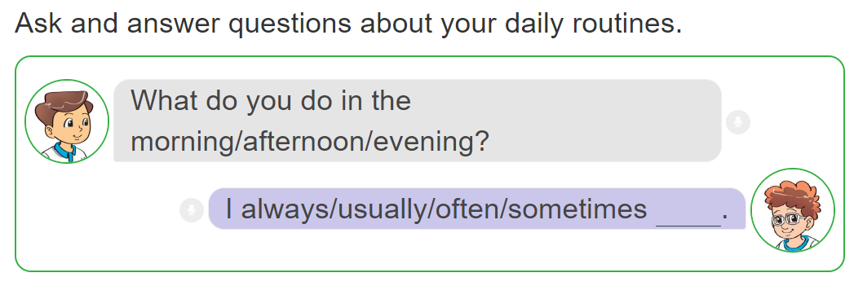
3. Let’s talk.

Slide 10
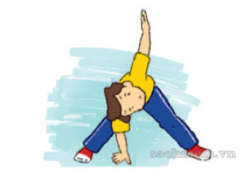
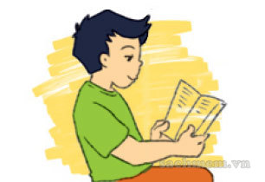
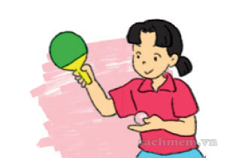
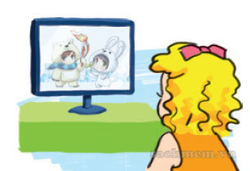
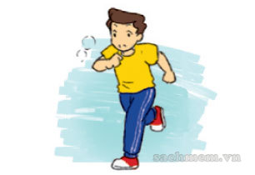
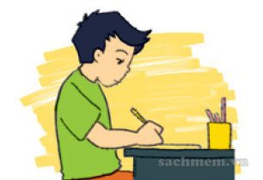
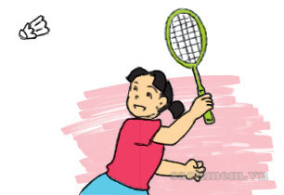
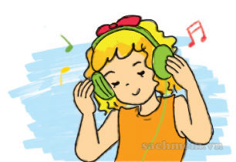
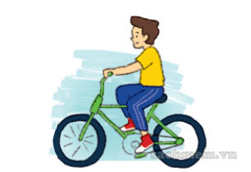
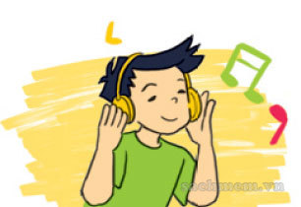
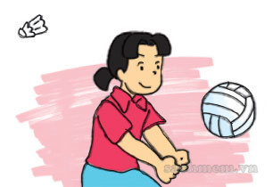
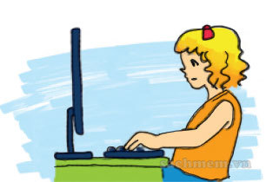
4. Listen and tick
1
2
3
4
a
a
a
a
✔
✔
b
b
b
b
✔
✔
c
c
c
c

Slide 11
5. Read and complete.
play do TV like usually
Hi. My name is Nam. Every morning, I get up early. I (1) do morning exercise, have breakfast and then go to school. After school, I (2) usually do homework with my classmates. Then I often go to the sports centre and (3) play football. In the evening, I sometimes watch (4) TV . I (5) like watching films after dinner.
_______
__________
______
______
______

Slide 12
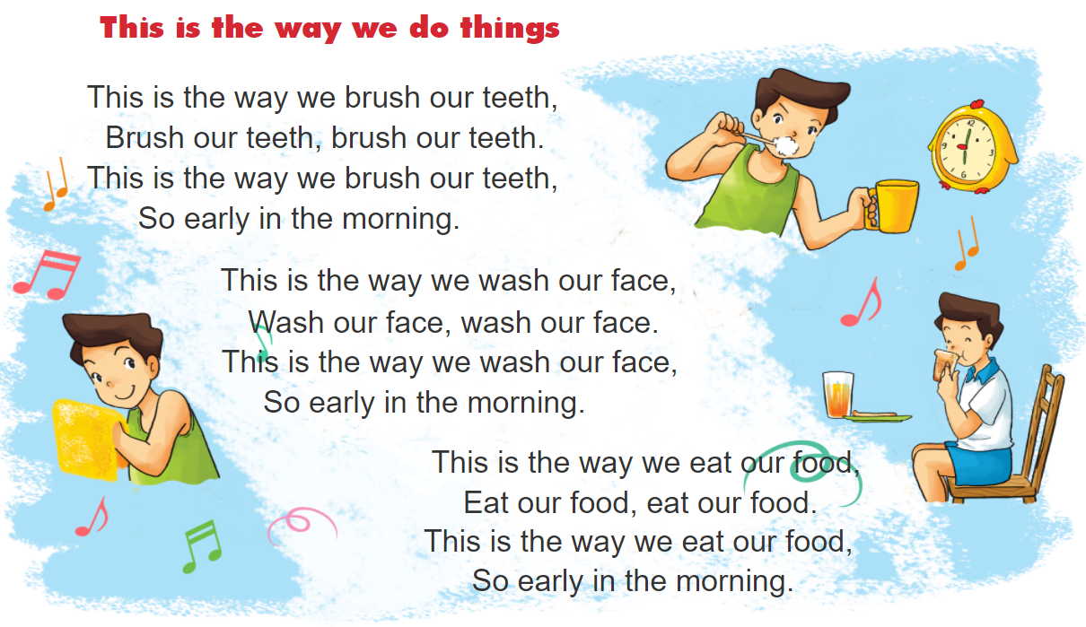

6. Let’s sing.

