Slide 1



Unit 1
What’s your address?
Lesson 3

Slide 2
PRONUNCIATION

Slide 3
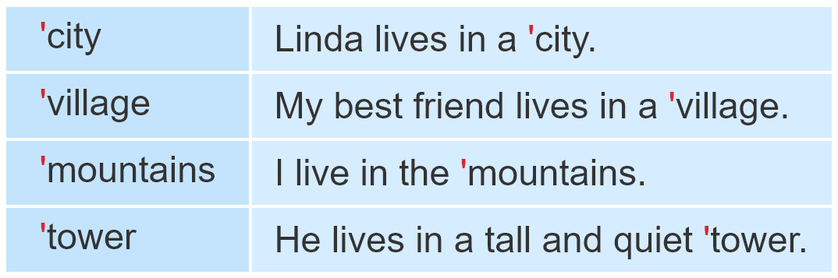
1. Listen and repeat.

Slide 4
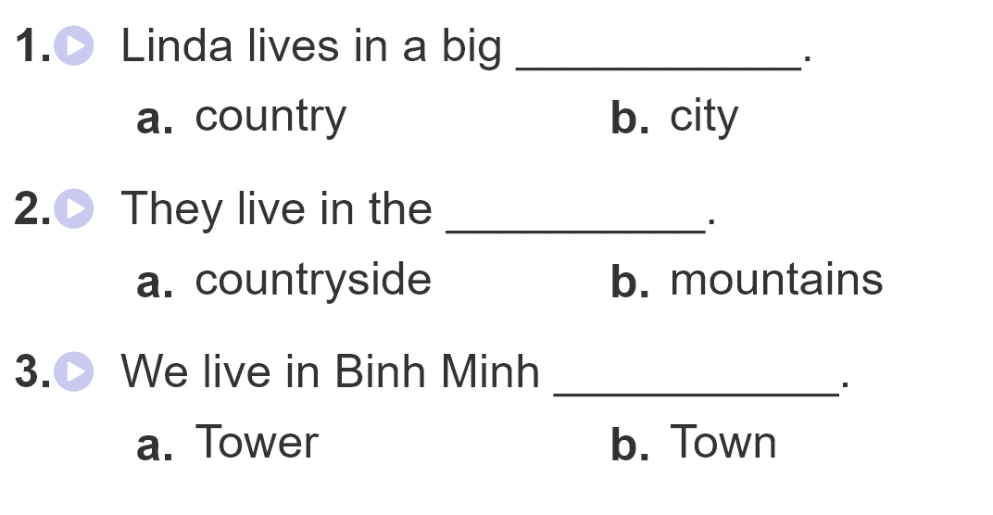
2.Listen and circle

Slide 5
PRACTISE

Slide 6
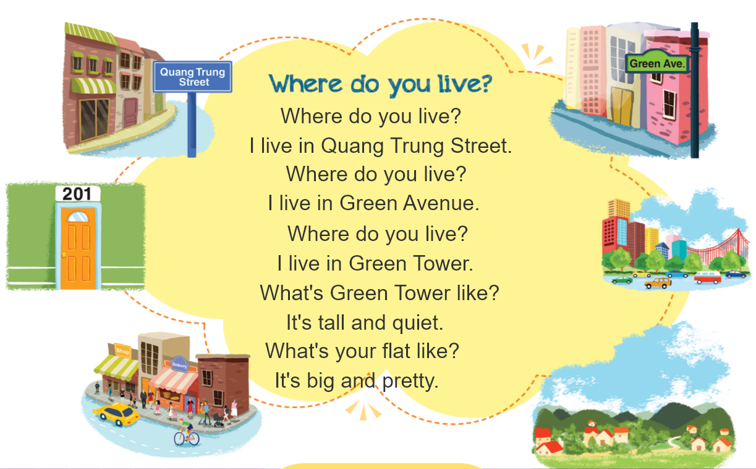

3. Let’s chant

Slide 7
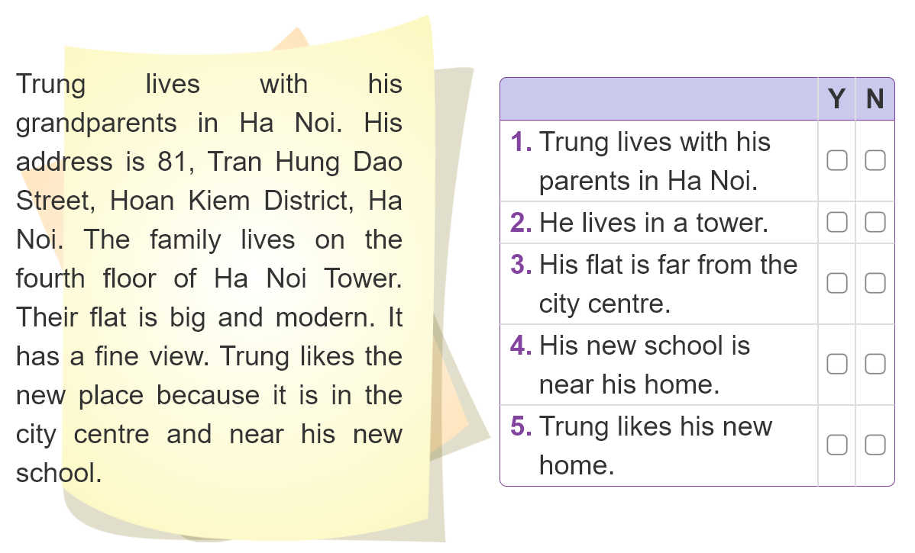

4. Listen and circle

Slide 8
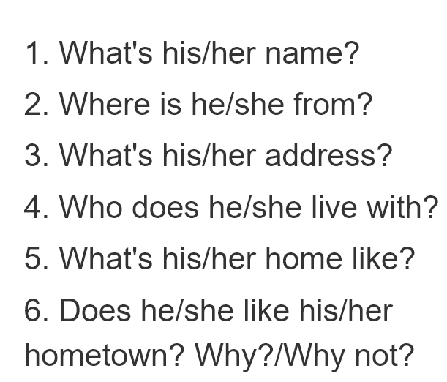
5. Write about your friend.
_________________________________________________________________________________________________________________________________________________________________________________________________________________________________________________________________________________

Slide 9
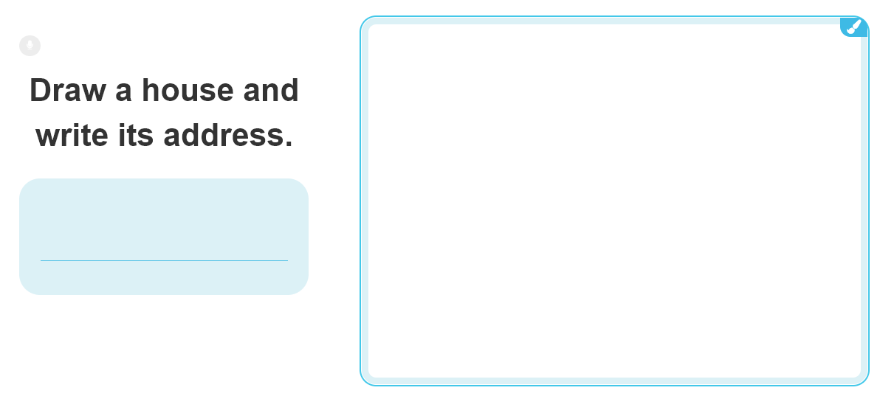
6. Let’s play

