Slide 1

UNIT 16. WHERE’S THE POST OFFICE?
LESSON 3

Slide 2
LISTEN AND REPEAT
Where’s the post office? ↷
It’s opposite the stadium. ↷
Where’s the cinema? ↷
It’s next to the post office. ↷
Where’s the supermarket? ↷
It’s on the corner of the street. ↷

Slide 3

LISTEN AND CIRCLE
a.It’s opposite the museum.
b.It’s opposite the library.
1.Where’s the cinema?
a.It’s next to the supermarket.
b.It’s next to the stadium.
2.Where’s the restaurant?
a.It’s on the corner of the street.
b.It’s at the end of the street.
3. Where’s the park?

Slide 4
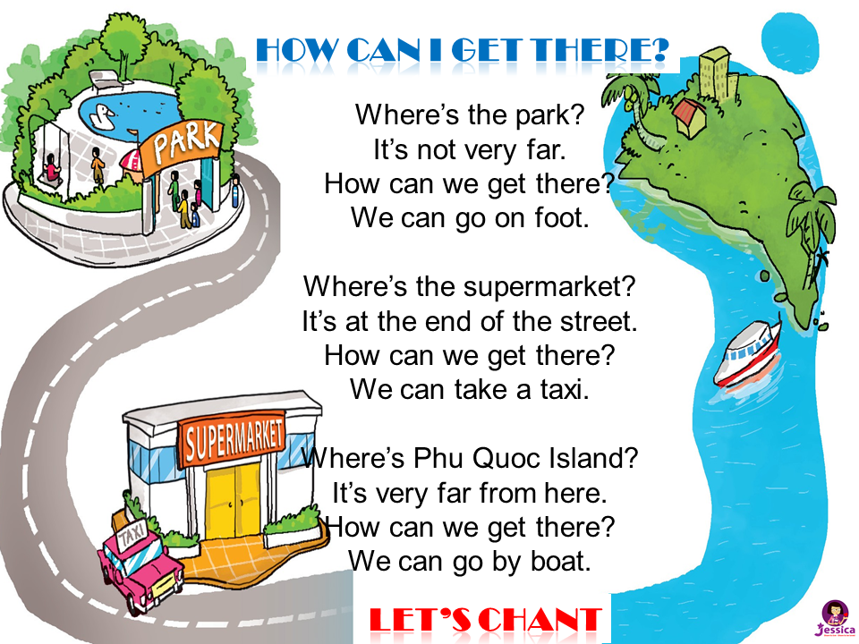


LET’S CHANT

Slide 5
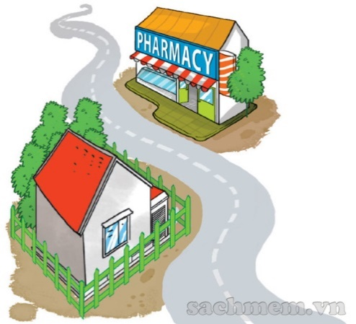
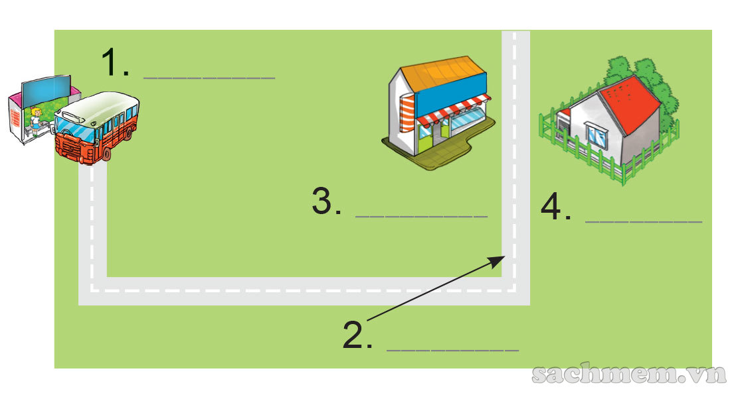
READ AND DO THE TASKS
Dear Linda, I’m happy you’re going to visit me. You can take bus
Number 12 at West Street and get off at the fifth stop.
Then walk along the street for five minutes.
You will see Pear Street at the end of the street.
Turn left and you will see a pharmacy on the left.
My house is opposite the pharmacy. It is behind a green fence. See you! Tony
Bus stop
pharmacy
Tony’s house
Pear Street

Slide 6
READ AND DO THE TASKS
Dear Linda, I’m happy you’re going to visit me. You can take bus
Number 12 at West Street and get off at the fifth stop.
Then walk along the street for five minutes.
You will see Pear Street at the end of the street.
Turn left and you will see a pharmacy on the left.
My house is opposite the pharmacy. It is behind a green fence. See you! Tony
1.What bus should Linda take?
→ She should take bus Number 12.
2.Where should she get off the bus?
→ She should get off at the fifth stop.
3.What’s the name of the road at the end of the street?
→ It’s Pear Street.
4.What’s opposite Tony’s house?
→ A pharmacy is opposite his house.
5.What colour is the fence of Tony’s house?
→ It’s green.

Slide 7
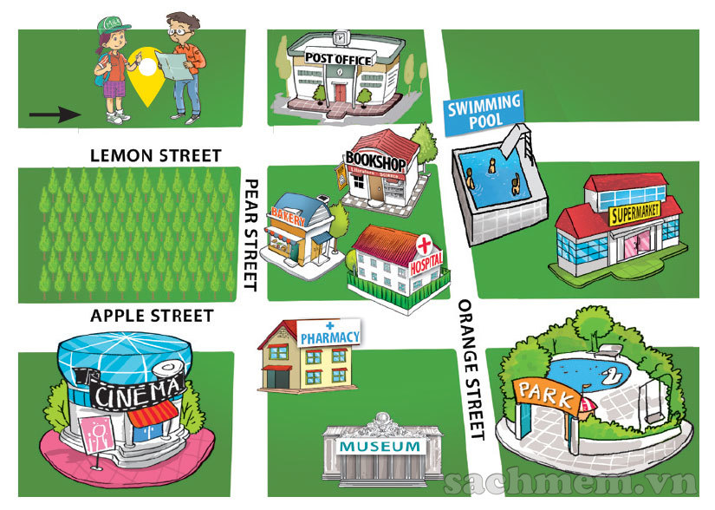
WRITE DIRECTIONS
A: Where’s the park?
B: You are here, at Lemon Street.
Go
straight ahead. Turn right at Orange Street. The park is on the corner of Orange Street and Apple Street..
A: Where’s the pharmacy?
B: Go
straight ahead. Turn right at Pear Street. The pharmacy is on the corner of Pear Street and Apple Street /straight ahead. Turn right at Pear Street. The pharmacy is opposite the cinema.

