Slide 1

UNIT 16. WHERE’S THE POST OFFICE?
LESSON 2

Slide 2
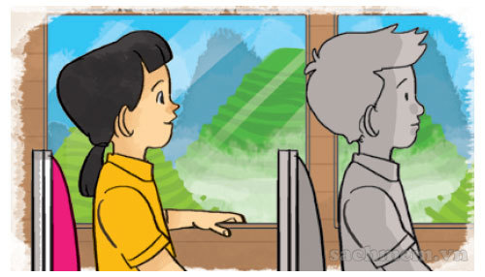
Take a coach

Slide 3
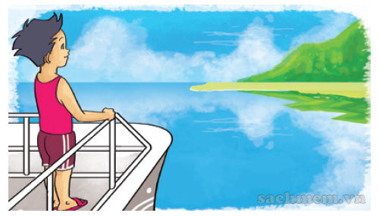
Take a boat

Slide 4
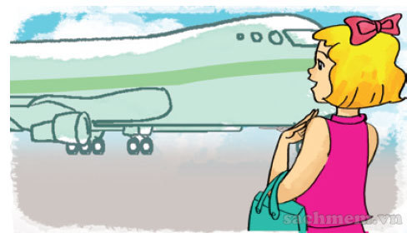
Go by plane

Slide 5
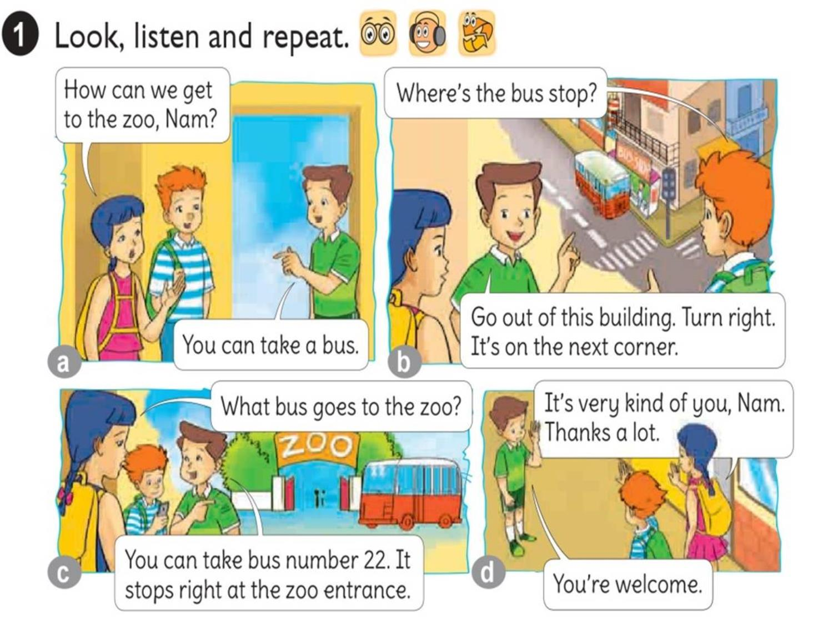




Slide 6
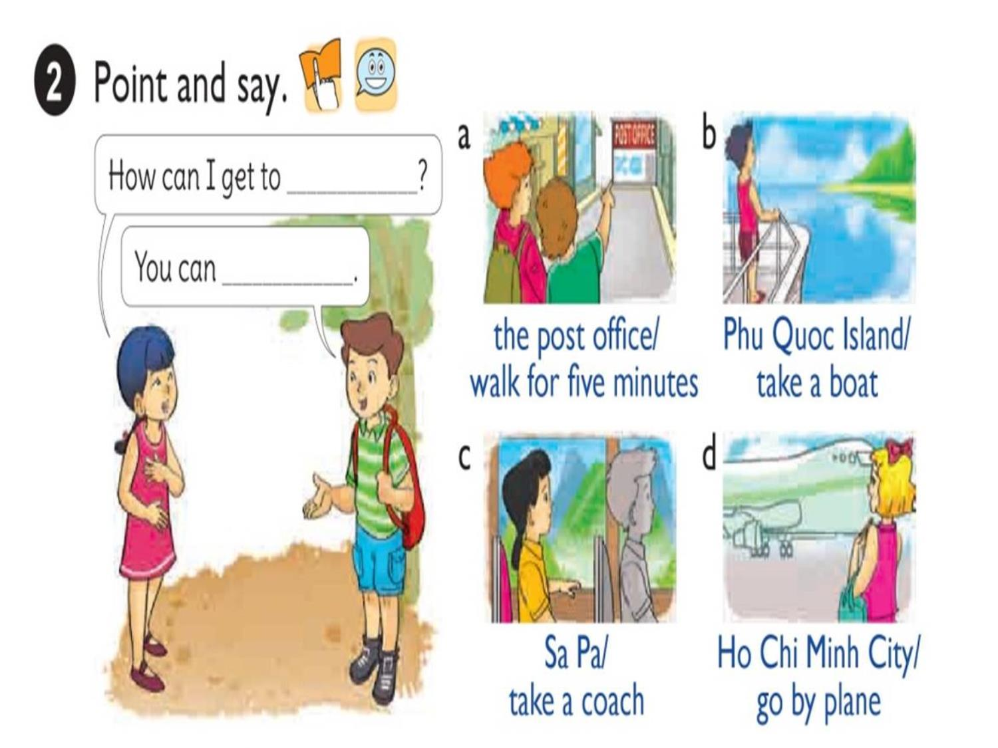

Slide 7

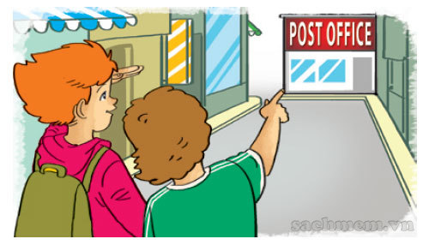
1. Vocabulary
- Take a coach
- Take a boat
- Go by plane
2. Model sentence
How can I get to the post office.
You can walk for five minutes.

Slide 8

How can I get to ?
the post office
You can
walk for five minutes.

Slide 9
How can I get to ?
Phu Quoc Island
You can
take a boat.

Slide 10
How can I get to ?
Sapa
You can
take a coach.

Slide 11
How can I get to ?
Ho Chi Minh city
You can
go by plane.

Slide 12
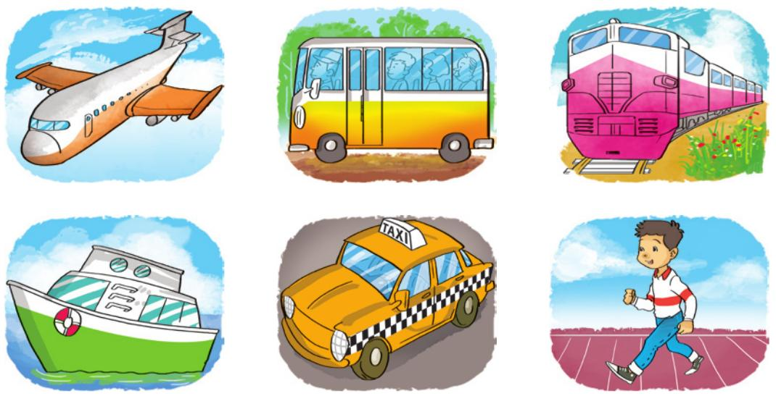
LISTEN AND WRITE
1
2
3
4
How can they get there? | By ...
1. Akiko
2. Tony
3. Mai
4. Linda
boat
taxi
coach
plane

Slide 13
Look, READ AND COMPLETE
Mai: We’re going to have a school (1) next weekend.
Akiko: Where are you going?
Mai: We’re going to the (2)
Akiko: Is it far from your school?
Mai: No, it isn’t.
Akiko: How are you going to get there?
Mai: On (3)
trip
how
zoo
welcome
foot
foot
Tony: I’ll go to Ho Chi Minh City tomorrow.
Mai: (4) are you going to get there?
Tony: By plane because I don’t have much time.
Mai: (5) a nice trip!
Tony: Thanks a lot, Mai.
Mai: You’re (6)
have
How
trip
Have
zoo
Welcome

Slide 14
