Slide 1

UNIT 16. WHERE’S THE POST OFFICE?
LESSON 1

Slide 2
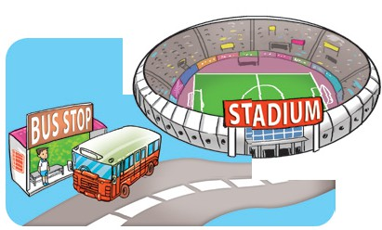
next to

Slide 3
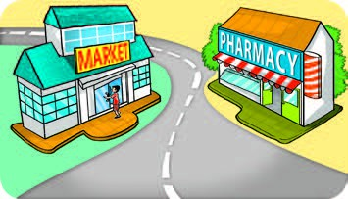
opposite

Slide 4
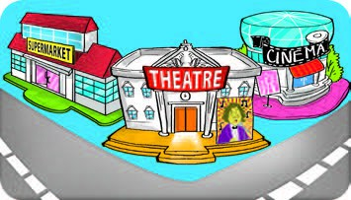
Theatre / between

Slide 5
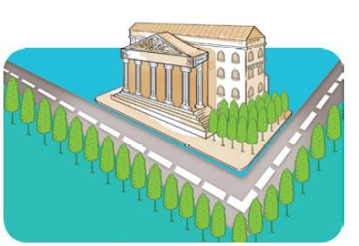
museum
On the corner of street

Slide 6
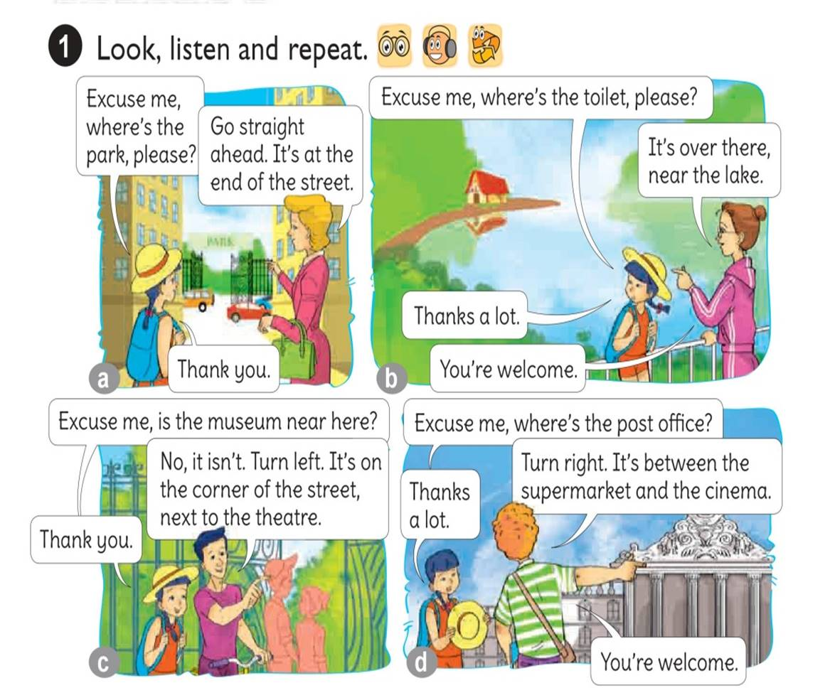




Slide 7
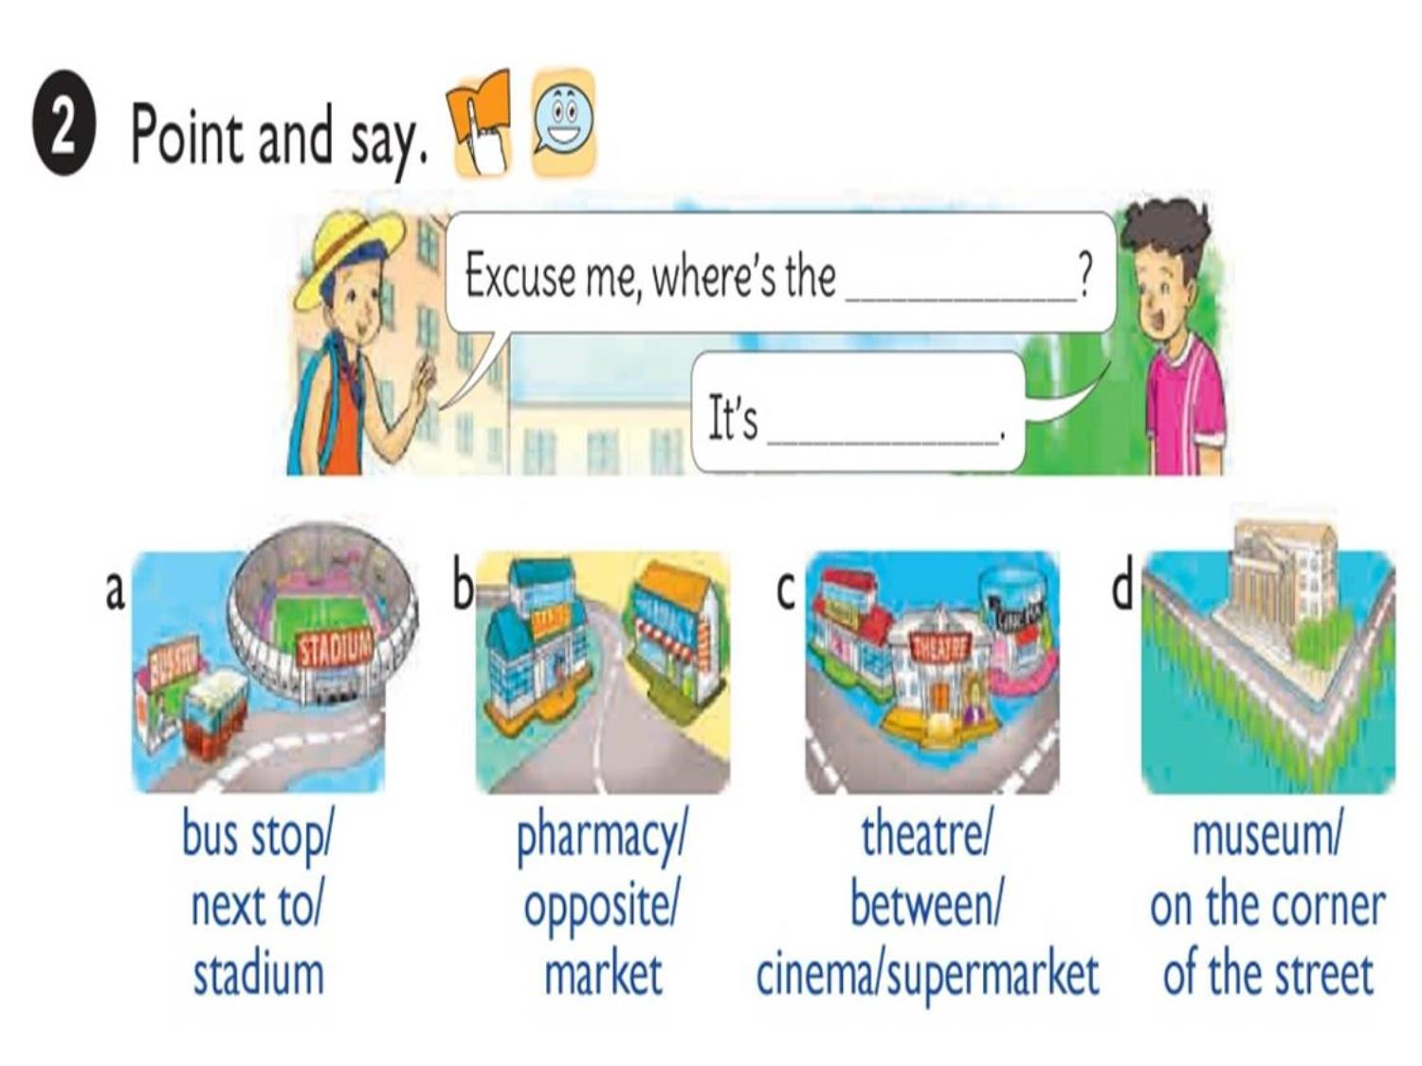

Slide 8

1. Vocabulary
- bus stop
- stadium
- market
- theatre
- museum
- opposite
- the coner
2. Model sentence
Where’s the bus stop?
It’s next to stadium.

Slide 9
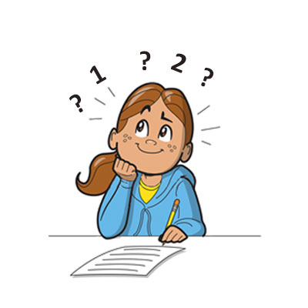
Where’s ?
the bus stop
It’s
next to the stadium.

Slide 10
Where’s ?
the pharmacy
It’s
opposite the market.

Slide 11
Where’s ?
the theatre
It’s
between the supermarket and the cinema.

Slide 12
Where’s ?
the museum
It’s
on the corner of street.

Slide 13




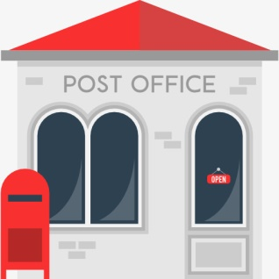

LISTEN AND TICK
Opposite the pharmacy
Between the supermarket and the cinema
Next to the stadium
Go along the street and turn left

Slide 14
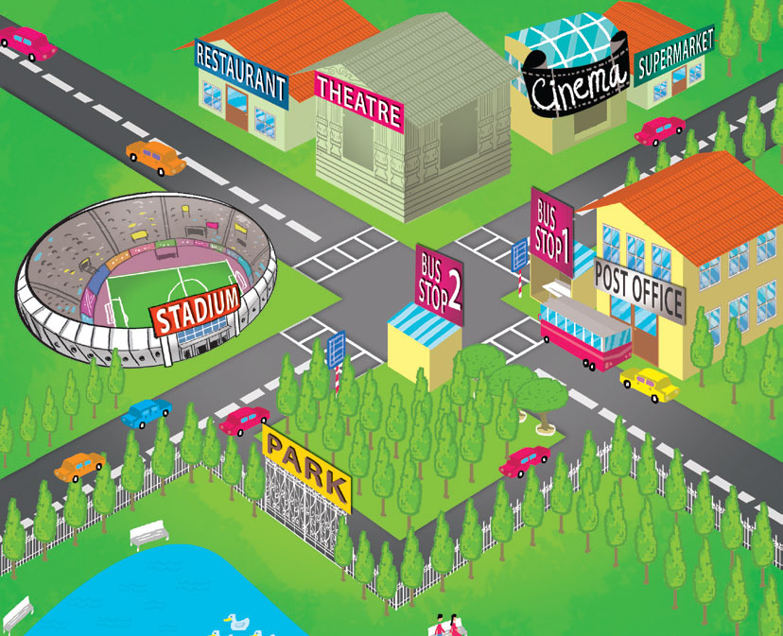
Look, READ AND COMPLETE
between
On the coner
opposite
Next to
1.The theatre is the stadium.
2.The cinema is the theatre and the supermarket.
3.The stadium is of the street.
4.Bus stop 1 is Bus stop 2.
5.The post office is Bus stop
opposite
between
on the coner
opposite
next to

Slide 15
