Slide 1

UNIT 15. WHAT WOULD YOU LIKE
TO BE IN THE FUTURE?
LESSON 3

Slide 2
LISTEN AND REPEAT
What would you like to be in the future? ↷
I’d like to be a nurse. ↷
Why would you like to be a nurse? ↷
Because I’d like to look after patients. ↷

Slide 3
LISTEN AND MARK THE SENTENCE INNOTATION
A: What would he like to be in the future?
B: He’d like to be a teacher.
1
A: Where would he like to work?
B: He’d like to work in a school.
2
A: Why would he like to be a teacher?
B: Because he’d like to teach young children.
3

Slide 4
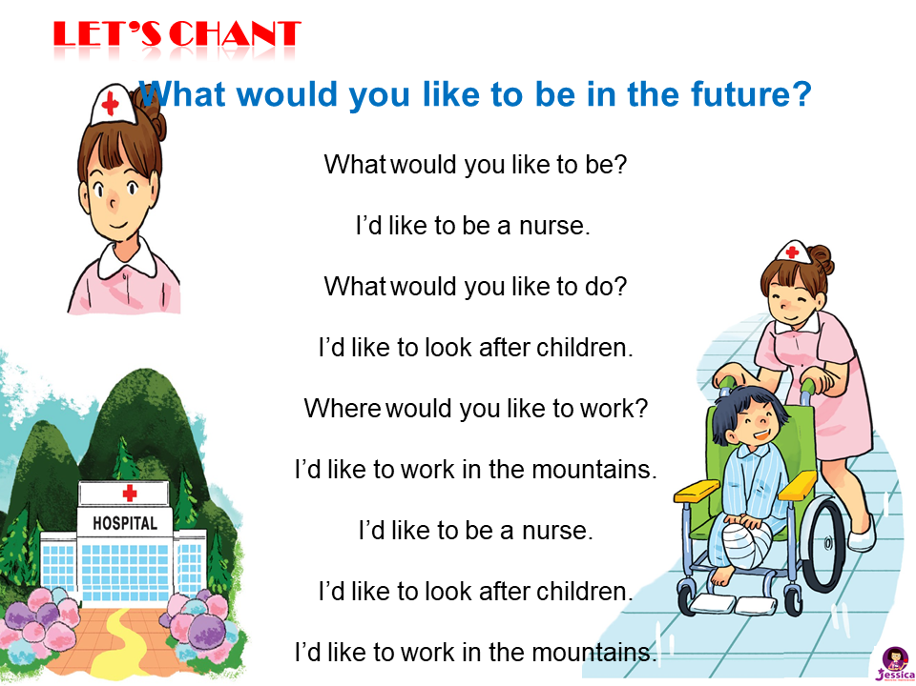

LET’S CHANT

Slide 5
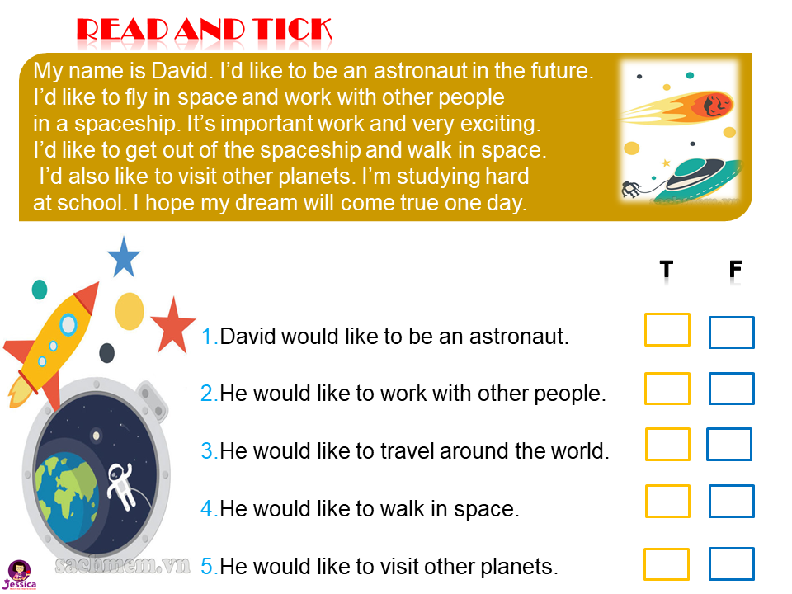

READ AND TICK
T
F

Slide 6
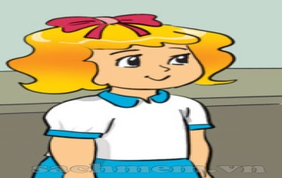
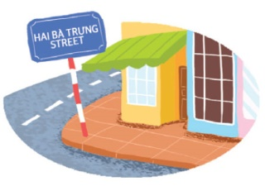
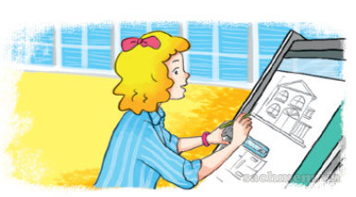


WRITE ABOUT YOUR FUTURE JOB
My name is
I’m studying at
I’d like to be in the future.
I’d like to
In my free time, I’d like
Linda.
Nguyen Du Primary School.
an architect
design buildings.
to go to the cinema.

