Slide 1

UNIT 15. WHAT WOULD YOU LIKE
TO BE IN THE FUTURE?
LESSON 1

Slide 2



Slide 3

pilot

Slide 4

doctor

Slide 5
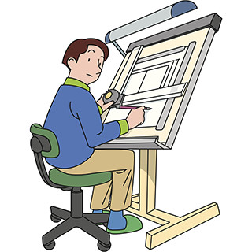
architect

Slide 6

writer

Slide 7
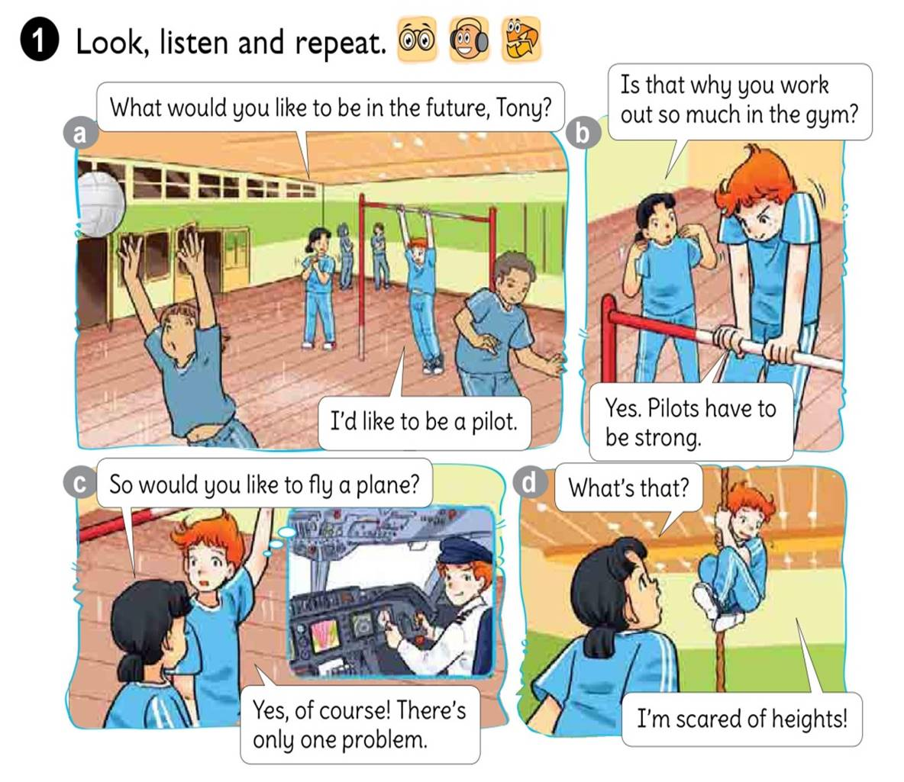




Slide 8
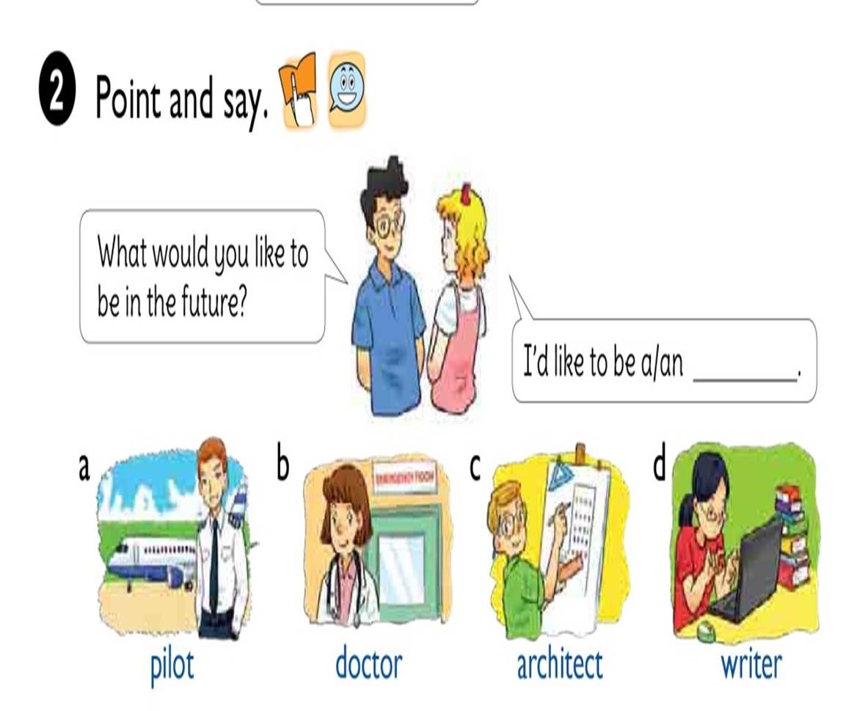

Slide 9




1. Vocabulary
- future
- pilot
- doctor
- architect
- writer
2. Model sentence
What would you like to be in the future?
I’d like to be a writer.

Slide 10

What would you like to be in the future?
I’d like to be a
pilot.

Slide 11

What would you like to be in the future?
I’d like to be a
doctor.

Slide 12
What would you like to be in the future?
I’d like to be an
architect.

Slide 13
What would you like to be in the future?
I’d like to be a
writer.

Slide 14


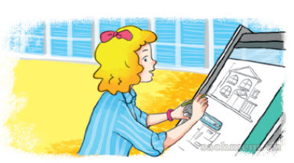
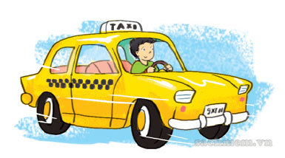


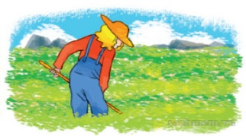
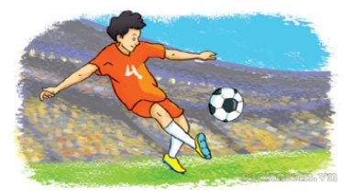
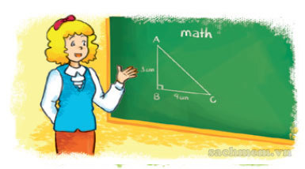
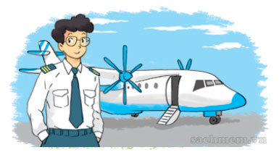

LISTEN AND TICK
1
2
3

Slide 15

Look and write
1
A: What would you like to be in the future, Hoa?
B: I’d
like to be a teacher.

Slide 16
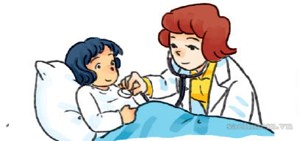
Look and write
2
A: What would she like to be when she grows up?
B: She’d
like to be a doctor.

Slide 17
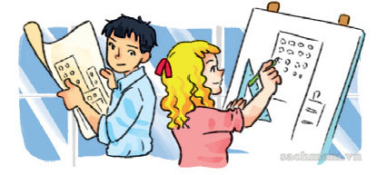
Look and write
3
A: What would Linda and Trung like to do when the leave school?
B: They’d
like to be architects.

Slide 18
