Slide 1

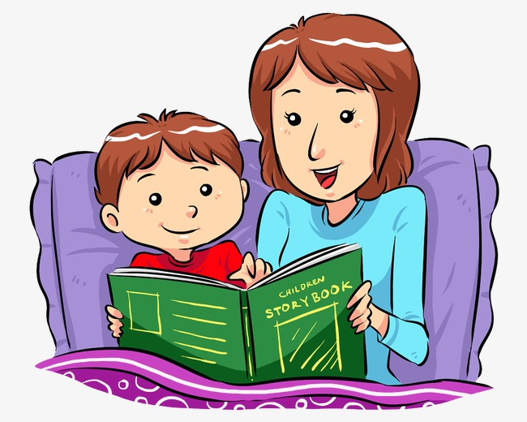
UNIT 14. WHAT HAPPEN
IN THE STORY?
LESSON 3

Slide 2
What happened in the story? ↷
LISTEN AND REPEAT
First, King Hung ordered Mai An Tiem and his family to live on an island. ↷
Then one day, An Tiem found some black seeds and he grew them. ↷
Next, An Tiem’s family exchanged the watermelons for food and drink. ↷
In the end, King Hung let An Tiem and his family go back home. ↷

Slide 3

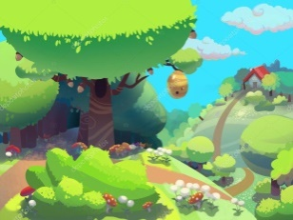

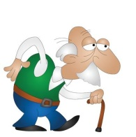
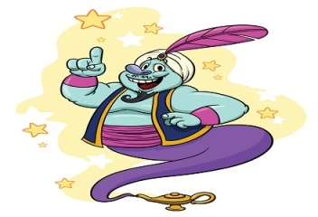
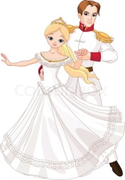
LISTEN AND CIRCLE
1.First, the poor girl went to the _________.
a.castle b.forest
2.Then she met a/an _________.
a.young man b.old man
3.Next, he gave her three _________.
a.wishes b.apples
4.In the end, she _________.
a.married a prince b.became a queen

Slide 4
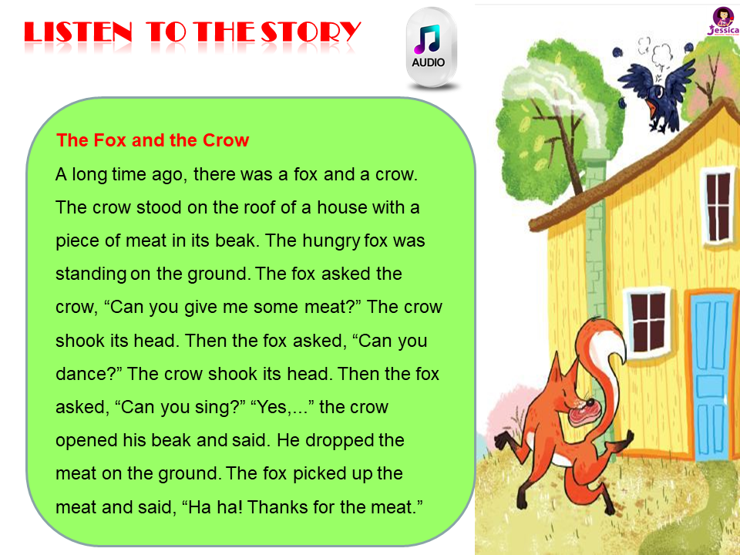
LISTEN to the story

Slide 5
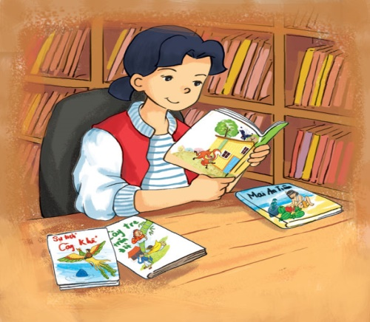
READ AND write
Hi, I’m Mai. My hobby is reading folk tales. Folk tales are usually short and interesting. They often give me one surprise after another.
The characters are sometimes honest, sometimes greedy,
sometimes wise, sometimes stupid. I like
The Fox and the Crow very much. The fox was clever
and the crow was not. The crow lost its delicious meat
and the fox got it. I love folk tales very much b
ecause each of them gives me a lesson in life.
1.What kinds of stories does Mai like reading?
→ She likes reading folk tales.
2.What does she think of folk tales?
→ She thinks they are usually short and interesting.
3.What does she think of the characters in folk tales?
→ She thinks the characters are sometimes honest, sometimes greedy, sometimes wise, sometimes stupid.
4.What does she think of the characters in The Fox and the Crow?
→ She thinks the fox was clever and the crow was not.
5.Why does she love folk tales?
→ Because each of them gives her a lesson in life.

Slide 6

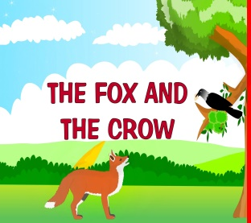
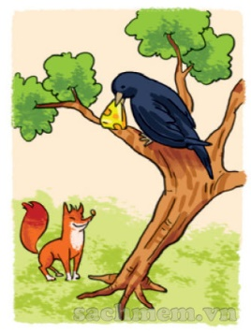
WRITE ABOUT the characters in your story
My favourite story is
The main characters are
I Iike because he is
The Fox and The Crow
The Fox and The Crow
the fox
very intelligent.

