Slide 1

UNIT 13. WHAT DO YOU DO IN YOUR FREE TIME?
LESSON 3

Slide 2
LISTEN AND REPEAT
What do you do in your free time? ↷
I surf the Internet. ↷
What does he do in his free time? ↷
He listens to music. ↷
What does she do in her free time? ↷
She goes shopping. ↷
What do they do in their free time? ↷
They go camping. ↷

Slide 3

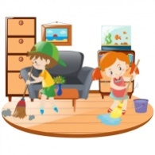
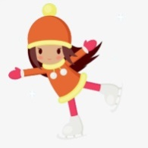
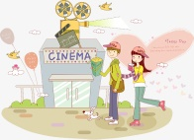

LISTEN AND CIRCLE
1. What do you do in your free time? I ___________.
a.clean the house b.watch cartoons
2.What does she do in her free time? She ___________.
a.goes skating b.goes fishing
3.What does he do in his free time? He ___________.
a.does karate b.goes to the cinema
4.What do they do in their free time? They ___________.
a.work in the garden b.go shopping

Slide 4
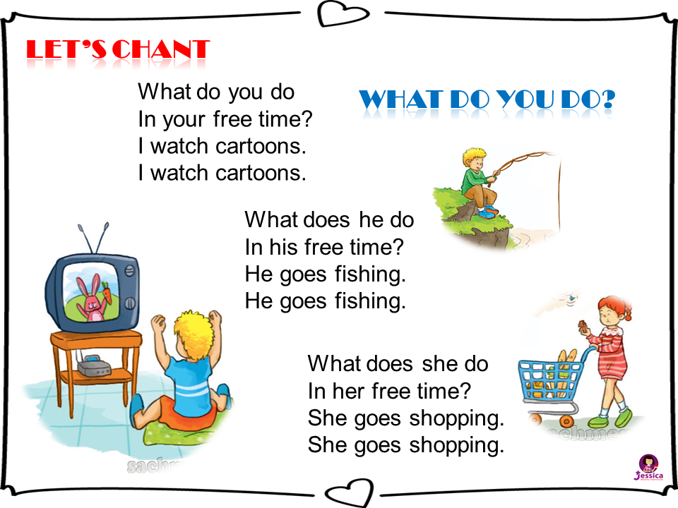


Slide 5
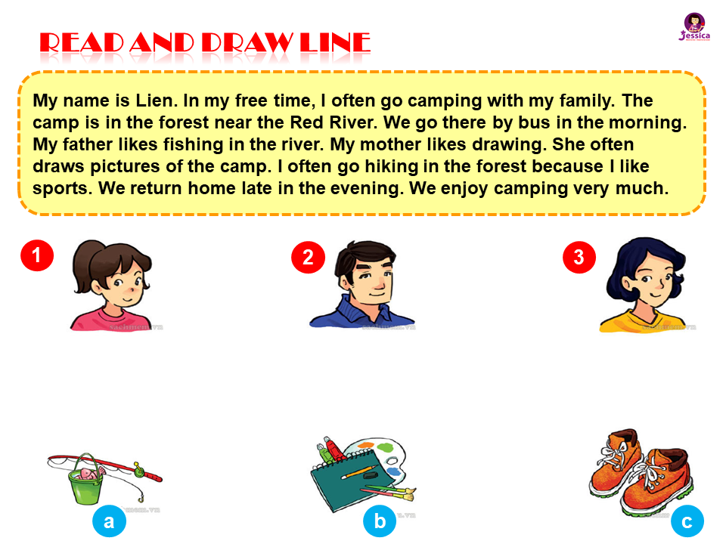
READ AND DRAW LINE
1
2
3
b
c

Slide 6

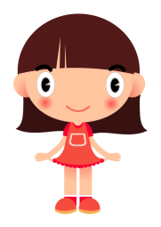
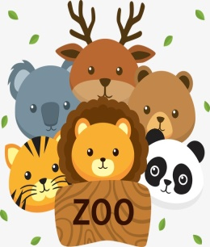
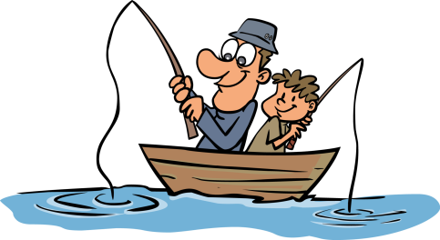


WRITE ABOUT YOUR FAMILY
My name is
At weekends, I often
My father
My mother
My brother
Sarah.
go to the zoo.
usually goes fishing.
sometimes goes shopping.
always surf the Internet.

