Slide 1

UNIT 13. WHAT DO YOU DO IN YOUR FREE TIME?
LESSON 1

Slide 2

Surf the internet

Slide 3
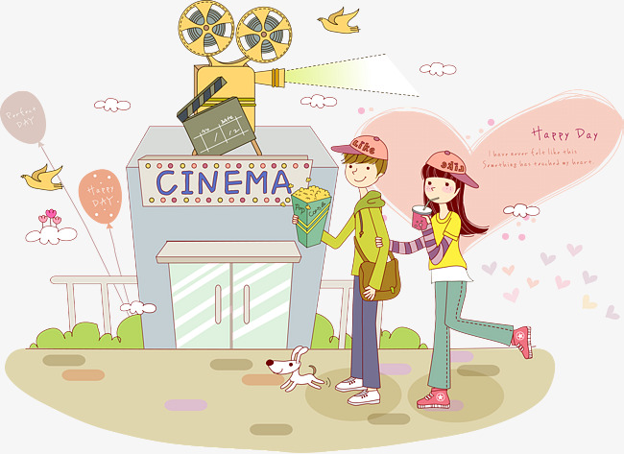
Go to the cinema

Slide 4
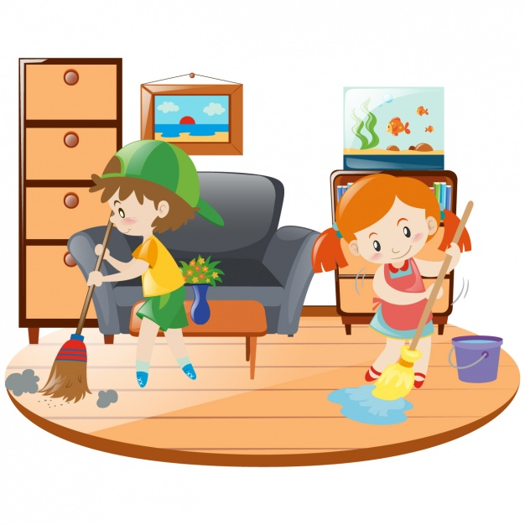
Clean the house

Slide 5
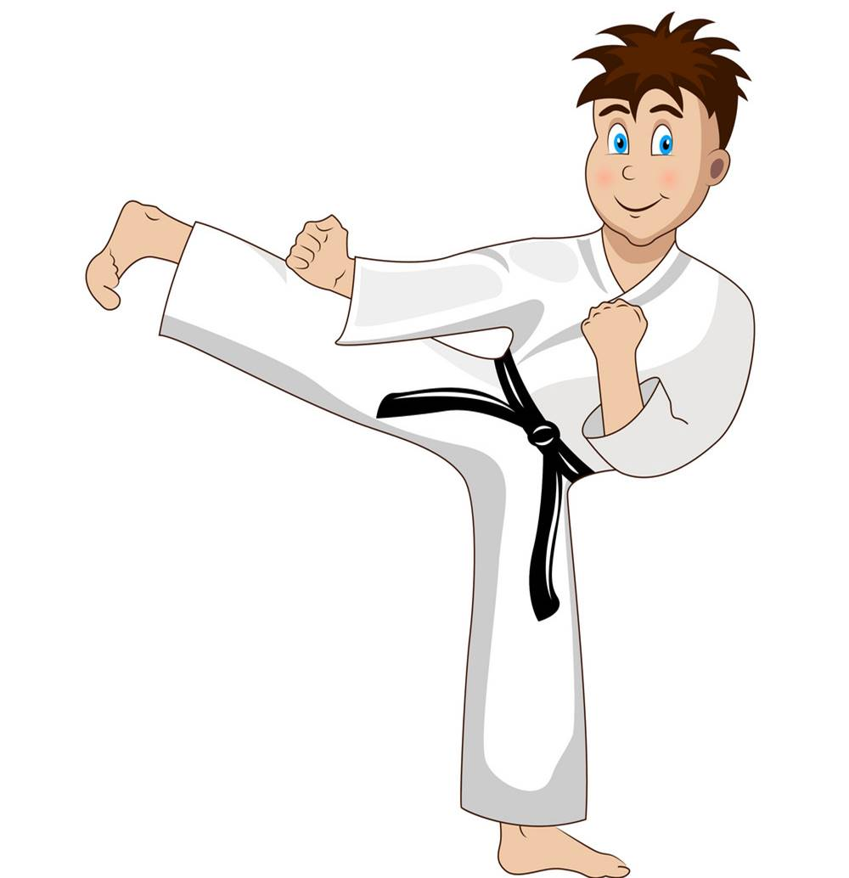
Do karate

Slide 6
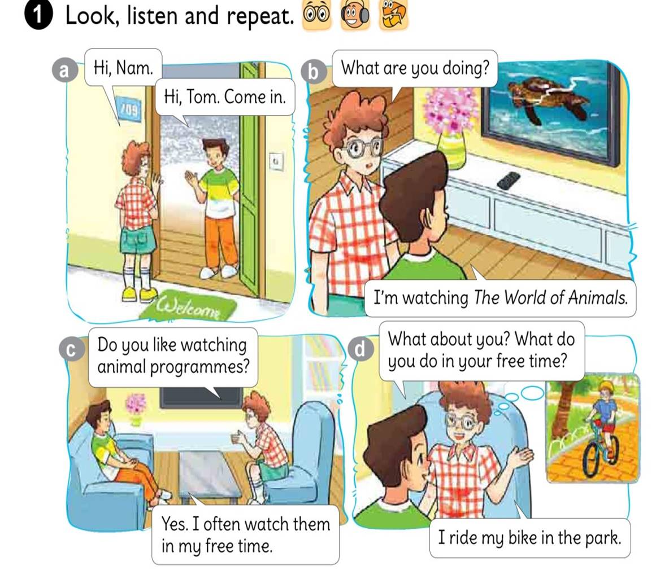




Slide 7


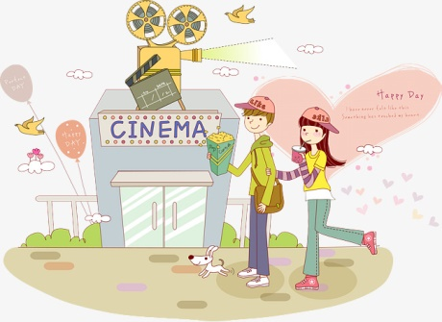

1. Vocabulary
- surf the Internet
- go to the cinema
- clean the house
- do karate
2. Model sentence
What do you do in your freetime?
I surf the Internet.

Slide 8
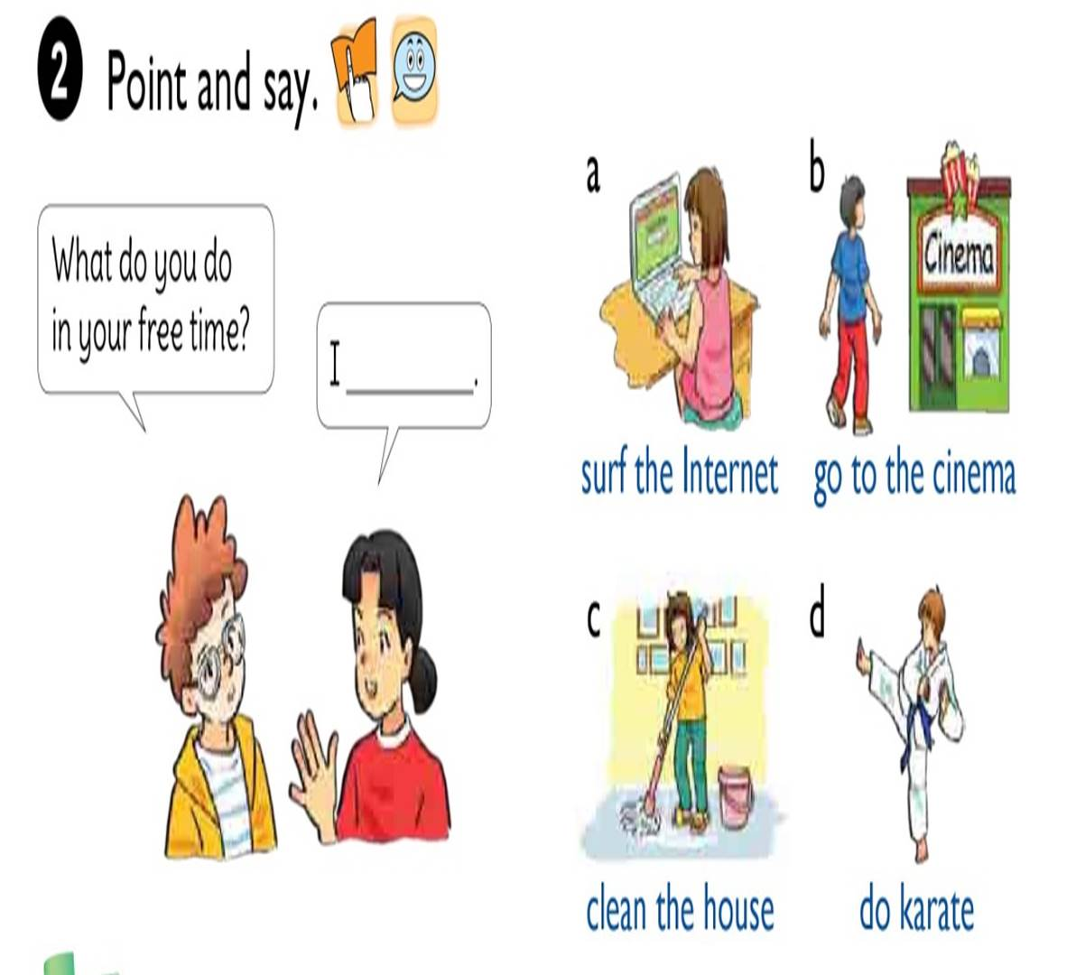

Slide 9
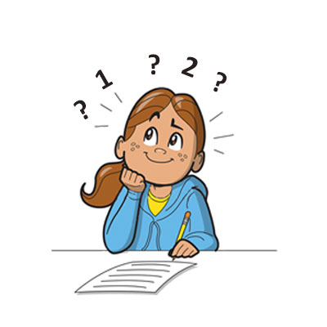

What do you do in your free time?
I
surf the Internet.

Slide 10
What do you do in your free time?
I
go to the cinema.

Slide 11

What do you do in your free time?
I
clean the house.

Slide 12

What do you do in your free time?
I
do karate.

Slide 13


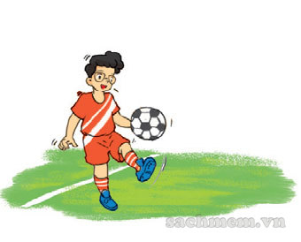


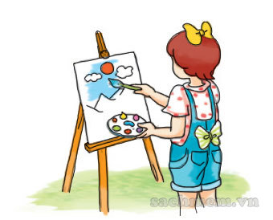

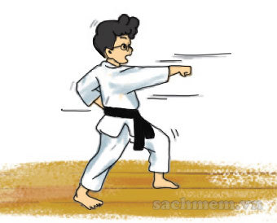

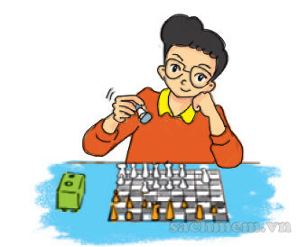
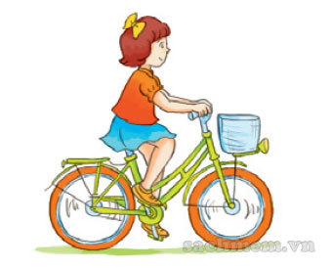
LISTEN AND TICK
1
2
3

Slide 14
READ AND COMPLETE
watch
free
songs
go
twice
Hoa: What do you do in your (1) time, Quan?
Quan: I often (2) sports programmes on TV. What about you, Hoa?
Hoa: I (3) to the music club with my friends.
Quan: How often do you go to the music club?
Hoa: (4) a week.
Quan: What do you do there?
Hoa: I dance and sing (5) .
free
watch
go
Twice
songs

Slide 15

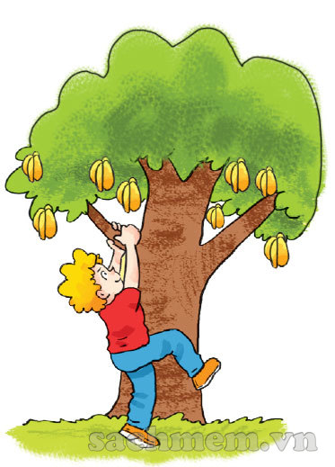
LET’S play

