Slide 1

UNIT 12. DON’T RIDE YOUR BIKE TOO FAST!
LESSON 1

Slide 2
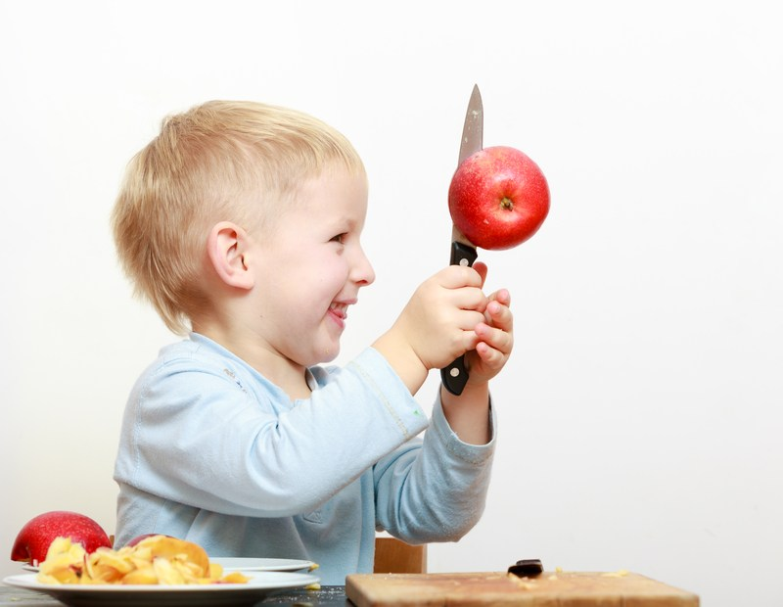

Play with the knife

Slide 3

Play with matches

Slide 4
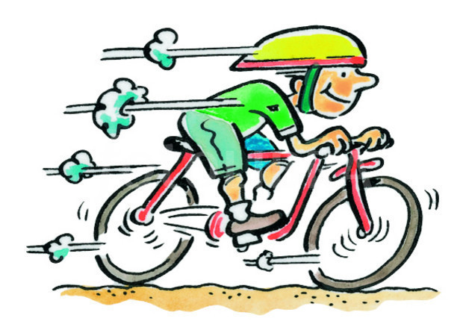
Ride your bike too fast

Slide 5
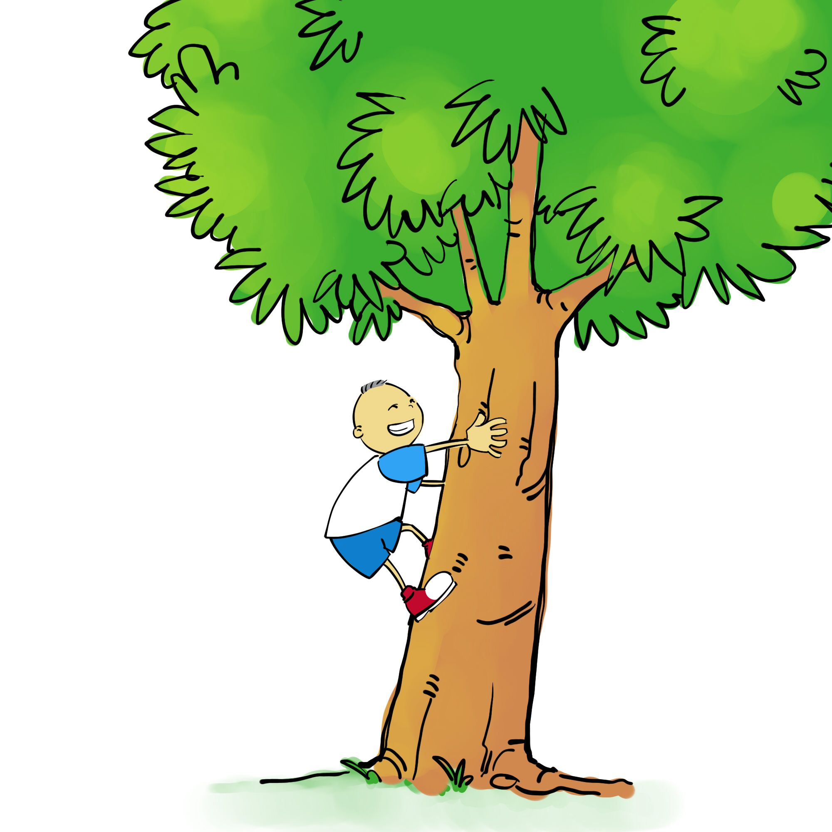
Climb the tree

Slide 6
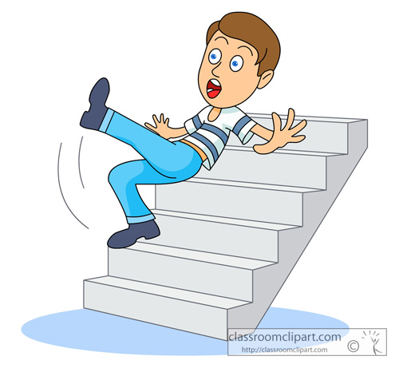
Run down the stairs

Slide 7
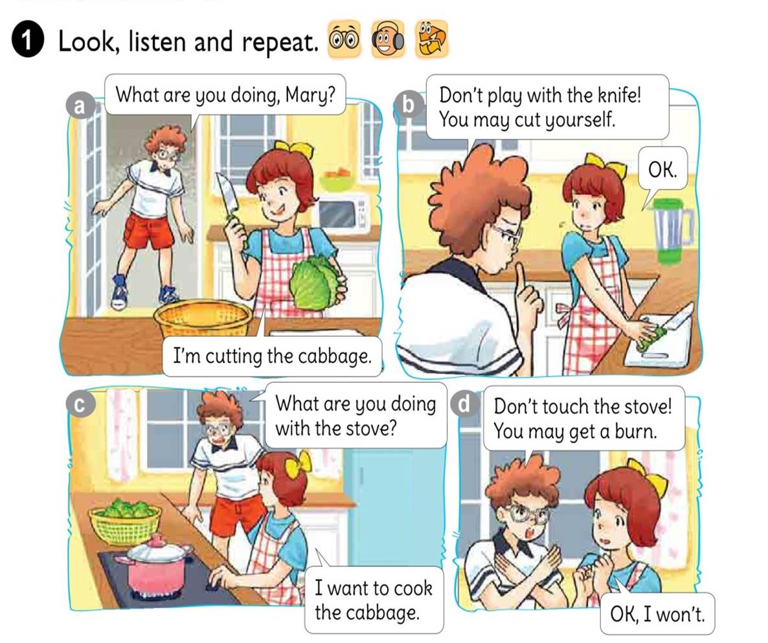



Slide 8

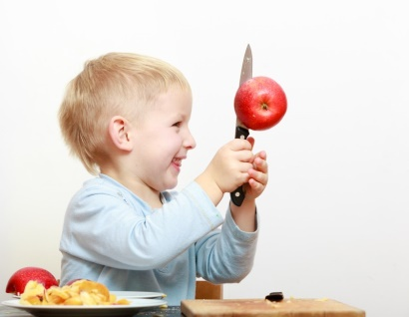



1. Vocabulary
- play with the knife
- play with matches
- ride your bike too fast
- climb the tree
- run down the stairs
2. Model sentence
Don’t ride your bike too fast.
OK, I won’t.

Slide 9
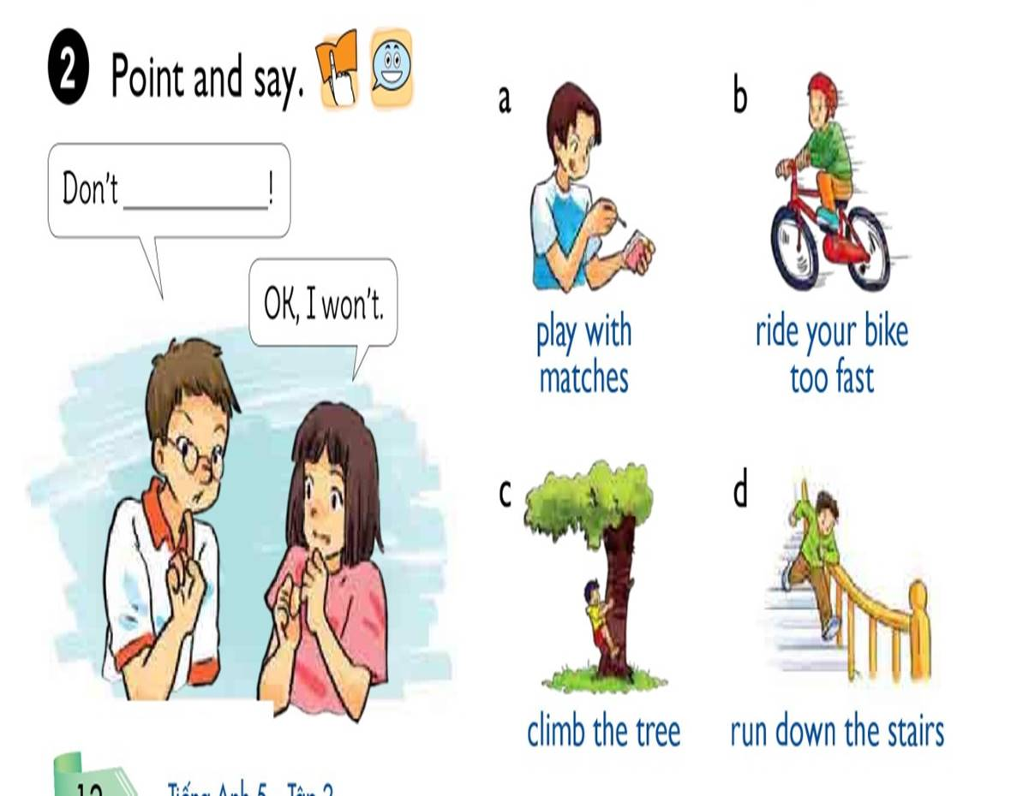

Slide 10

Don’t
play with matches
OK, I won’t

Slide 11
Don’t
ride your bike too fast
OK, I won’t

Slide 12

Don’t
climb the tree
OK, I won’t

Slide 13
Don’t
run down the stairs
OK, I won’t

Slide 14

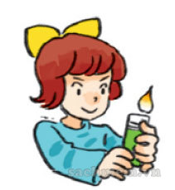
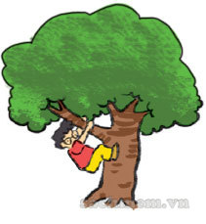
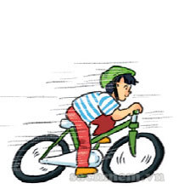
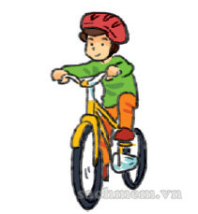


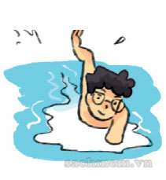
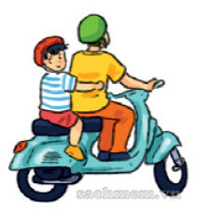
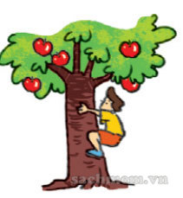
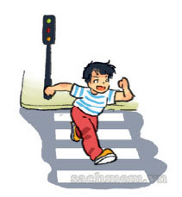
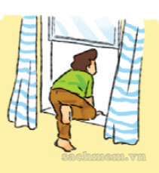
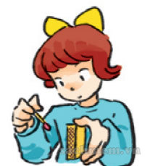
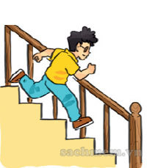
LISTEN AND TICK
1
2
3
4

Slide 15
READ AND COMPLETE
run
answered
won’t
cooking
room
One day, Peter was bored. He was in his (1) and his mother was (2) in the kitchen. She asked loudly “Where are you, Peter?” He (3) , “I’m upstairs, Mum.” His mother heard him running down and said “Don’t (4) down the stairs!” Peter replied “OK, I (5) do it again, Mum.”
room
cooking
answered
run
won’t

Slide 16
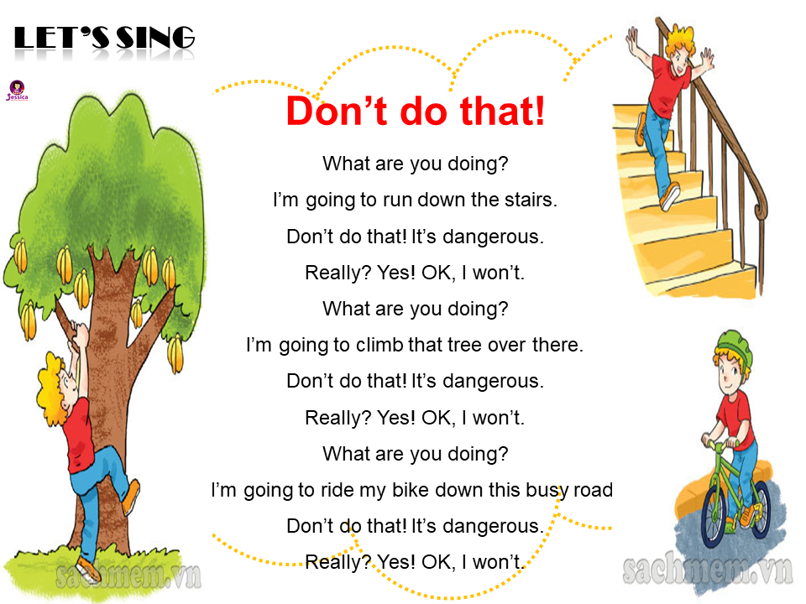
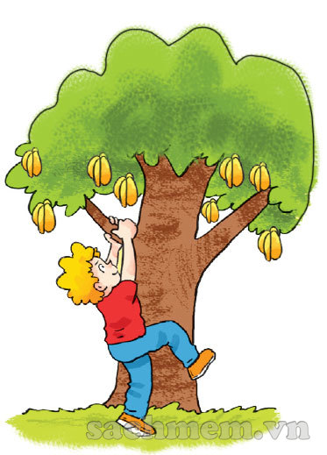

LET’S SING

