Slide 1
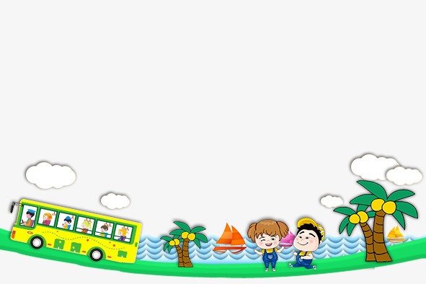
UNIT 11. WHAT’S THE MATTER WITH YOU?
LESSON 2

Slide 2



Slide 3
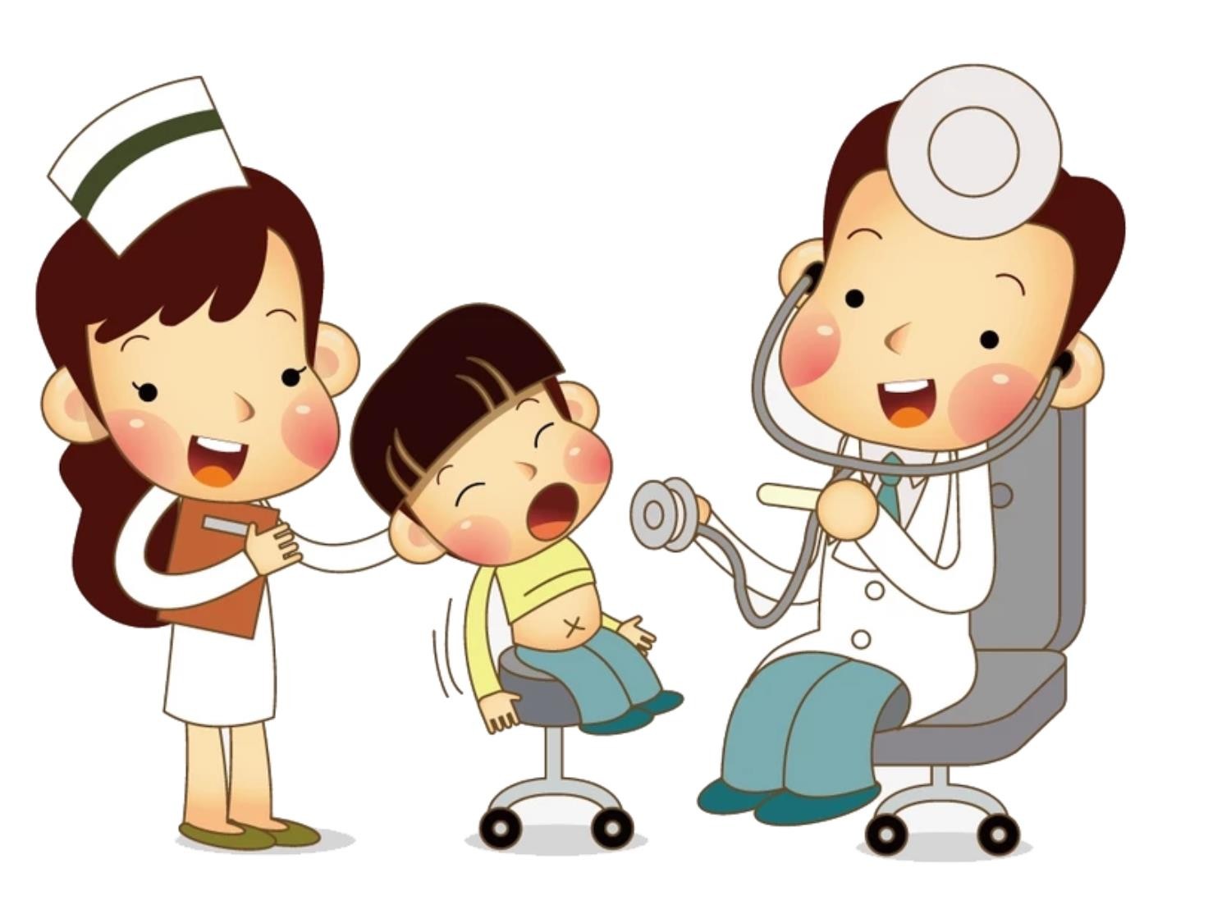
Go to the doctor

Slide 4
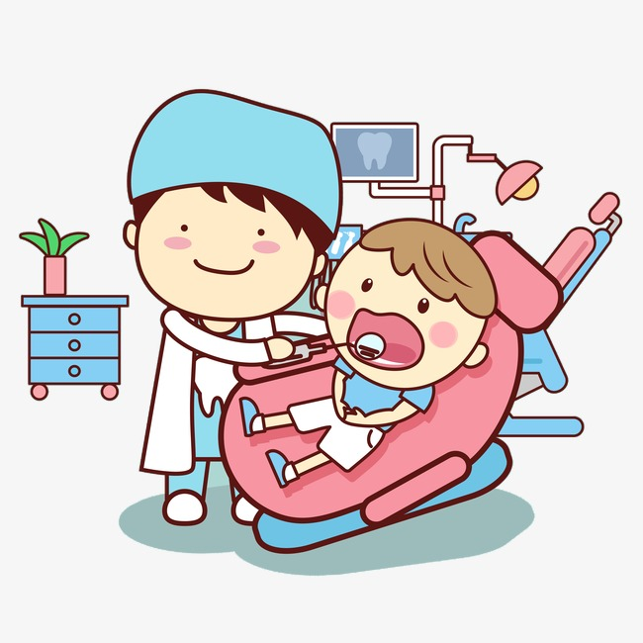
Go to the dentist

Slide 5
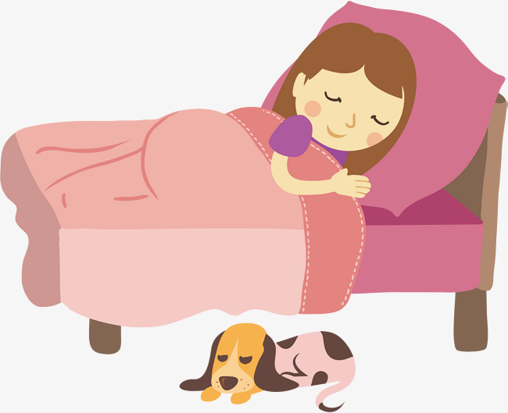
Take a rest

Slide 6
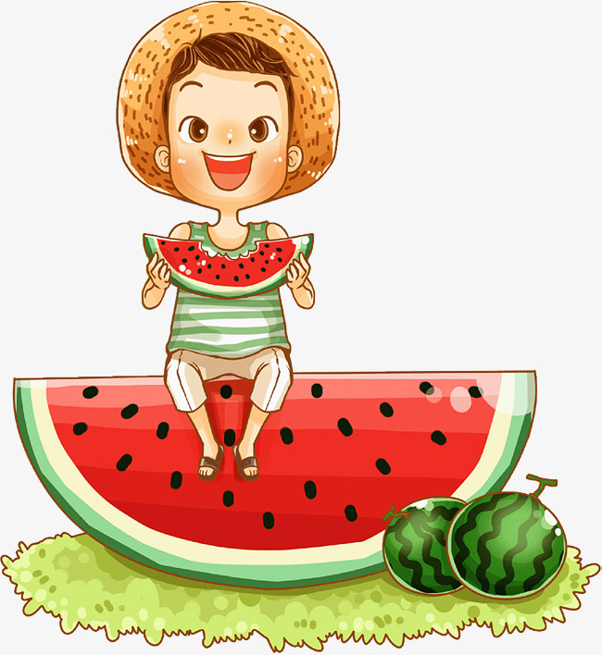
Eat a lot of fruit

Slide 7
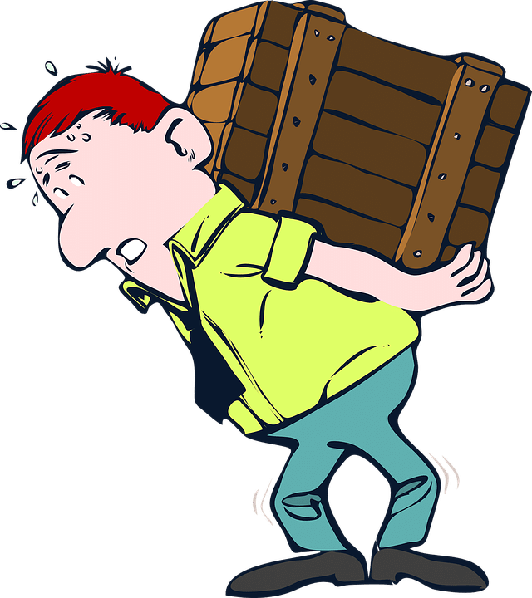
Carry heavy thing

Slide 8
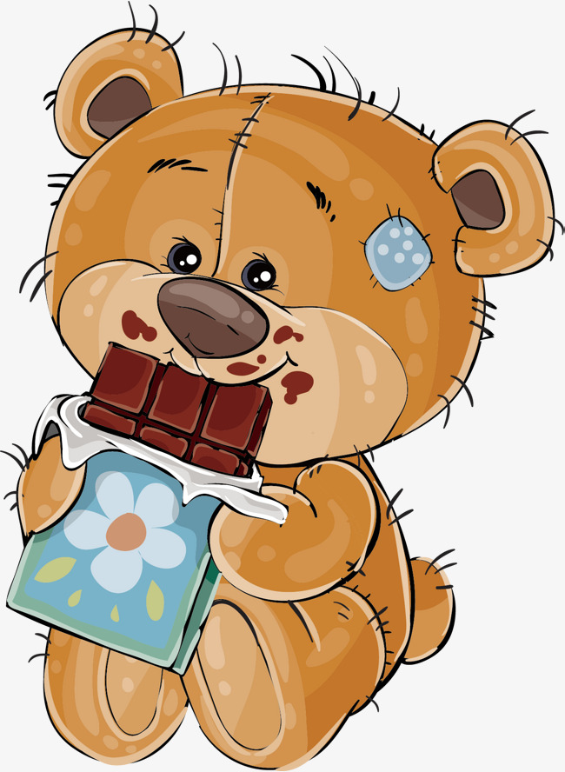
Eat a lot of sweets

Slide 9
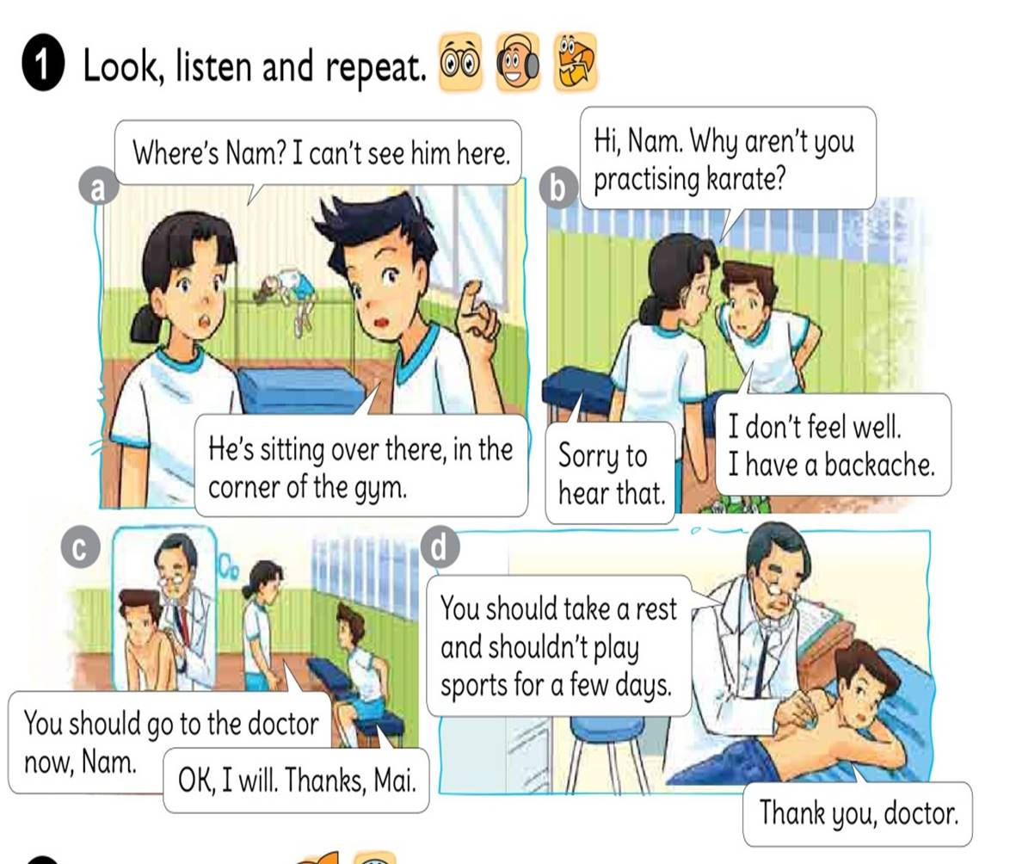


Slide 10
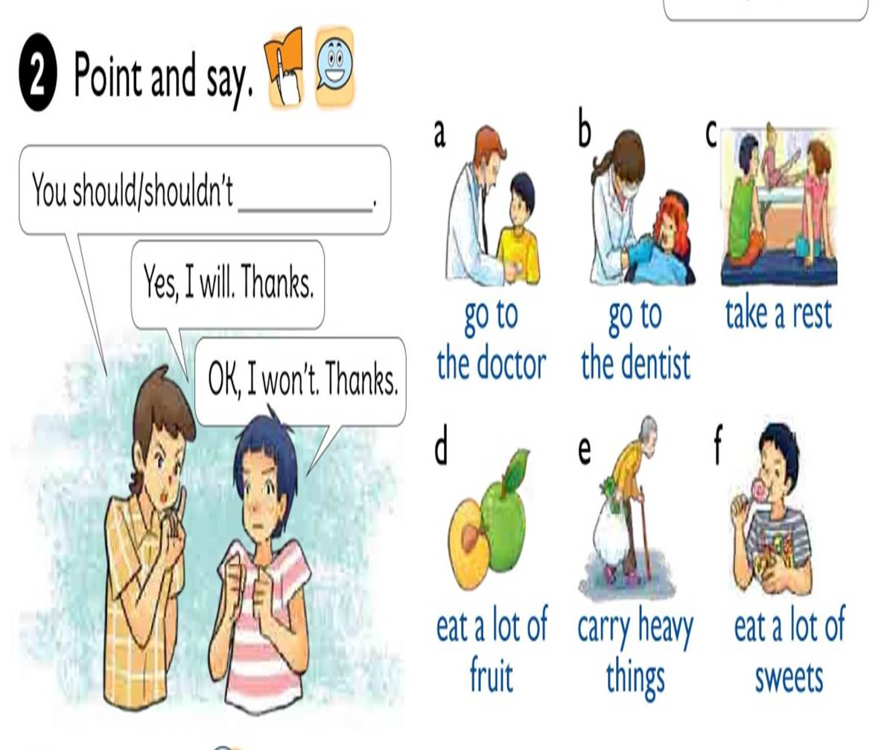

Slide 11


Listen and COMPLETE
Health Problem
should
shouldn’t
Quan
Stomach ache
Go to the doctor
Tony
fever
Go to school
Phong
toothache
eat ice cream
Mrs Green
backache
carry heavy things

Slide 12
READ AND COMPLETE
Quan: Where’s Phong?
Mai: He can’t go to school today.
Quan: Why not?
What’s the (1) with him?
Mai: He (2) a bad cough and is going to see the (3) this morning.
Quan: Oh, really? Poor him!
rest
matter
stomach
has
doctor
matter
Mai: What’s the matter with you, Tony?
Tony: I have a pain in my (4)
Mai: Oh, dear. You should take a (5) now and go to the doctor later.
has
stomach
doctor
rest

Slide 13
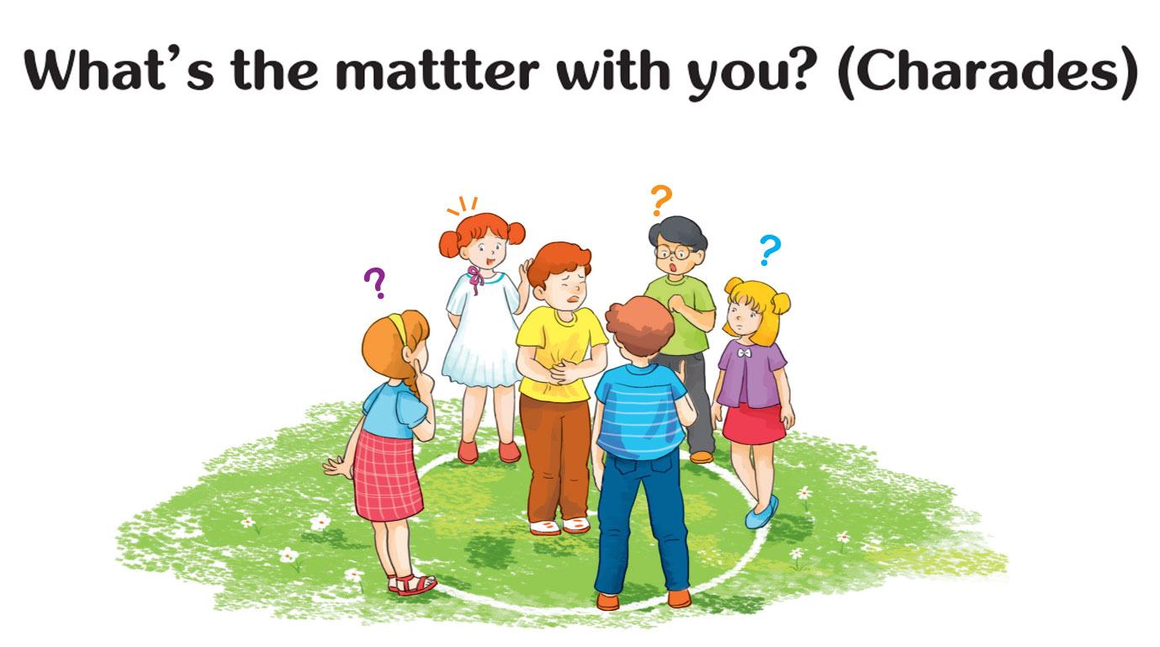
Let’s PLAY

