Slide 1


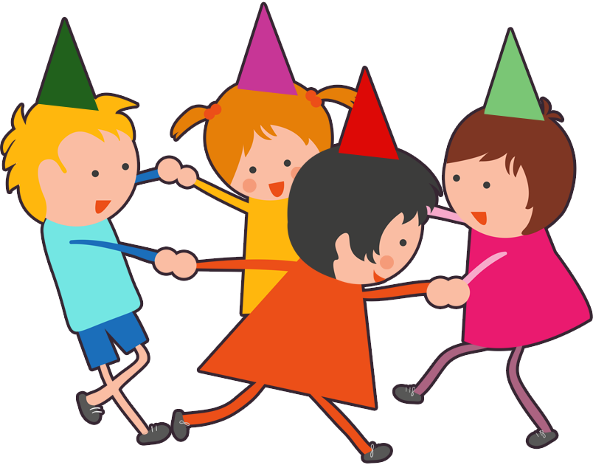
UNIT 11. WHAT’S THE MATTER
WITH YOU?
LESSON 1

Slide 2



Slide 3
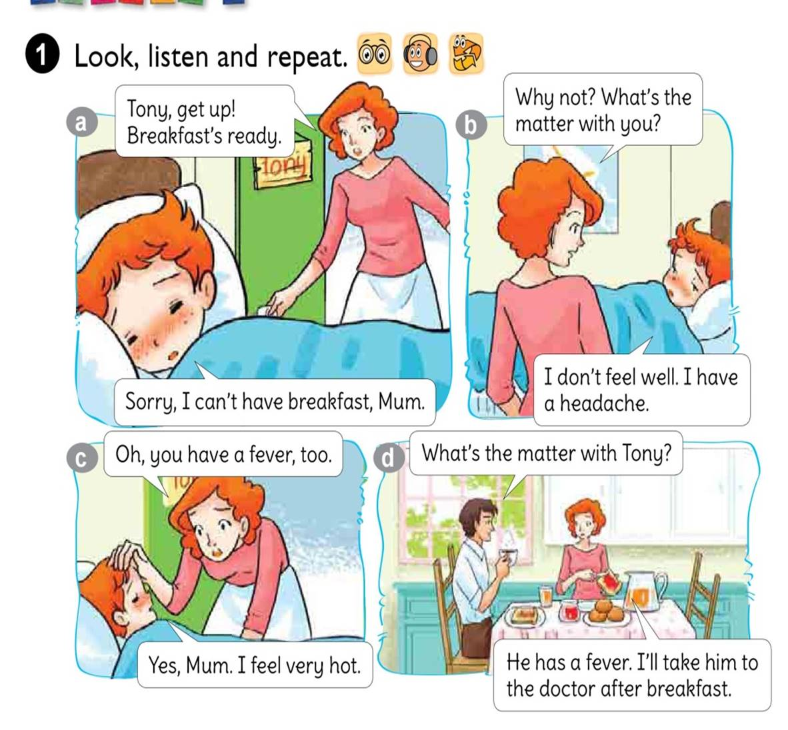



Slide 4
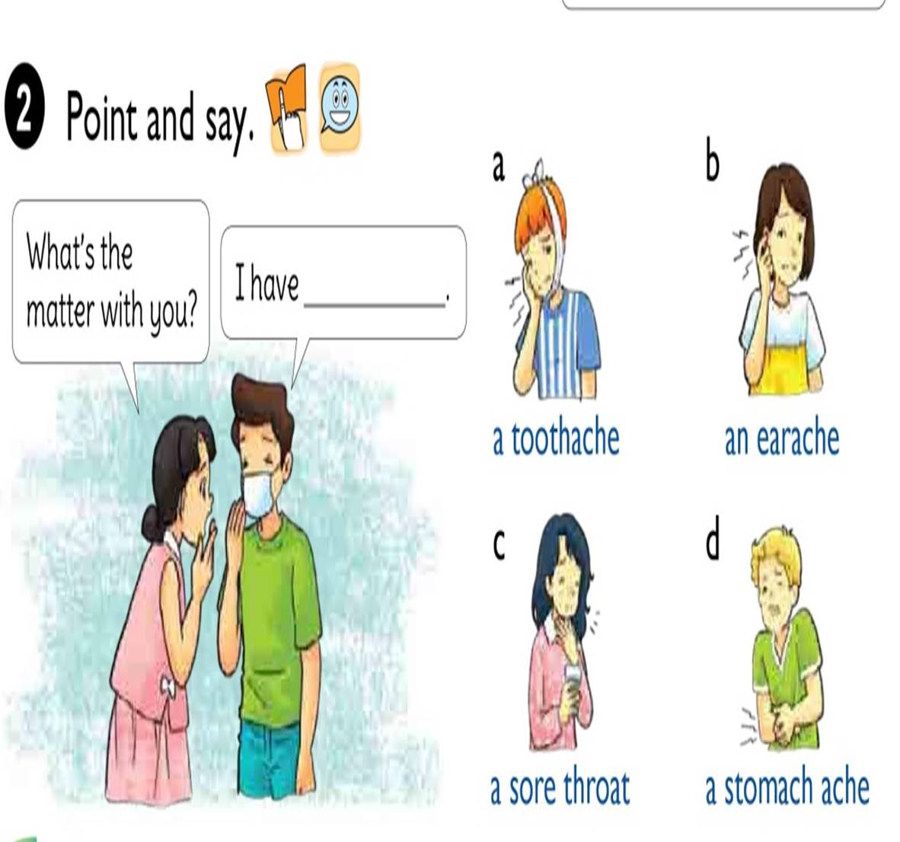

Slide 5

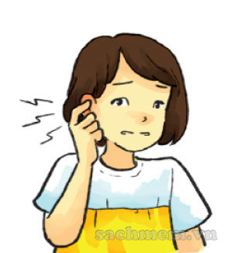
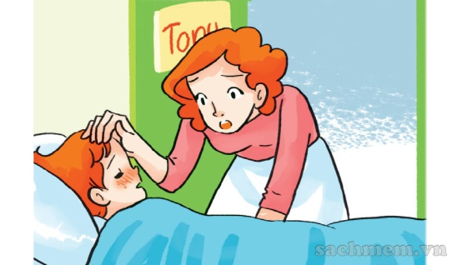
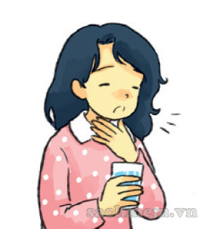
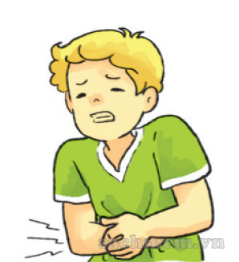
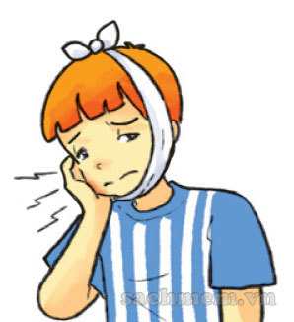
1. Vocabulary
- a fever
- a toothache
- an earache
- a sore throat
- a stomach ache
2. Model sentence
What’s the matter with you?
I have a toothache.

Slide 6

What’s the matter with you?
I have
a toothache.

Slide 7
What’s the matter with you?
I have
an earache.

Slide 8
What’s the matter with you?
I have
a sore throat.

Slide 9
What’s the matter with you?
I have
a stomach ache.

Slide 10
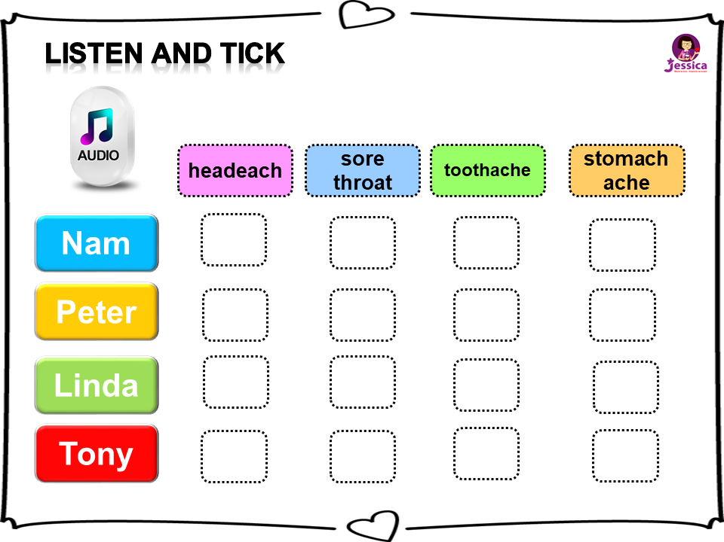


Listen and TICK
headeach
sore throat
toothache
stomach
ache
Nam
Peter
Linda
Tony

Slide 11
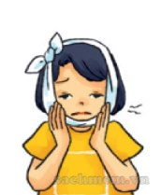
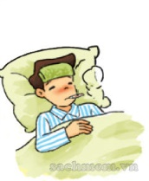
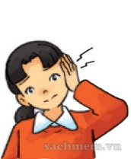
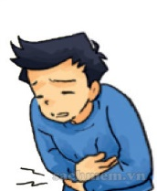

READ AND COMPLETE
earache
sore throat
stomach ache
fever
toothache
She has a pain in her tooth. She has a
toothache
Nam has a high temperature. He has a
fever
Mai has a pain in her ear. She has an
earache
Quan has a pain in his stomach.
He has a
stomach ache
Linda has a pain in her throat.
She has a
sore throat

Slide 12
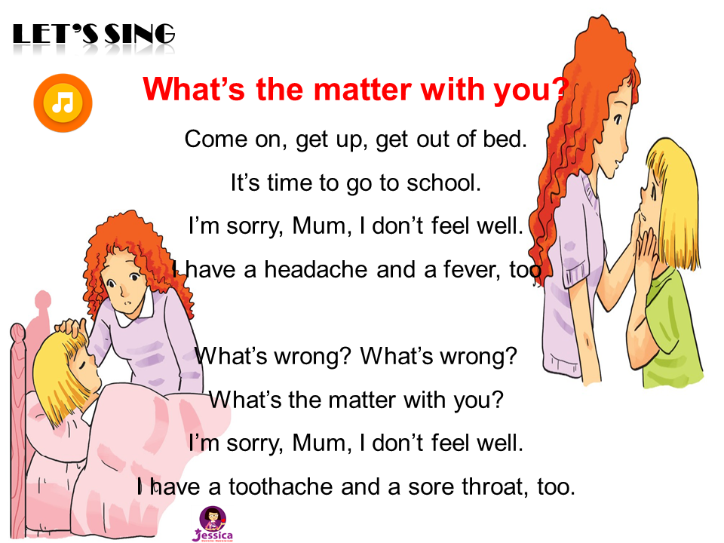

LET’S SING

