Slide 1
Unit 5
What will you do
this weekend?
Lesson 2

Slide 2
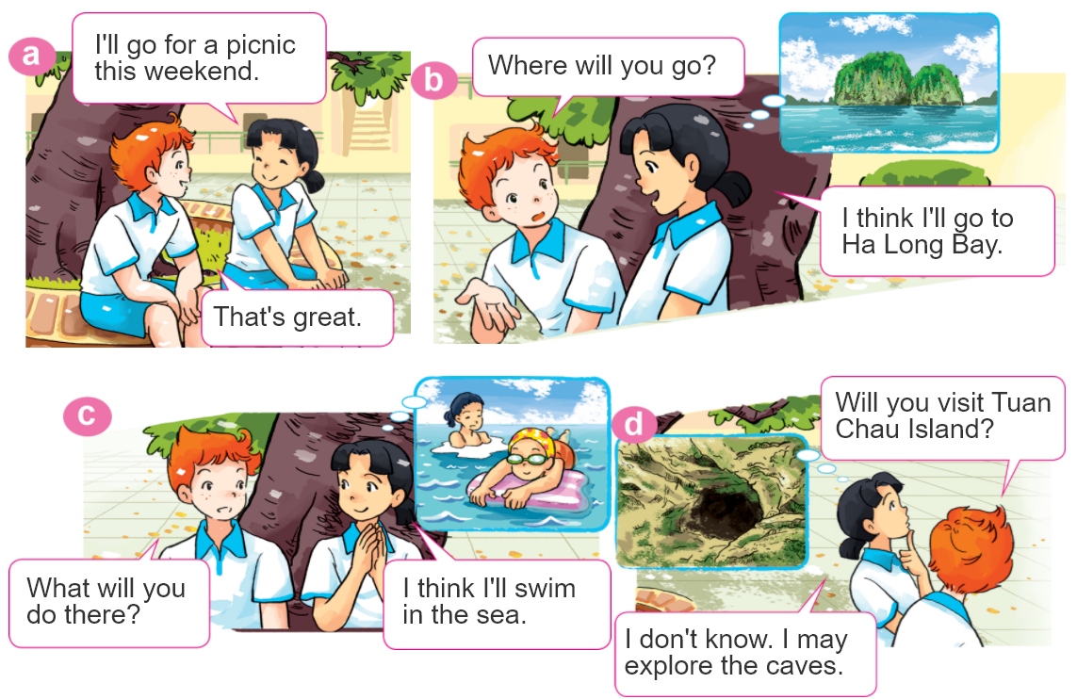
1. Look, listen and repeat

Slide 3

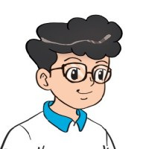
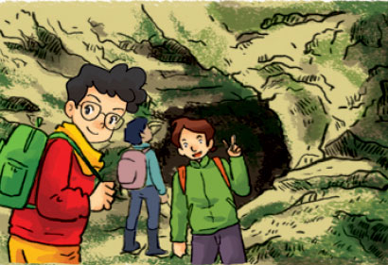
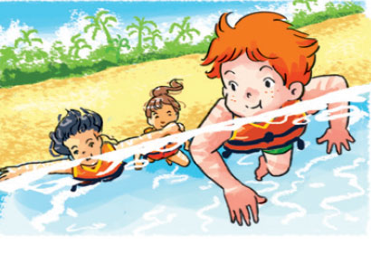
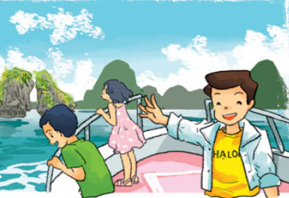
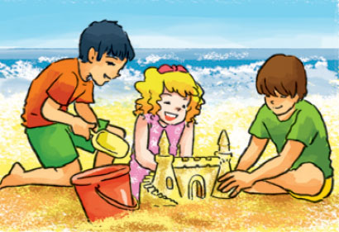
2. Point and say
What will you do at Ha Long Bay?
I think I'll ____________.
explore
the caves
swim
in the sea
take a boat trip
around the islands
build sandcastles
on the beach

Slide 4
2. Point and say
What will you do at Ha Long Bay?
I don’t know. I may ________.
explore
the caves
swim
in the sea
take a boat trip
around the islands
build sandcastles
on the beach

Slide 5

3. Let’s talk.
Where will you be next week?
I think I'll ____________.
I don't know. I may _____________.
What will you do?

Slide 6
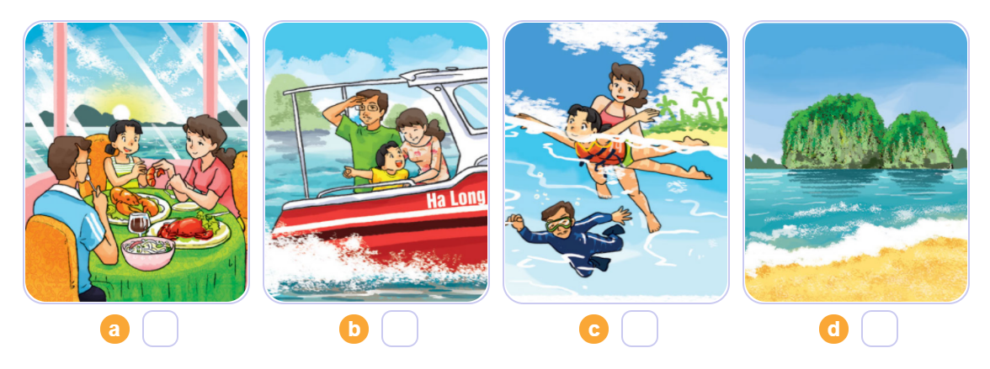
4. Listen and number
3
2
4
1
1
2
3
4

Slide 7
5. Write about your daily routines.
Where will you be tomorrow?
____________________________________.
2. What will you do?
____________________________________.

Slide 8
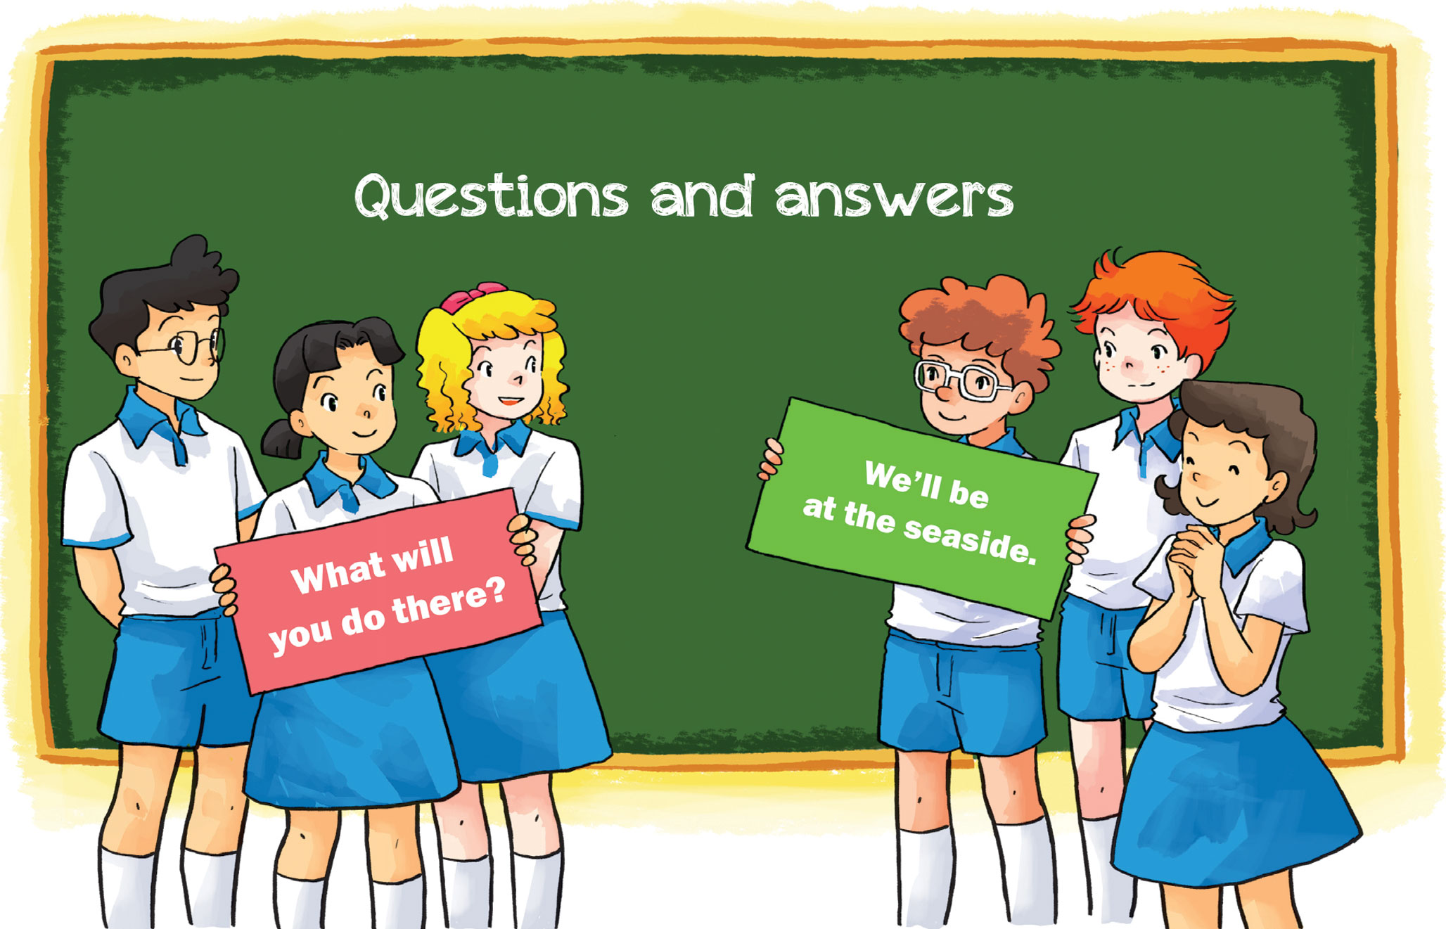
6. Let’s play.

