Slide 1
Unit 5
What will you do
this weekend?
Lesson 1

Slide 2
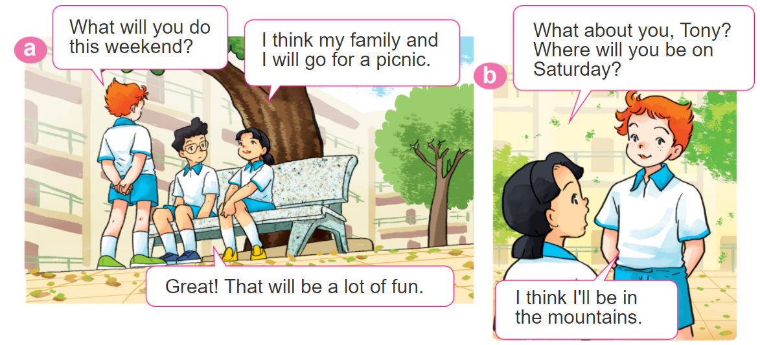
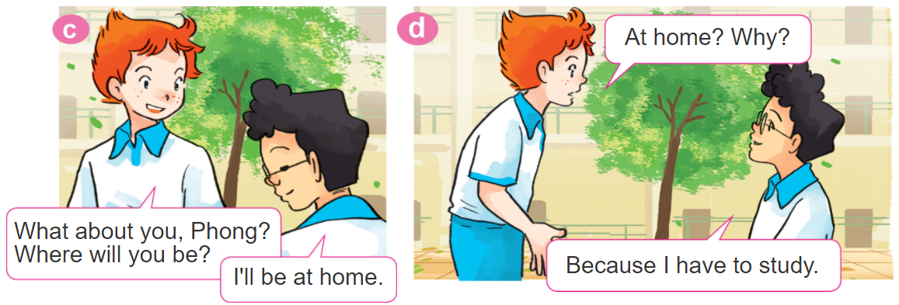
1. Look, listen and repeat

Slide 3
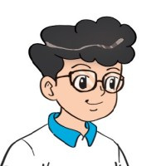
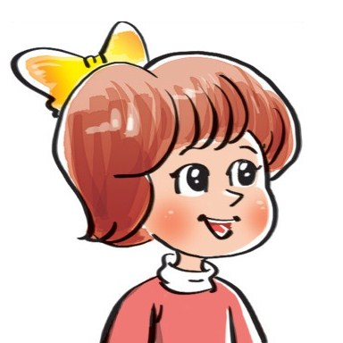

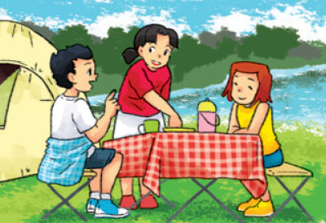
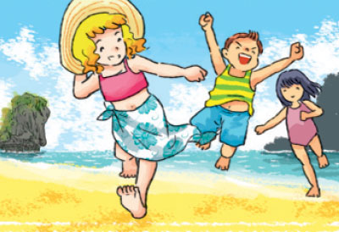
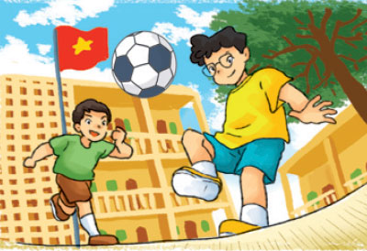
2. Point and say
Where will you be this weekend?
I think I'll be ____________.
in the
countryside
by the sea
on the beach
at school

Slide 4

3. Let’s talk.

Slide 5
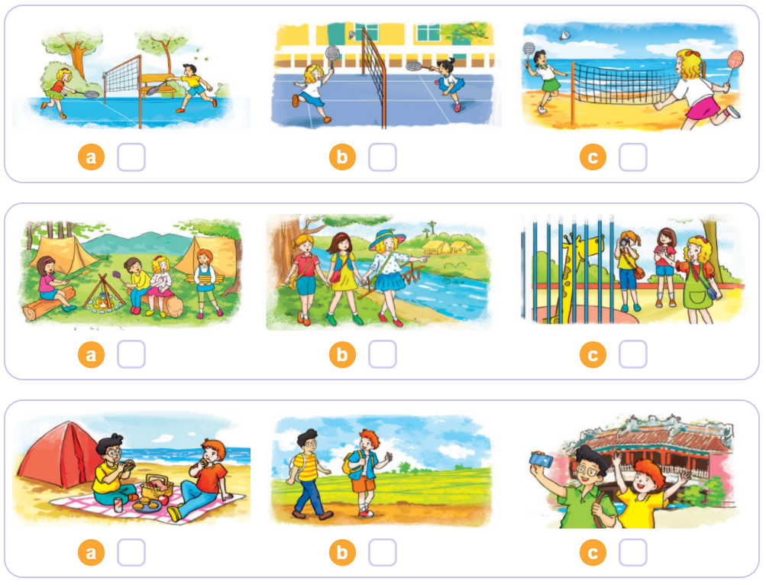

4. Listen and tick
1
2
3

Slide 6
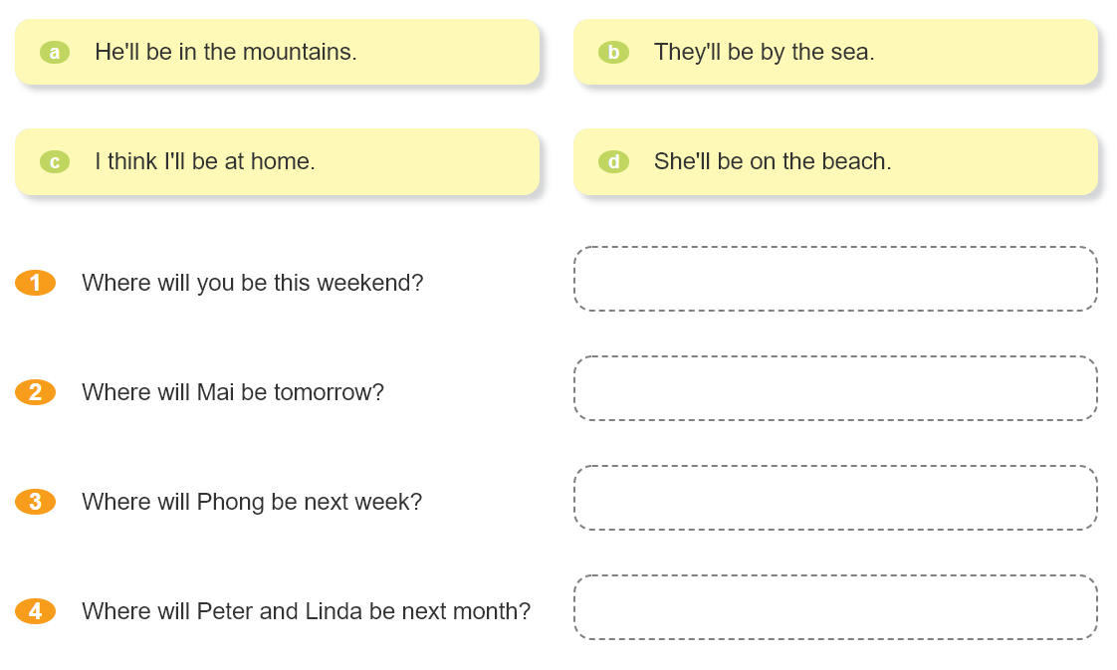


5. Read and match.

Slide 7
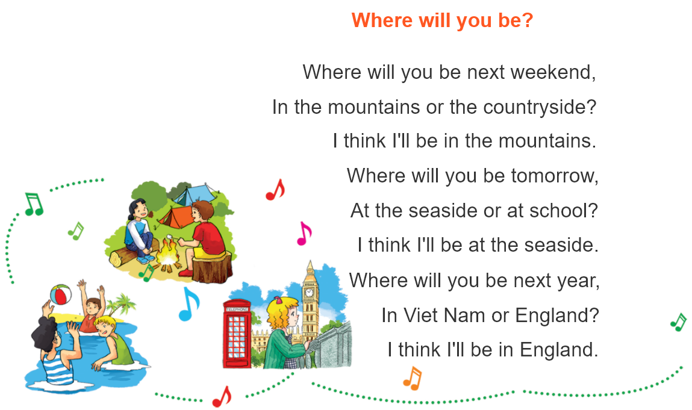

6. Let’s sing.

