Slide 1
PRONUNCIATION

Slide 2
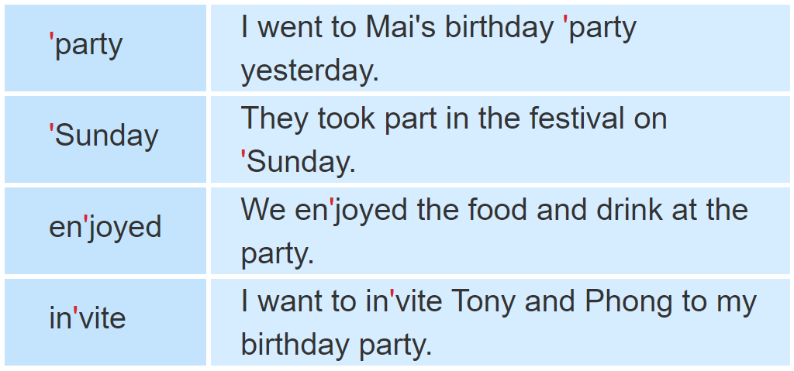
1. Listen and repeat.

Slide 3
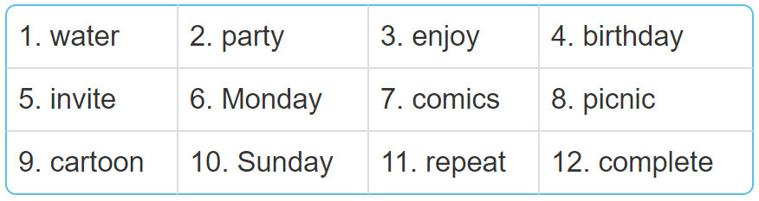
2. Mark the word stress. Then say the words aloud.
'water
'party
en'joy
'birthday
in'vite
'Monday
'comics
'picnic
car'toon
'Sunday
re'peat
com'plete

Slide 4
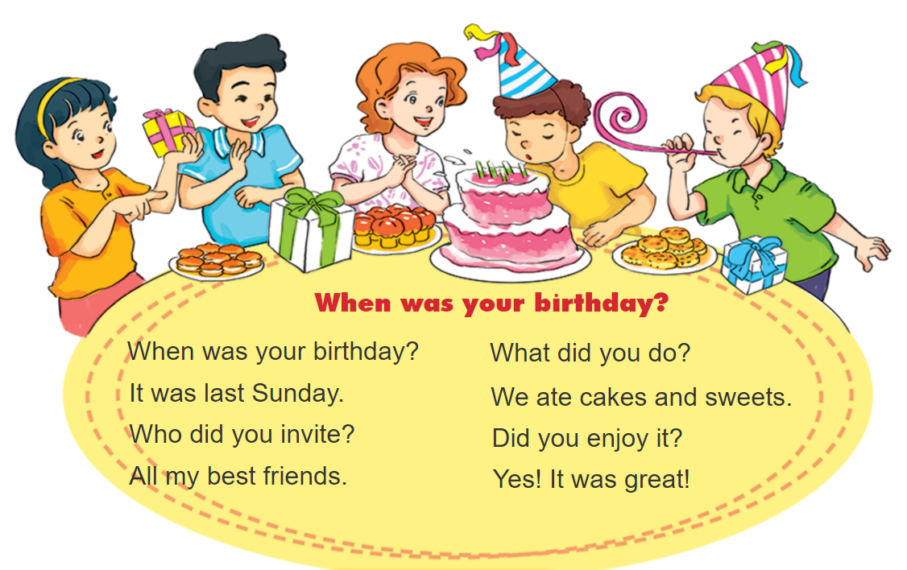
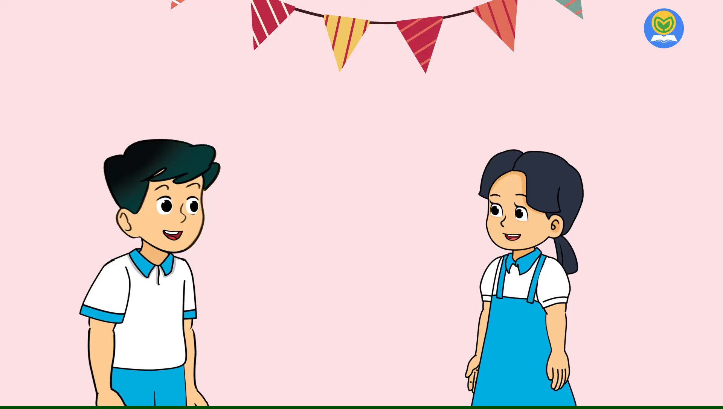


3. Let’s chant

Slide 5
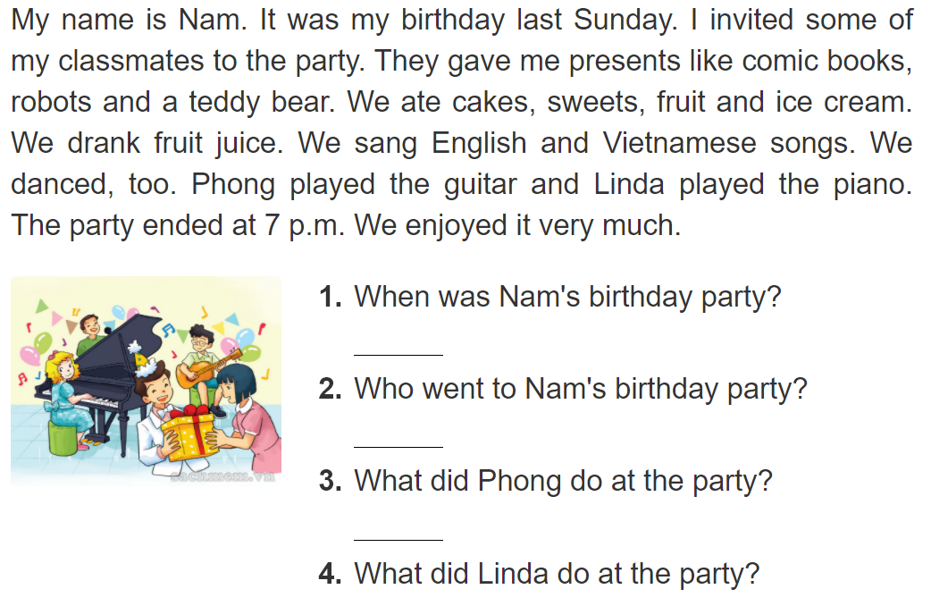
4. Read and answer.
It was last Sunday.
Some of his classmates went to the birthday party.
He played the guitar.
She played the piano.

Slide 6
5. Write about your friend.
When was your last birthday party?
____________________________________________.
2. Who went to your party?
____________________________________________.
3. What did you and your friends do at the party?
____________________________________________.

Slide 7
6. Write about your birthday party.

