Slide 1
Unit 4
Did you go to
the party?
Lesson 2

Slide 2
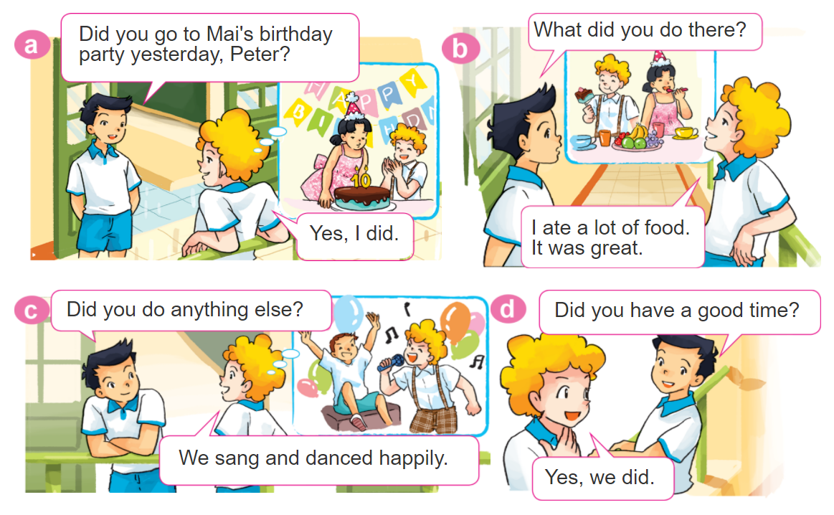
1. Look, listen and repeat.

Slide 3
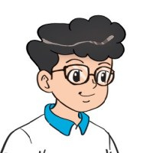
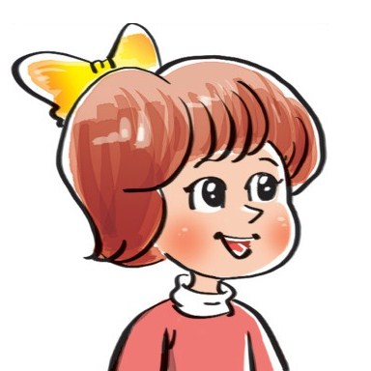
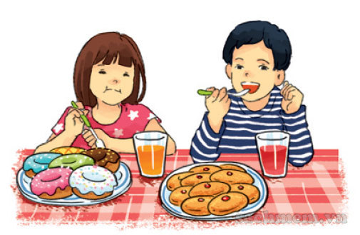
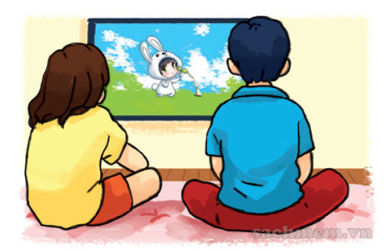
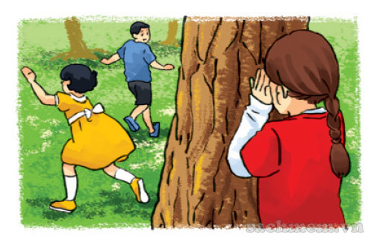
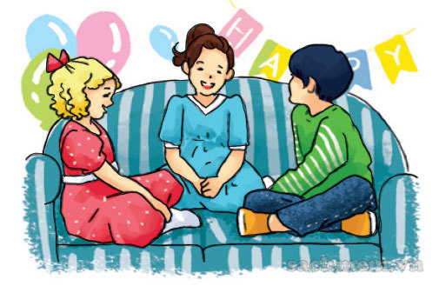
2. Point and say
What did you do at the party?
We ___________.
had nice
food and drink
watched cartoons
played
hide-and-seek
chatted
with friends

Slide 4




3. Let’s talk
Did you ________?
Yes. I did.
No, I didn't.
How was it?
It was________.
What did you do there?
I/We ____________.

Slide 5
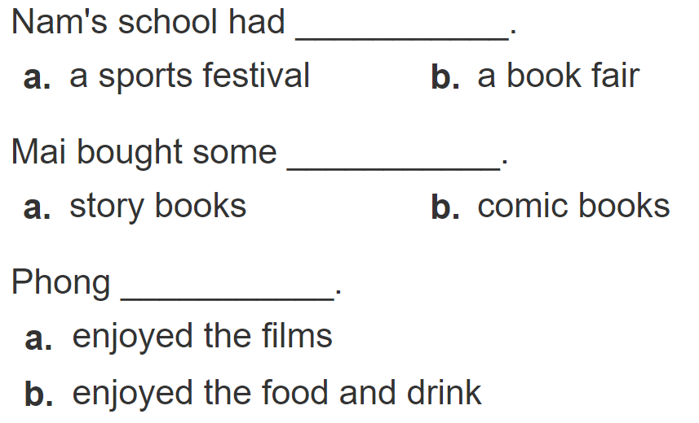
4. Listen and circle
1
2
3

Slide 6
5. Write about you.
Where were you yesterday?
__________________________________.
2. What did you do there?
__________________________________.
3. Did you enjoy it?
__________________________________.

Slide 7
6. Let’s play

