Slide 1
Unit 4
Did you go to
the party?
Lesson 1

Slide 2
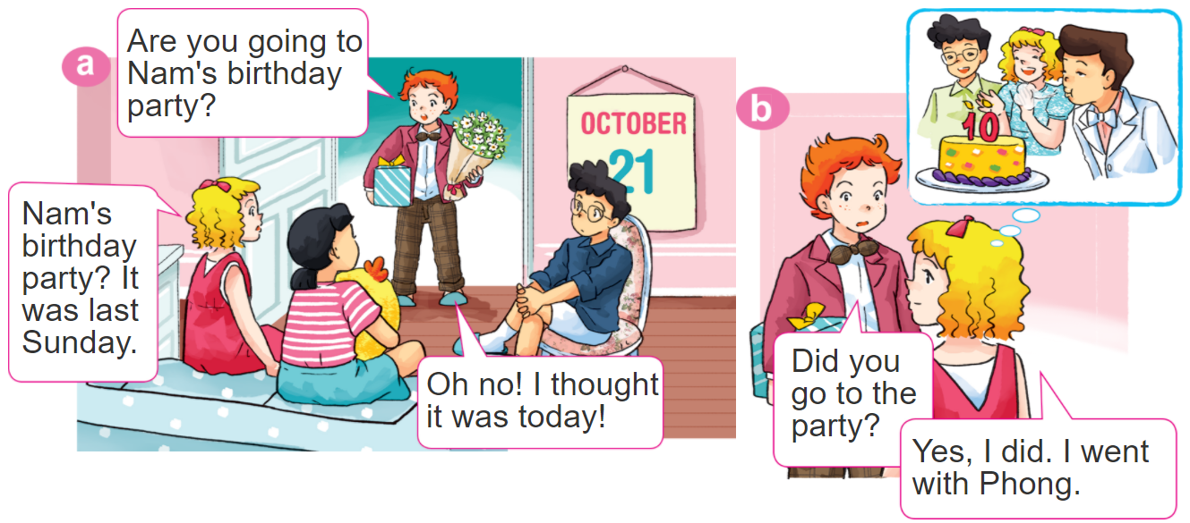
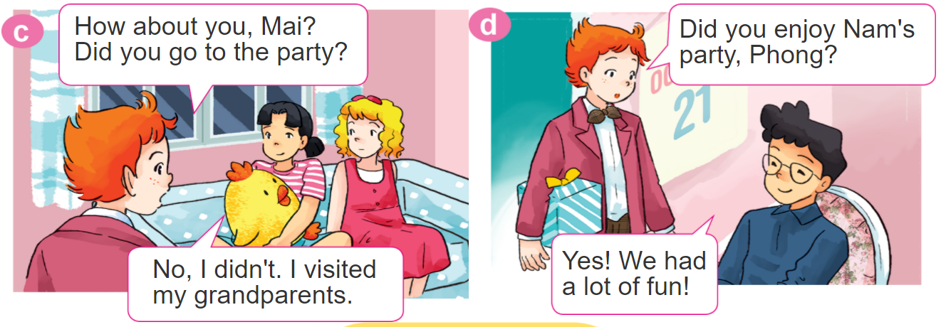
1. Look, listen and repeat.

Slide 3
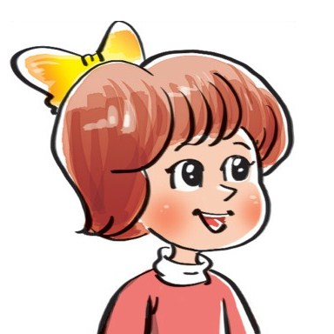

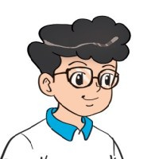

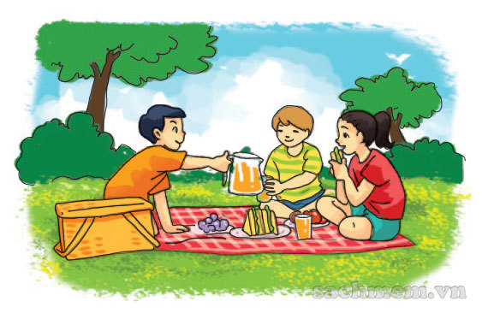
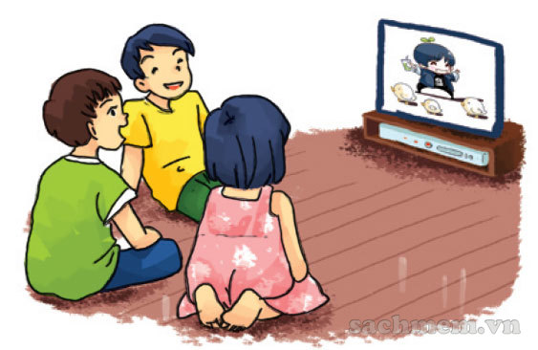
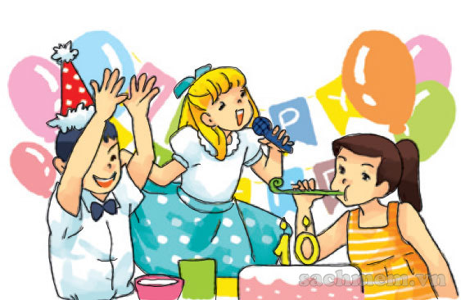
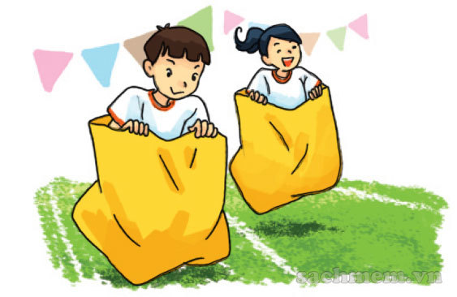
2. Point and say
Yes. I did.
Did you _________?
No, I didn't.
go on a picnic
watch TV
enjoy a party
join the funfair

Slide 4

3. Let’s talk
Did you go on a picnic?
Yes. I did.
Did you enjoy the weekend?
No, I didn't.
Did you watch TV?

Slide 5
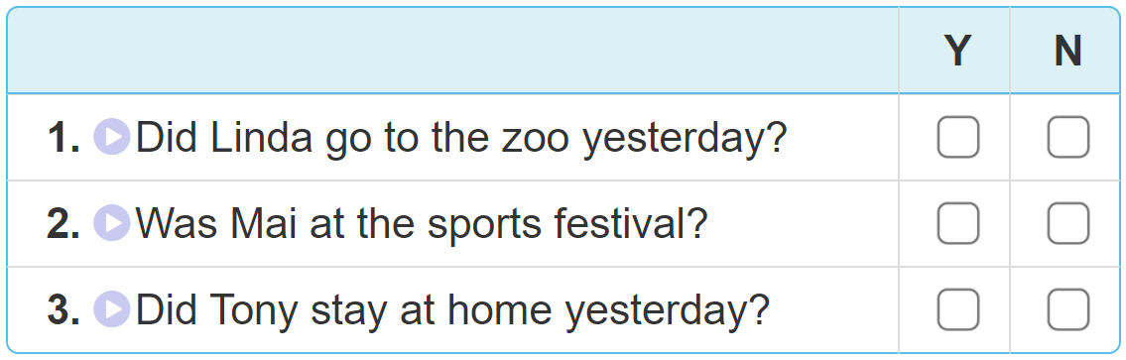

4. Listen and tick Yes (Y) or No (N).

Slide 6
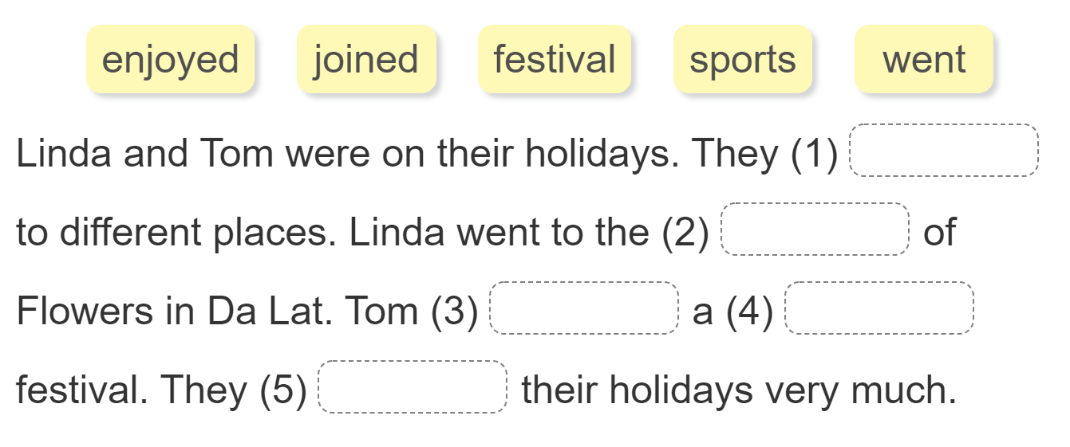
5. Read and complete.
went
festival
joined
sports
enjoyed

Slide 7
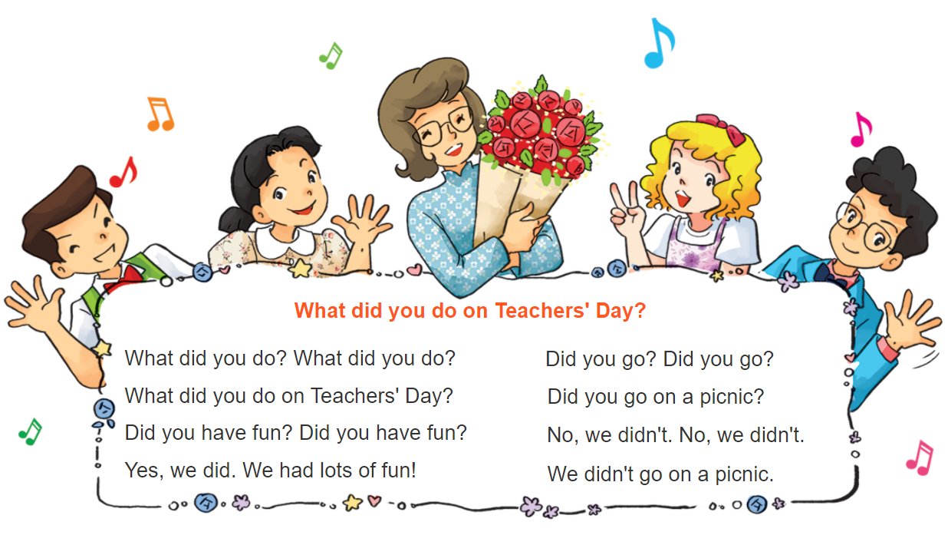


6. Let’s sing

