Slide 1
Unit 3
Where did you go
on holiday?
Lesson 3

Slide 2
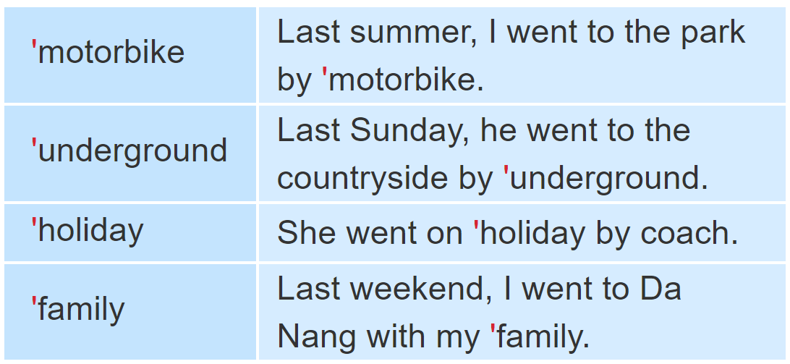

1. Listen and repeat

Slide 3
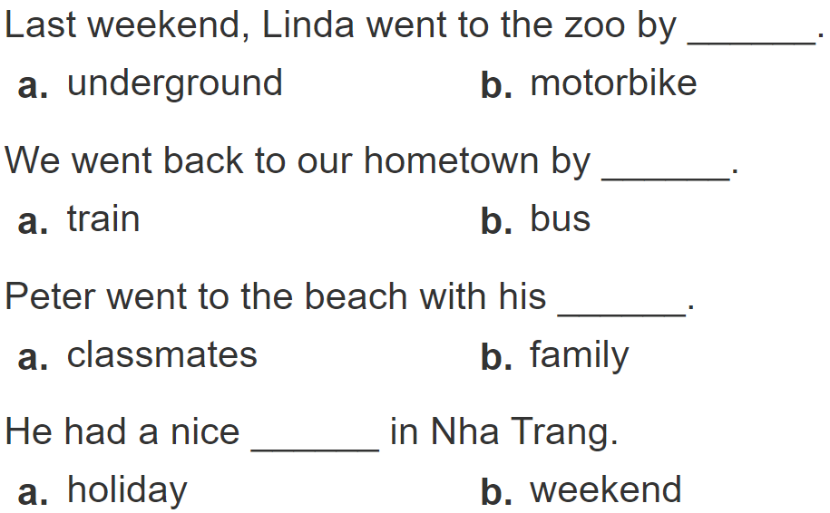
2.
Listen and circle a or b. Then say the sentences aloud.
1
2
3
4

Slide 4
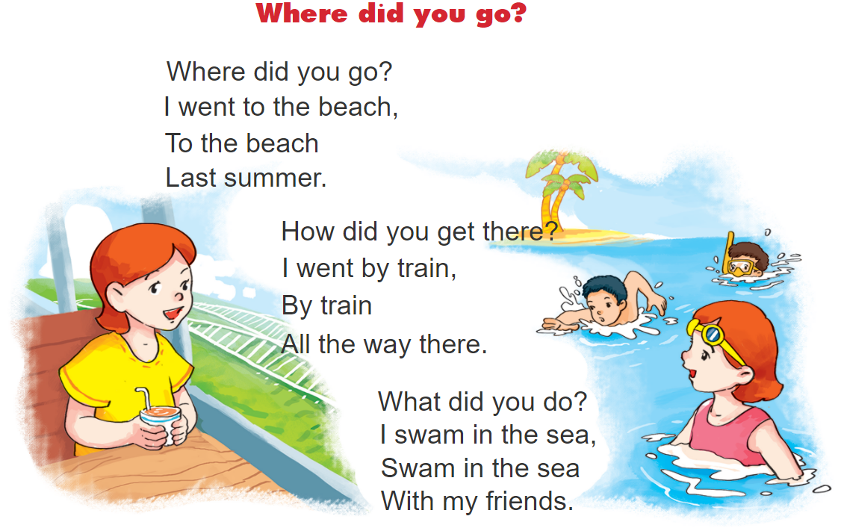
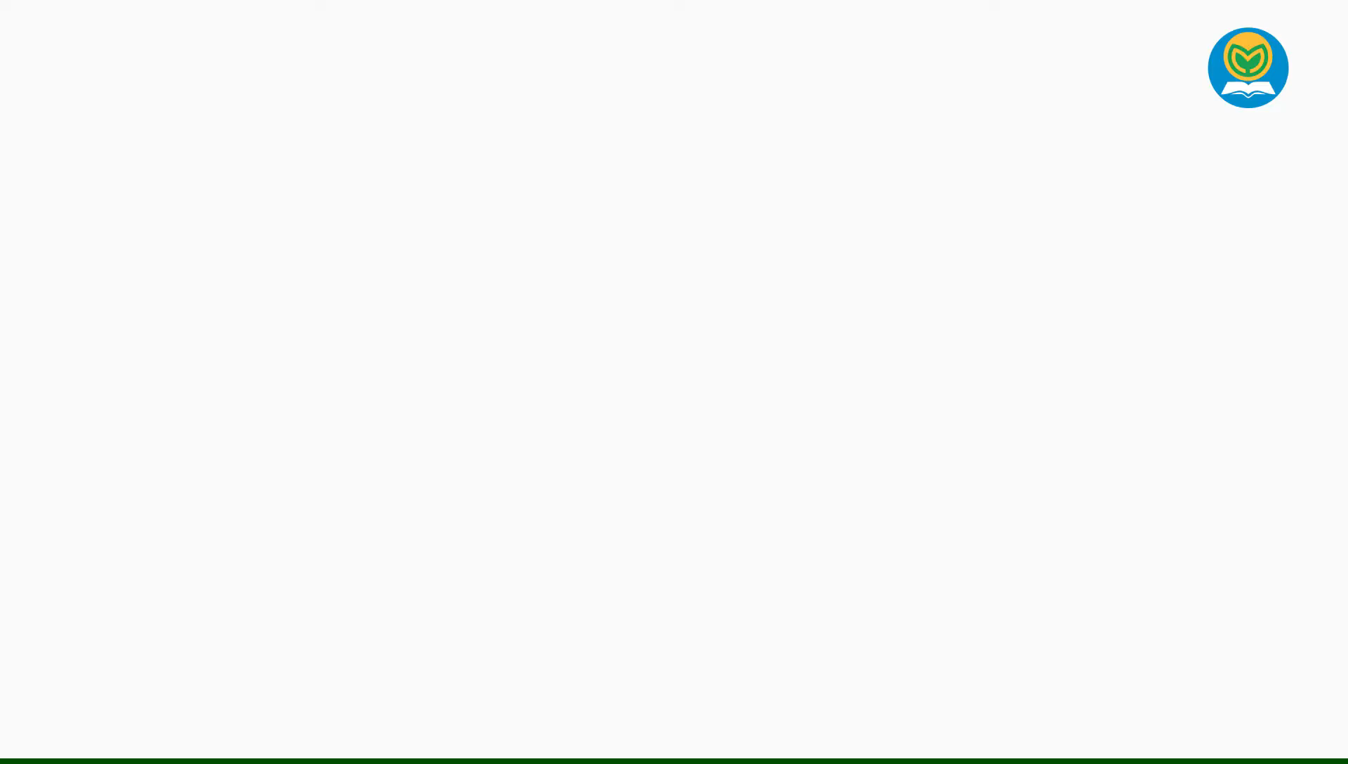
3. Let’s chant.

Slide 5
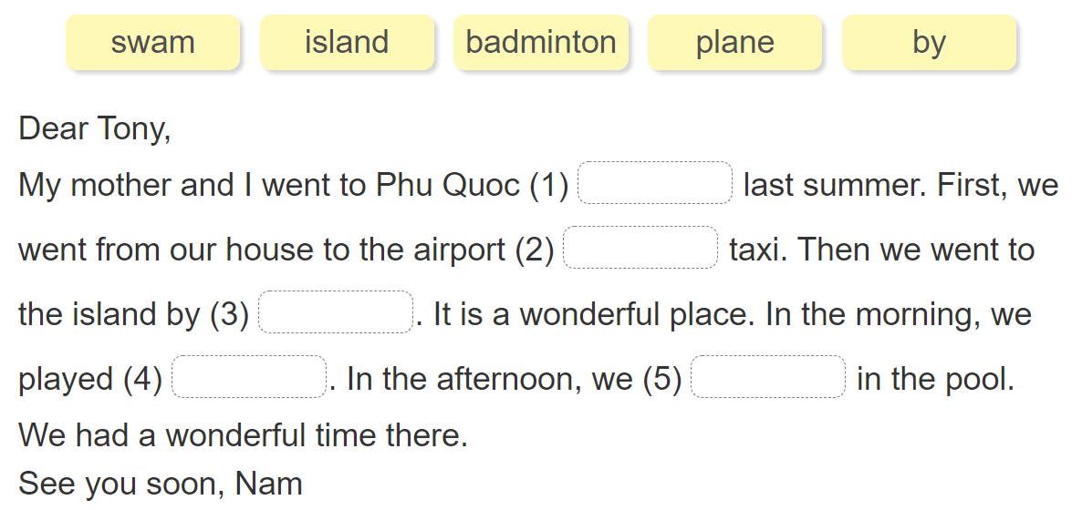
4. Read and answer.

Slide 6
5. Write about your day.

Slide 7









6. Project.

