Slide 1
Unit 9
What did you see
at the zoo?
Lesson 1

Slide 2
PRONUNCIATION

Slide 3

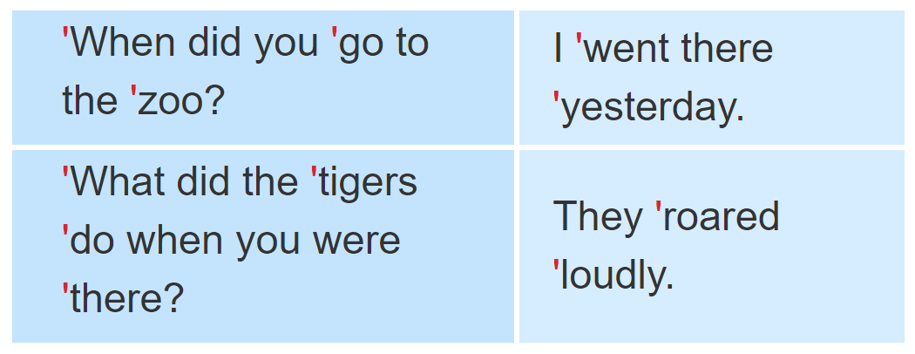
1. Listen and repeat.

Slide 4
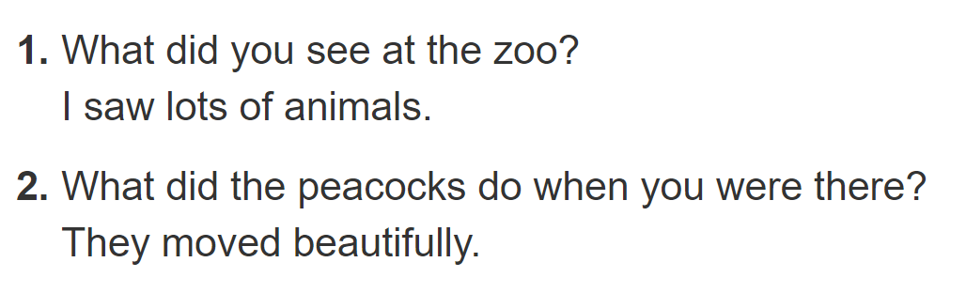

2. Listen and underline the stressed words. Then say the sentences aloud.

Slide 5
PRACTISE

Slide 6
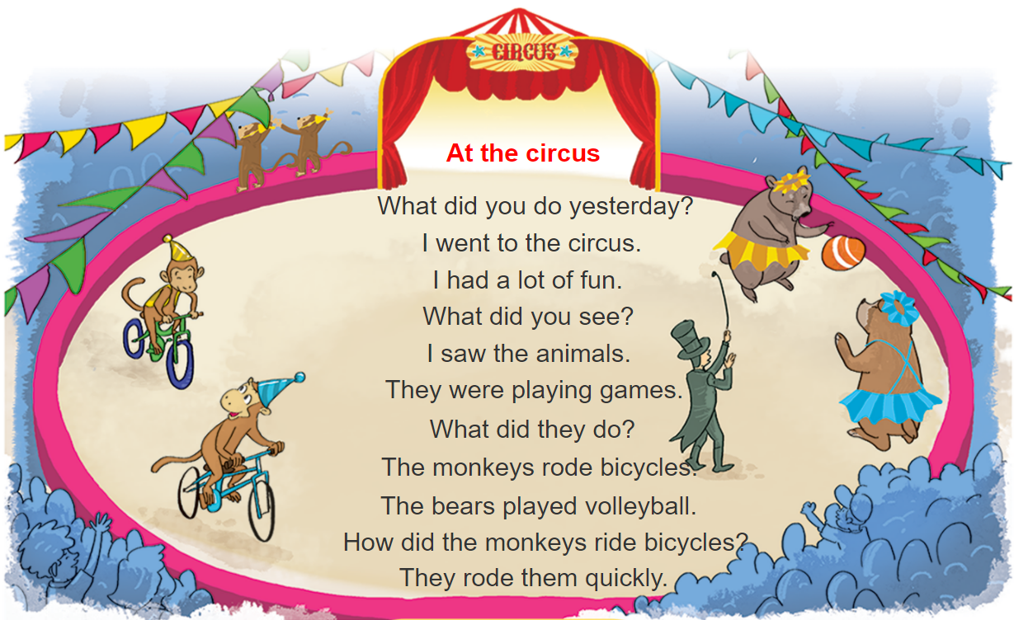



3. Let’s chant

Slide 7
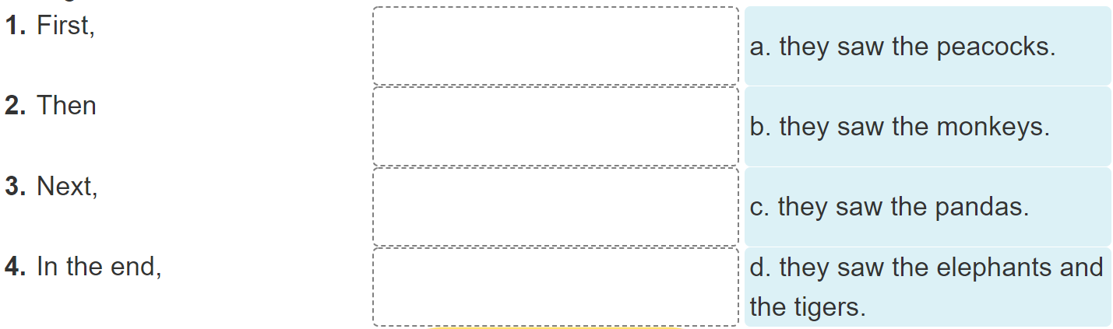
4. Read and complete

Slide 8
4. Read and complete
Dear Tuan,
I went to the zoo with my classmates last Friday. First, we saw the monkeys. They were fun to watch because they jumped up and down quickly. Then we went to see the elephants. They moved slowly and quietly. We also saw the tigers. I liked them very much because they were fast. Next, we saw the peacocks. My classmates liked them because they moved beautifully. In the end, we saw the pandas. They were very cute and did everything slowly. I had a really good time at the zoo.
See you soon.
Best wishes,
Phong

Slide 9
4. Read and complete

Slide 10
5. Write about your last visit to the zoo
I went to the zoo with_________last _________.
At the zoo, I saw ________________________.
The _________ and the _________.
I think the animals at the zoo are ____________.

Slide 11
6. Project
Draw your dream zoo.

