Slide 1
Unit 8
What are
you reading?
Lesson 3

Slide 2
PRONUNCIATION

Slide 3
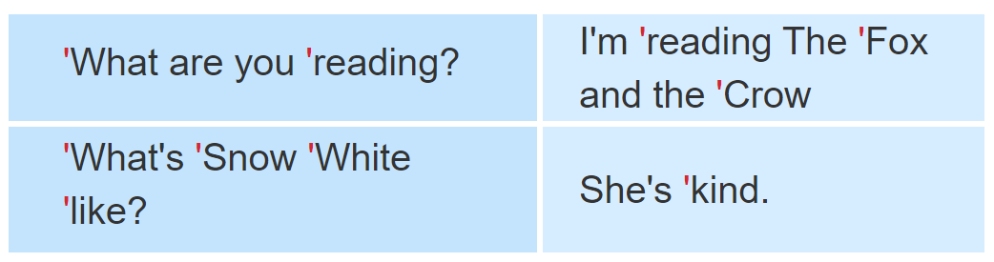

1. Listen and repeat.

Slide 4
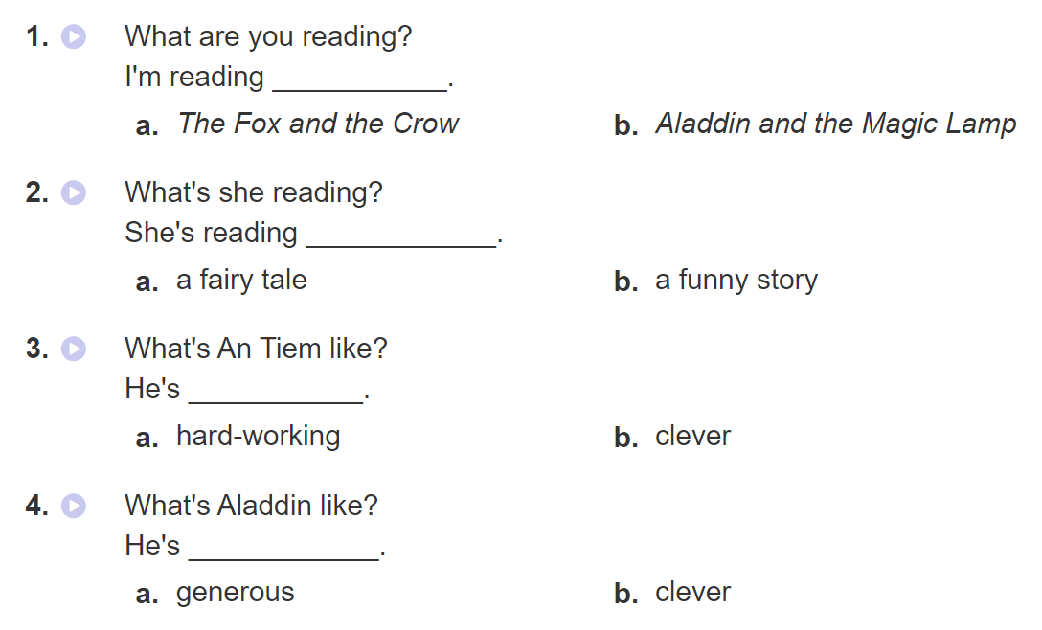

2. Listen and circle a or b. Then say the sentences aloud.

Slide 5
PRACTISE

Slide 6
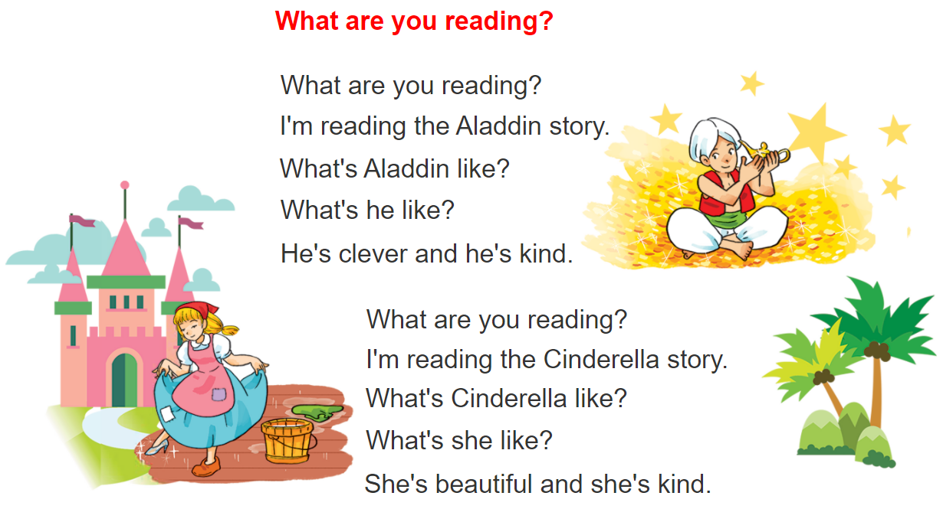


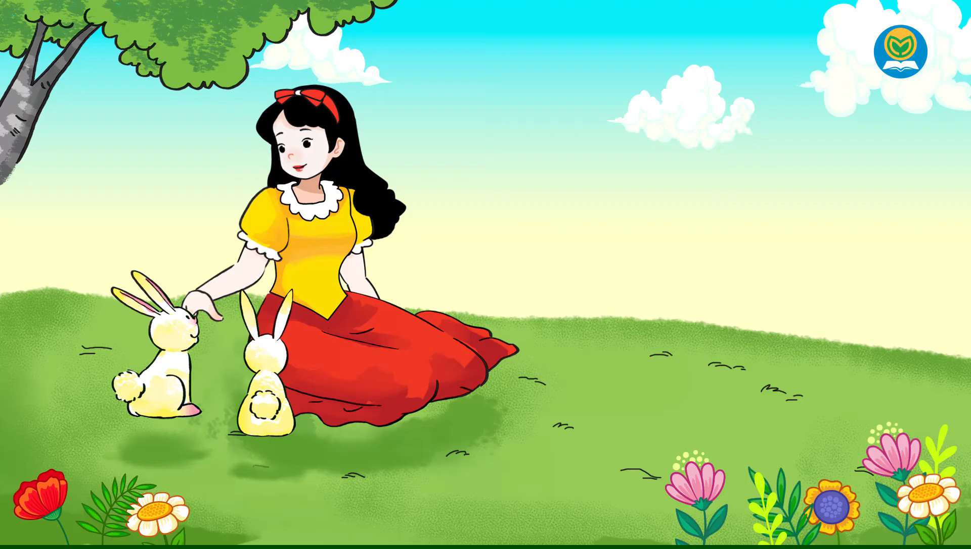
3. Let’s chant

Slide 7
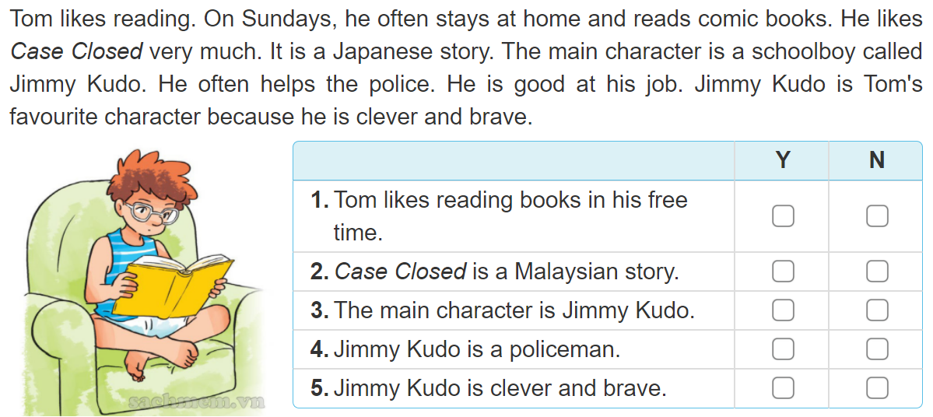
4. Read and complete
✔
✔
✔
✔
✔

Slide 8
5. Write about your school and lessons.
I like reading ___________ in my free time.
My favourite book is___________________.
The main character is ___________________.
I like him/her very much because __________ _______________________________________.

Slide 9
6. Project
Interview three classmates about their favourite books and characters.

