Slide 1



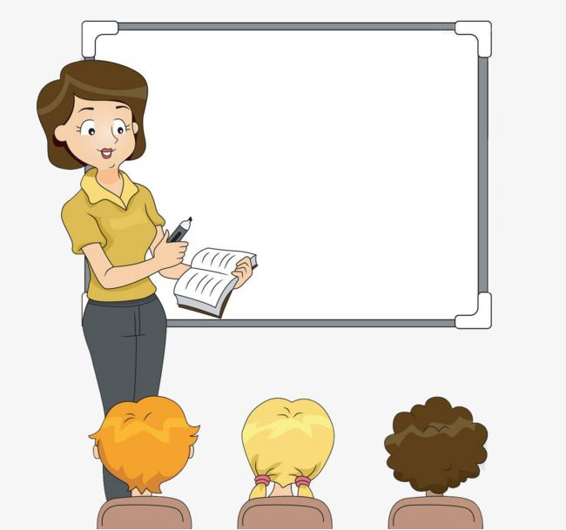

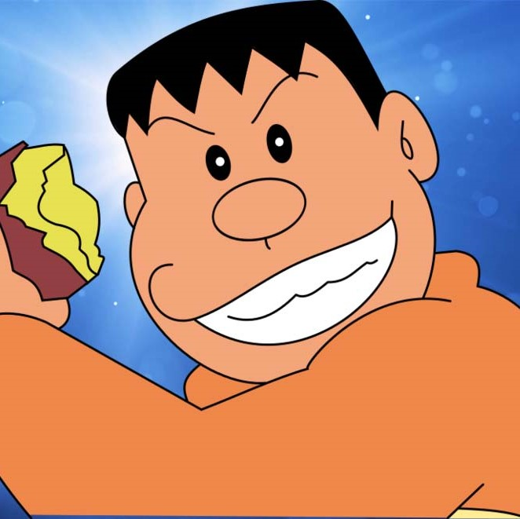
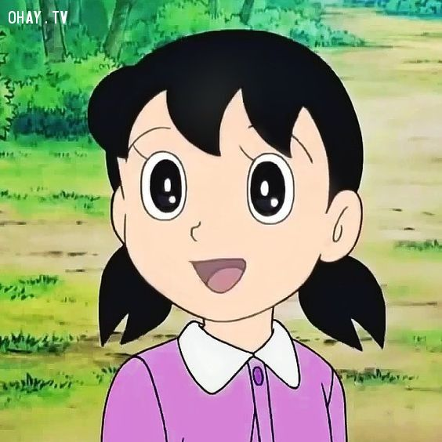

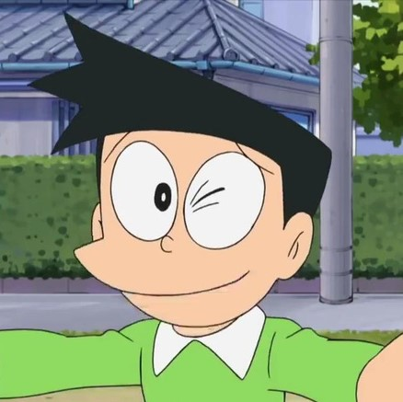




Classroom rules
2.Listen
1.Be quite
3.Sit nicely
4. Raise you hand

Slide 2


Slide 3


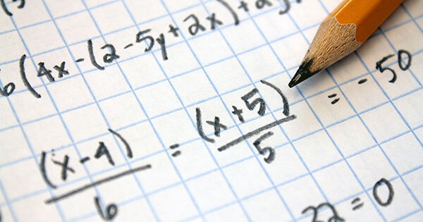

1.What subject is it?

Slide 4
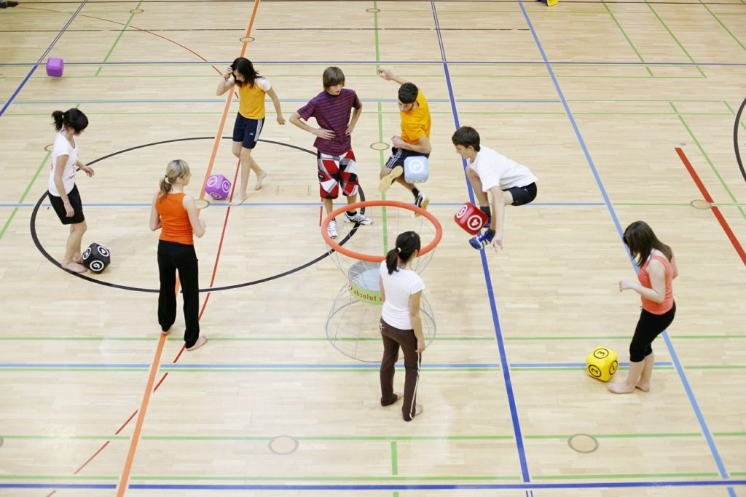
2.WHAT SUBJECT IS IT?

Slide 5

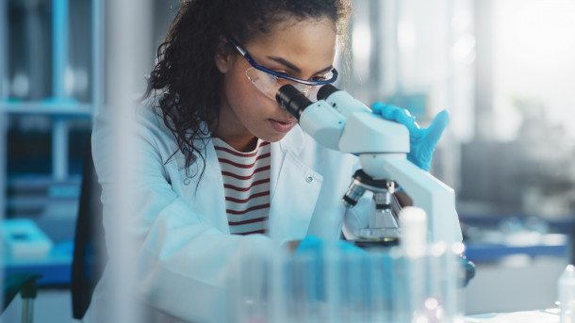
3.What subjects are these?
=> These are…………..?

Slide 6
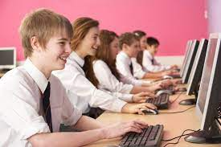
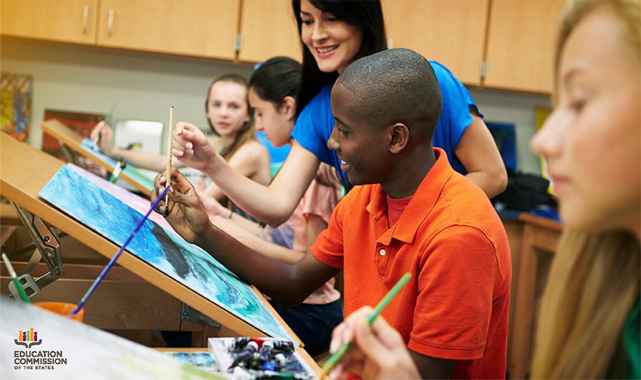
4.What subjects are these?
=> These are........

Slide 7
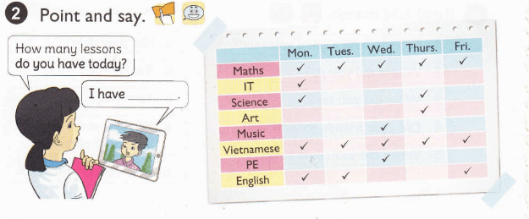
5.WHAT LESSONS DO YOU HAVE ON FRIDAY?
I HAVE MATHS, VIETNAMESE AND ENGLISH
I HAD MATHS, VIETNAMESE AND ENGLISH
I HAVE THREE LESSON
I HAVE THREE LESSONS

Slide 8
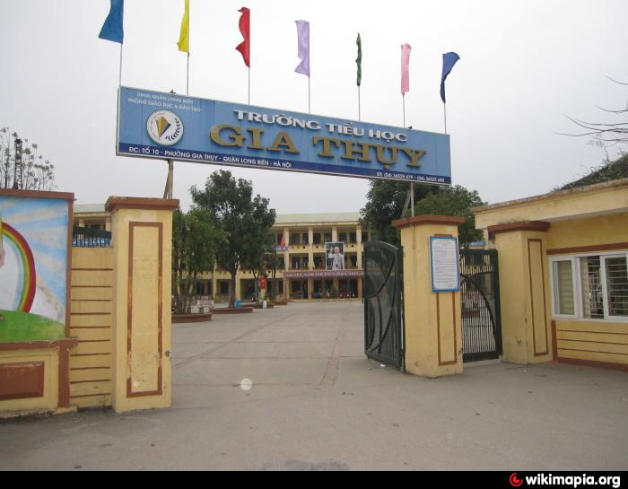
6.HOW MANY ENGLISH LESSONS DO YOU HAVE AT SCHOOL ON TUESDAY?

Slide 9
8.Complete the sentence below:
“HOW MANY ENGLISH LESSONS …….. HE HAVE AT SCHOOL TODAY?”

Slide 10
9.Complete the sentence below:
“HOW MANY ENGLISH LESSONS …….. SHE HAVE AT SCHOOL YESTERDAY?”

Slide 11

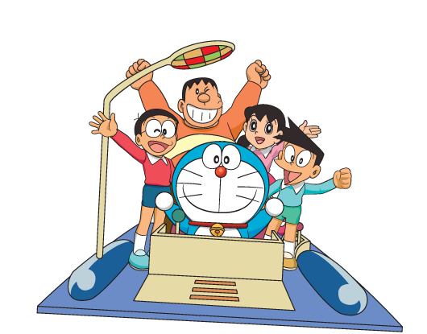

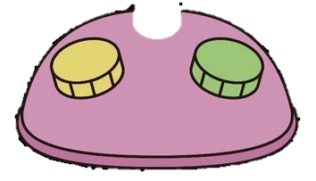

UNIT 6 : How many lessons do you have today?
Lesson 2 ( p.42-43)

Slide 12
Classroom rules
2.Listen
1.Be quite
3.Sit nicely
4. Raise you hand

Slide 13
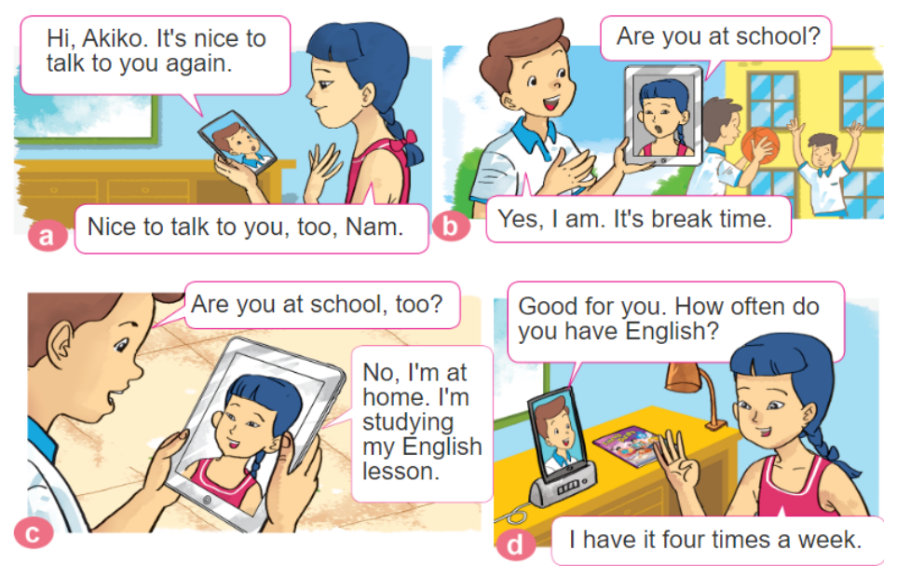
1. LOOK, LISTEN AND REPEAT
https://www.sachmem.vn/trial/books/19/exercises/5848?type=student

Slide 14
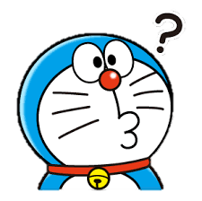
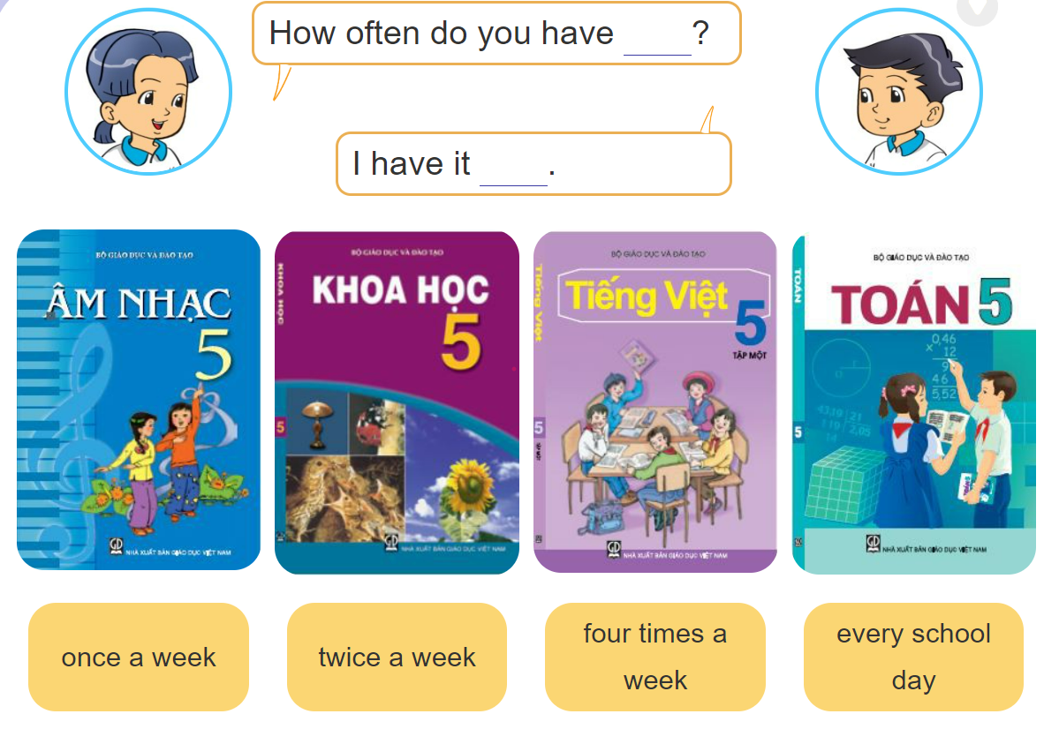
2: Point and say

Slide 15
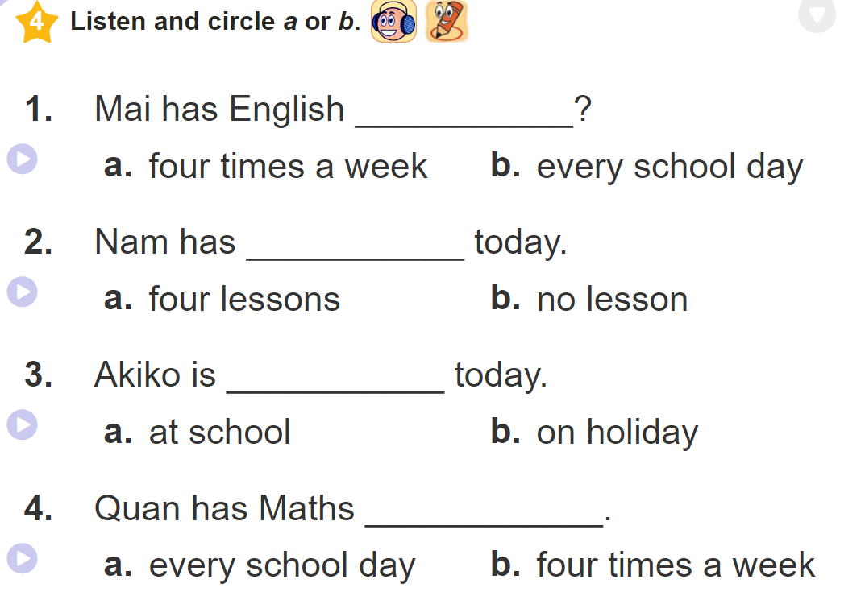
a.
a.
b.
b.

Slide 16
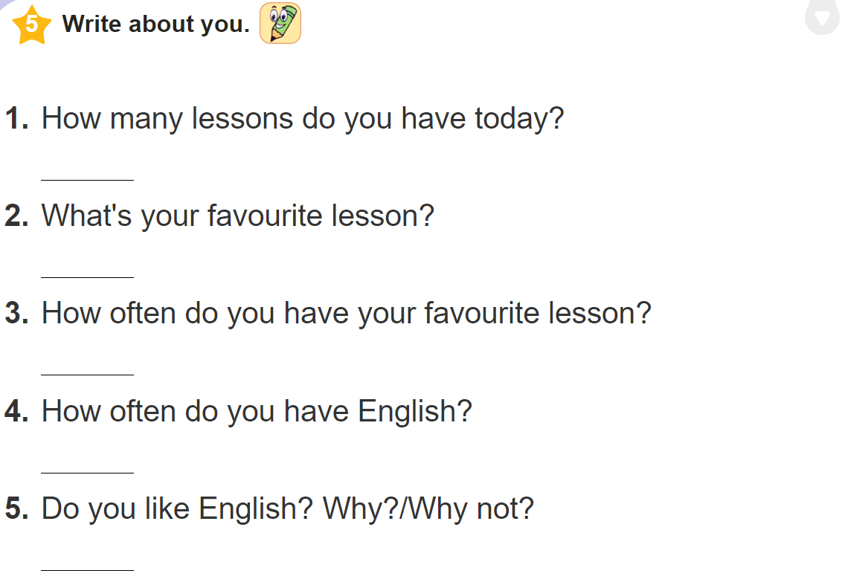

Slide 17
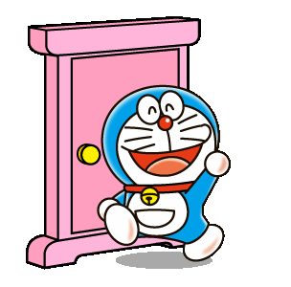



THANKS FOR WATCHING

