Slide 1

Unit 5: Getting Around
Lesson 2.3
Page 69

Slide 2
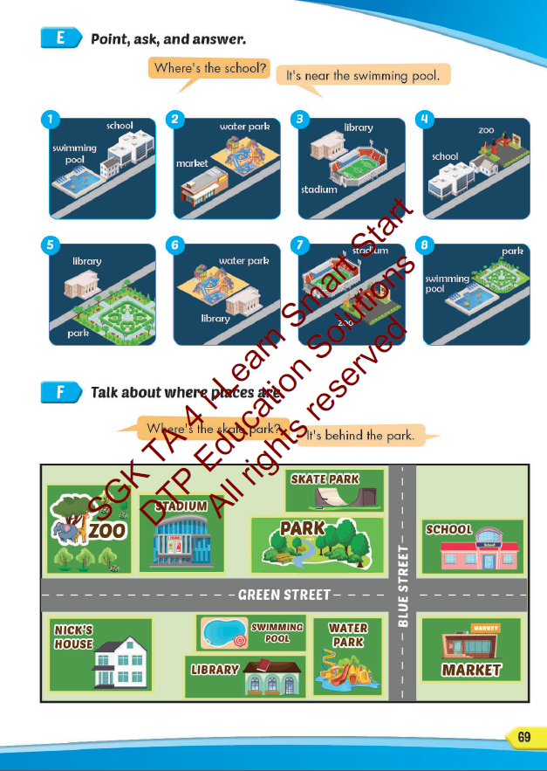
Lesson Outline
Warm-up
Practice
Speaking
Consolidation
Wrap-up

Slide 3
Objectives
By the end of this lesson, students will be able to…
Vocabulary: Pronounce and use the words related to the topic properly: near, behind, next to, opposite, in front of.
Structure: Where's the park? - It's next to the library.
Phonics: Identify the /eɪ/ sound and practice the conversations.

Slide 4

WARM UP

Slide 5




Slide 6
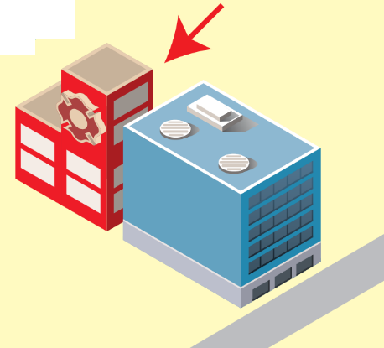



______________
near
opposite
next to
near
Click on the right balloon

Slide 7
opposite
__________
opposite
behind
near
Click on the right balloon

Slide 8
____________
behind
next to
near
behind
Click on the right balloon

Slide 9
______________
next to
behind
near
next to
Click on the right balloon

Slide 10

It’s time to learn …

Slide 11

Speaking

Slide 12


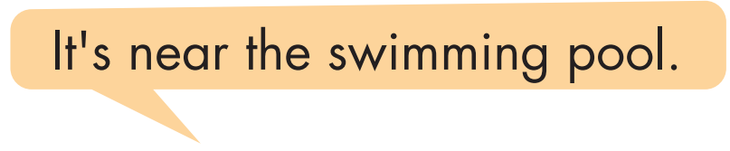
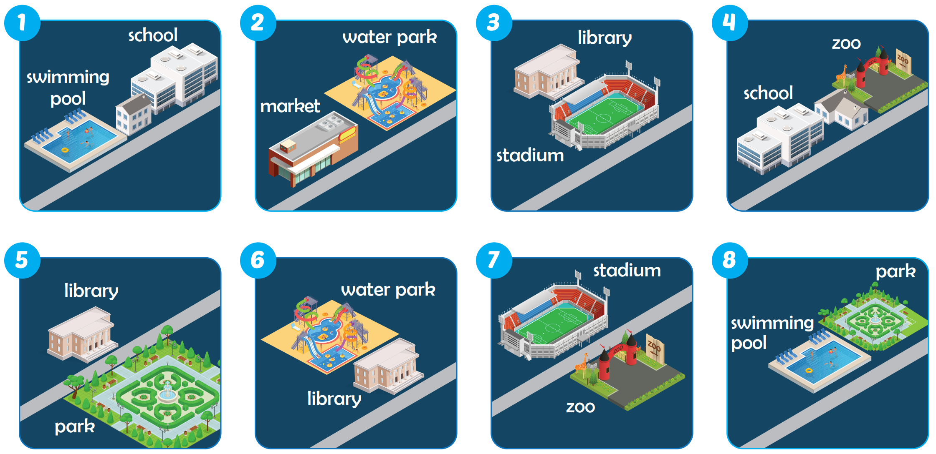

Slide 13



Where's the school?
It's near the swimming pool.

Slide 14
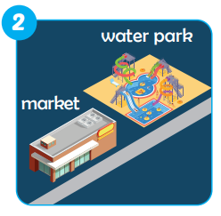
It's next to the water park.
Where's the market?

Slide 15
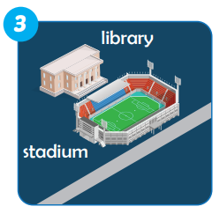
It's in front of the library.
Where's the stadium?

Slide 16
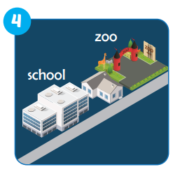
Where's the zoo?
It's near the school.

Slide 17
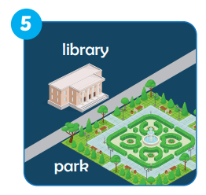
It's oppostite the library.
Where's the park?

Slide 18
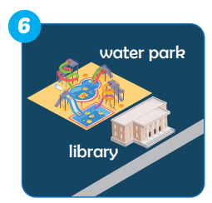
Where's the water park?
It's behind the library.

Slide 19
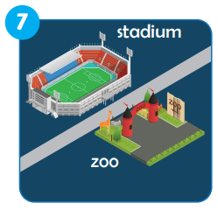
It's oppostite the stadium.
Where's the zoo?

Slide 20
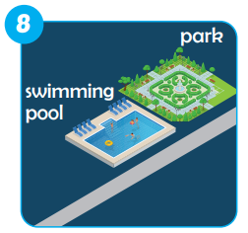
Where's swimming pool?
It's near the park.

Slide 21

Production

Slide 22

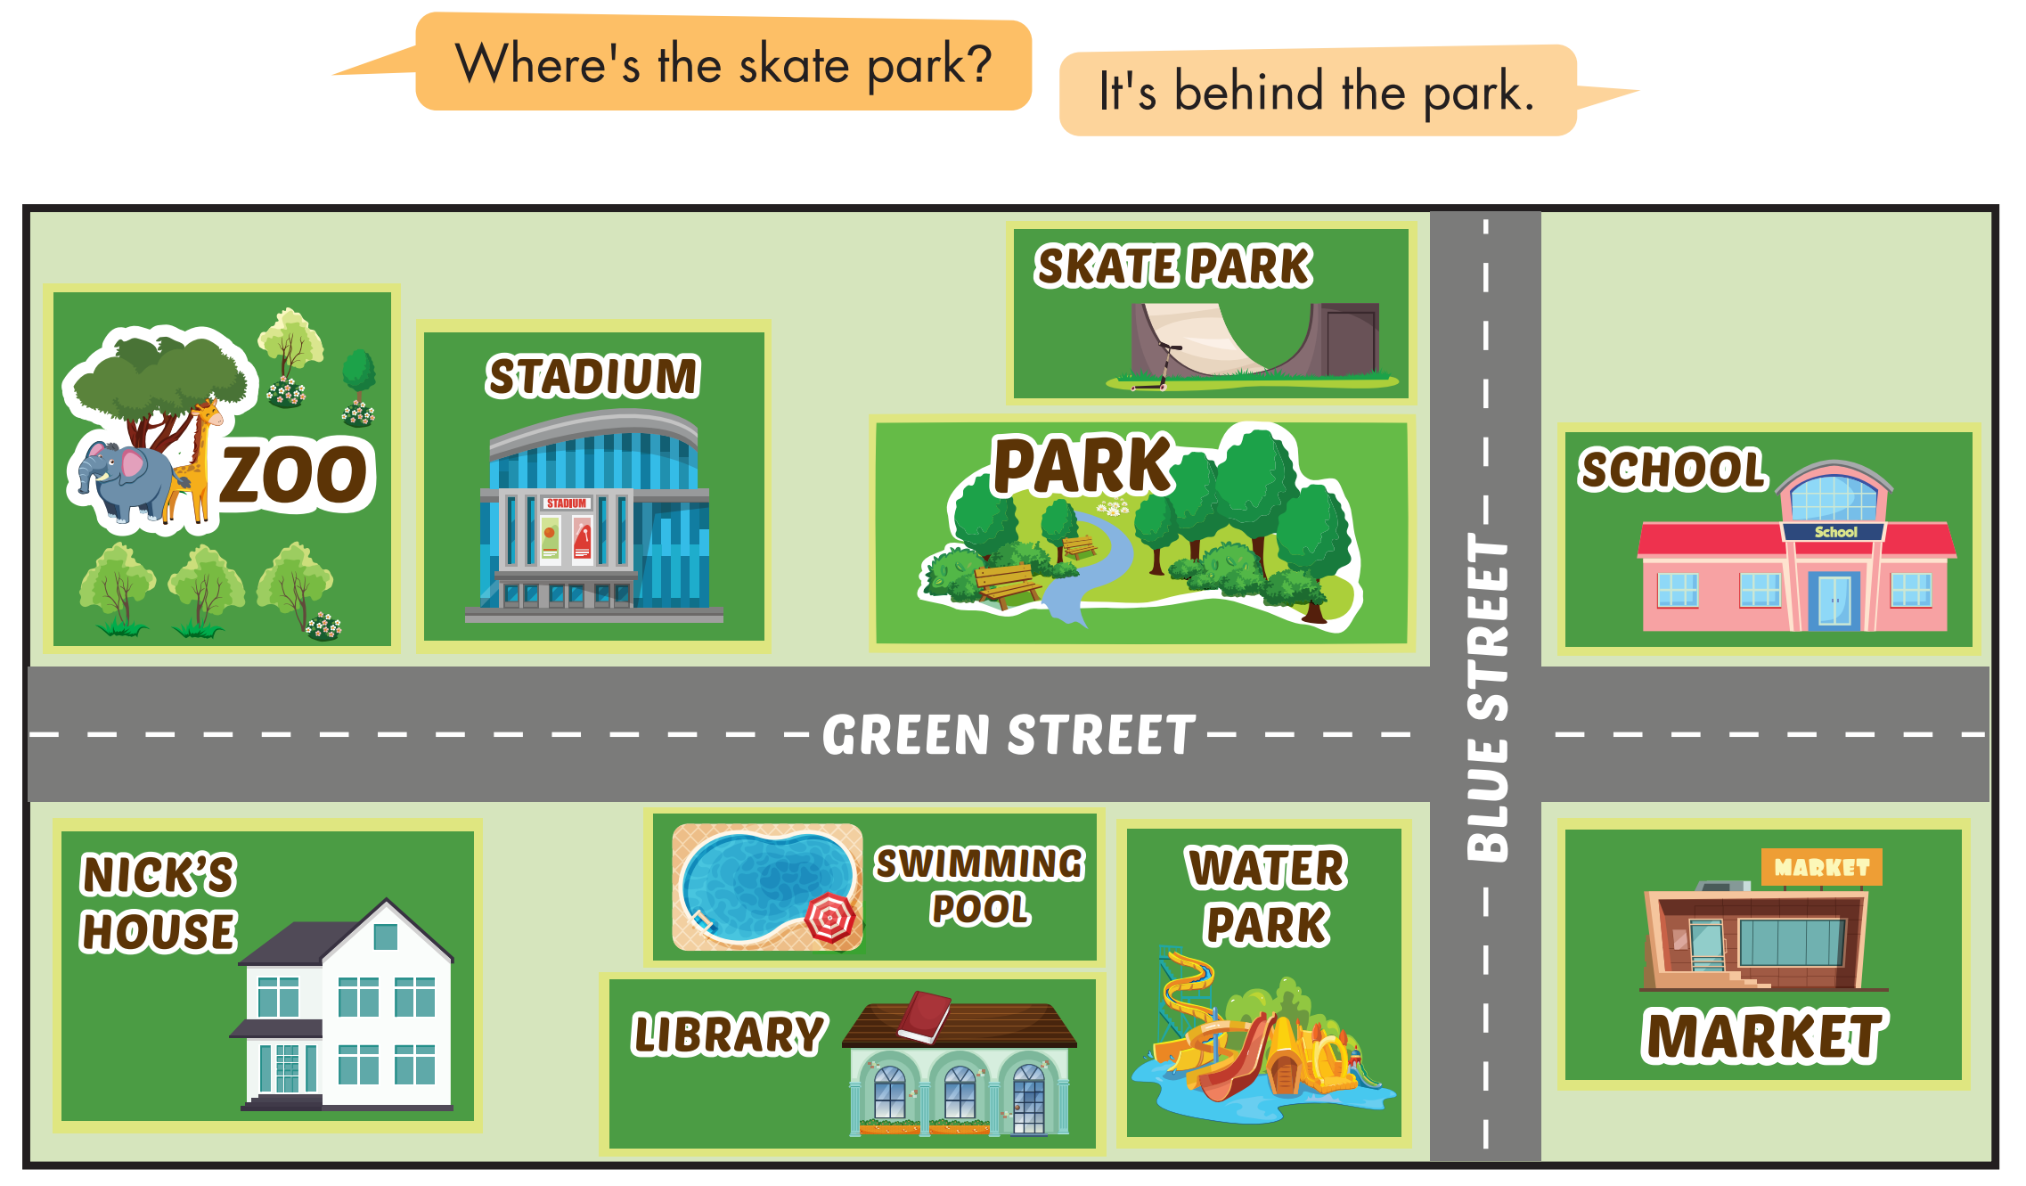

Slide 23

CONSOLIDATION

Slide 24

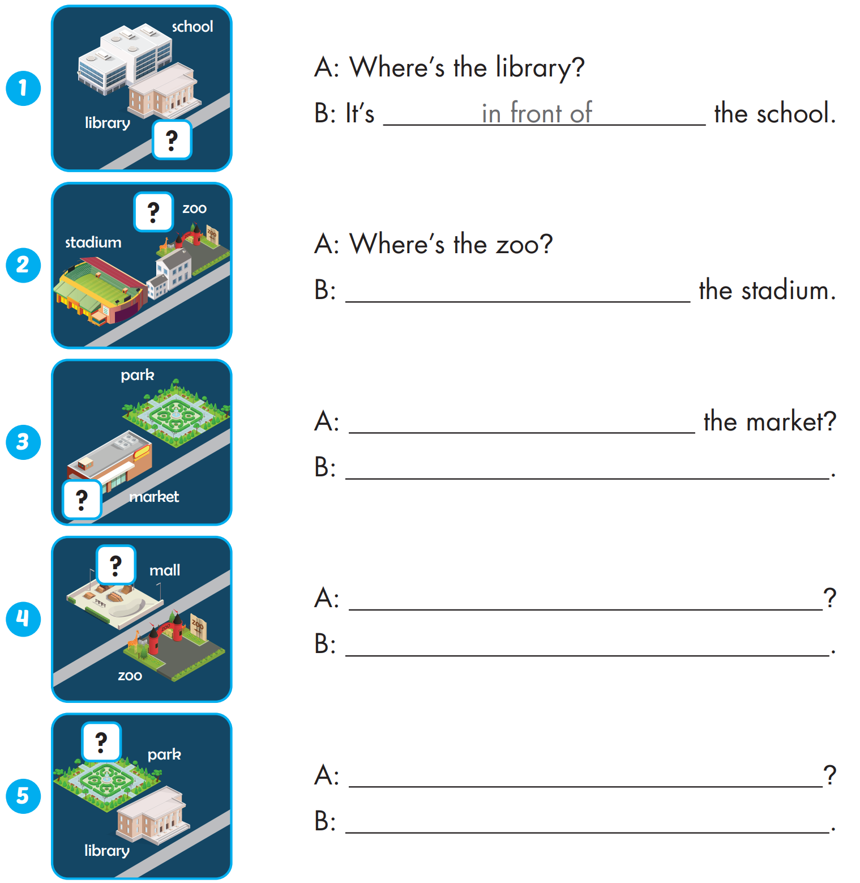
Extra Practice
WB, P. 45
It's near the
Where's
It's next to the park.

Slide 25
Extra Practice
WB, P. 45
Where's the mall
It's opposite the zoo.
Where's the library
It's in front of the park.

Slide 26

WRAP-UP

Slide 27
Today’s lesson
Vocabularies
near, behind, next to, opposite, in front of.
Structures/ Sentence patterns
Where's the park?
- It's next to the library.
Phonics
Identify the /eɪ/ sound and practice the conversations.

Slide 28
Homework
Practice the vocabularies and structure; and make sentences using them.
Do the exercises in Tiếng Anh 4 i-Learn Smart Start WB (page 45)
Prepare the next lesson (page 70 SB)
Play the consolidation games in Tiếng Anh 4 i-Learn Smart Start DHA App on www.eduhome.com.vn

Slide 29

Enjoy your day!

