Slide 1

Unit 8: Food
Lesson 2.3
Page 115

Slide 2
Lesson Outline
Warm-up
Practice
Speaking
Consolidation
Wrap-up

Slide 3
Objectives
By the end of this lesson, students will be able to…
Vocabulary: Practice vocabulary learnt earlier in the lesson.
Structure: Practice structures:
Are there any…? - Yes, there are (some…)/ No, there aren’t.
Is there…? - Yes, there is (a/an…)/No, there isn’t.

Slide 4

WARM UP

Slide 5


What’s in the box?
I am red.
Tomato!
I have six letters.
t_ma_ _

Slide 6
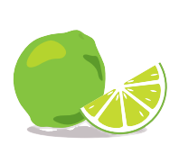
What’s in the box?
_im_
I am green.
Lime!
I have four letters.

Slide 7
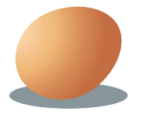
What’s in the box?
I have three letters.
I am brown.
Egg!
_ _ g

Slide 8

It’s time to learn …

Slide 9

Look and write
Pre-Speaking
______ _______ _______ limes?
Are there any limes?
Notes:
Click textbox: pre-speaking to hear the sound

Slide 10
Pre-Speaking
Look and write
______ , _______ are .
Yes, there are.
Notes:
Cắt: Would you like some pizza (lấy của lesson trước)

Slide 11
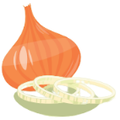
Pre-Speaking
Look and write
______ _______ an onion?
Is there an onion?
Notes:
Cắt: Would you like some fries (lấy của lesson trước)

Slide 12
Look and write
Pre-Speaking
______, _______ isn’t.
No, there isn’t.
Notes:
Cắt: Would you like some pizza (lấy của lesson trước)

Slide 13

Structures
Are there any…? - Yes, there are (some…)/ No, there aren’t.
Is there…? - Yes, there is (a/an…)/No, there isn’t.

Slide 14
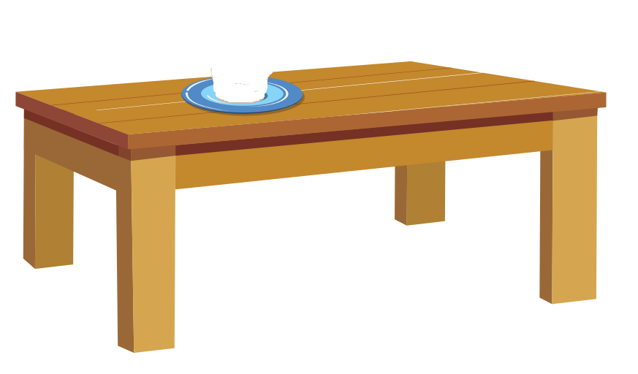



Look and answer.
Is there a tomato?
Yes, there is.

Slide 15
Look and answer.
Are there any potatoes on the table?
- No, there aren’t.

Slide 16
Look and answer.
Are there any limes on the table?
- Yes, there are.

Slide 17
Look and answer.
Is there an egg on the table?
- No, there isn’t.

Slide 18

Practice

Slide 19
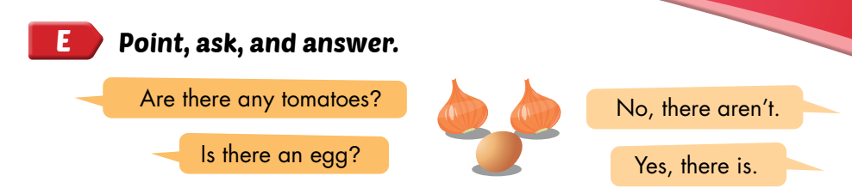
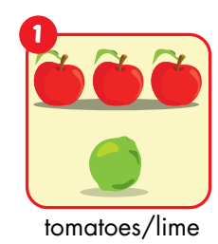

Slide 20

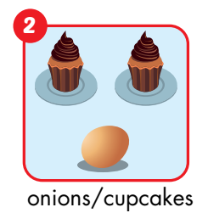
Are there any onions?
No, there aren’t.
Are there any cupcakes?
Yes, there are.

Slide 21
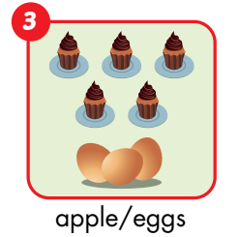
Is there an apple?
No, there isn’t.
Are there any eggs?
Yes, there are.

Slide 22
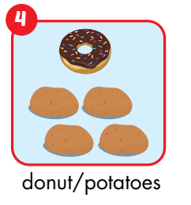
Is there a donut?
Yes, there is.
Are there any potatoes?
Yes, there are.

Slide 23
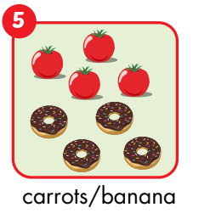
Are there any carrots?
No, there aren’t.
Is there a banana?
No, there isn’t.

Slide 24
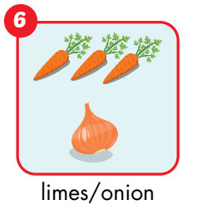
Are there any limes?
No, there aren’t.
Is there an onion?
Yes, there is.

Slide 25
Post speaking
Guess the food by asking questions.
One student will stand in front of the class. The teacher gives the student a picture of food. The other students will ask the questions to guess the food in the picture.

Slide 26

CONSOLIDATION

Slide 27
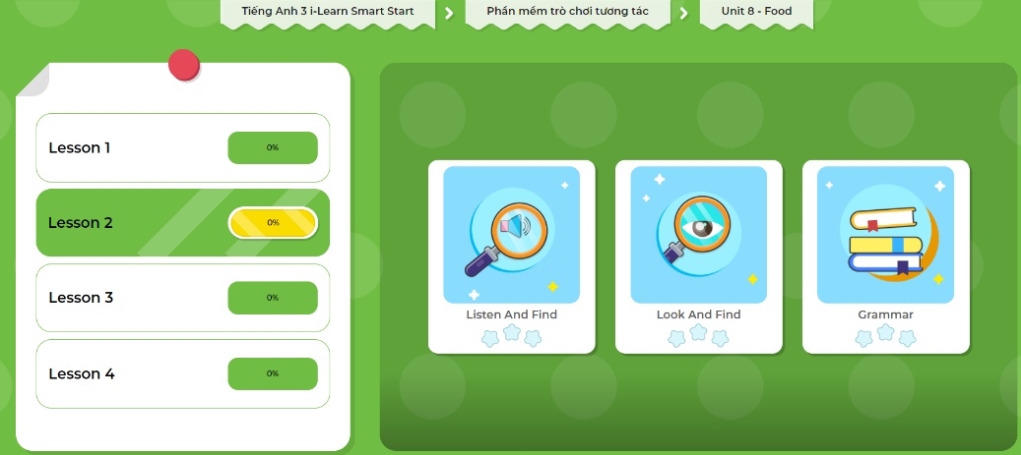
Extra Practice
DHA App
LET’S PLAY!
Click here to play the games

Slide 28
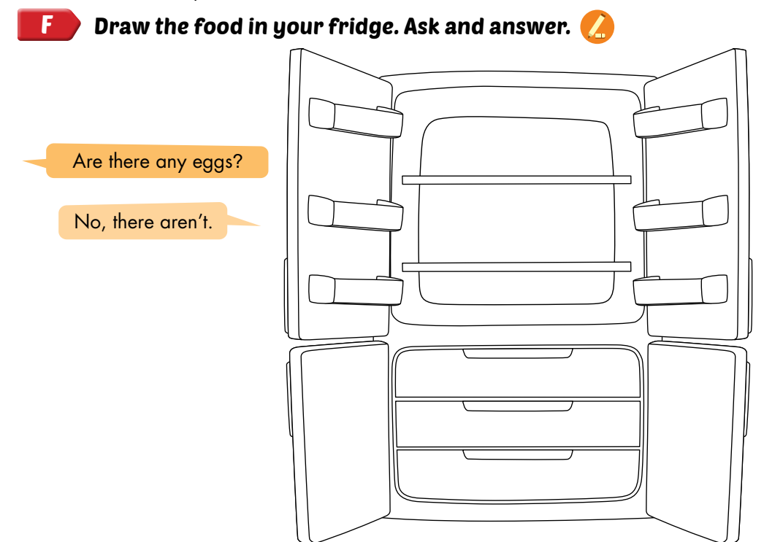

Slide 29
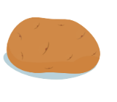

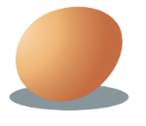
Memory game
Notes:
First, students have 30 seconds to remember as many pictures as they can from the screen. After 30 seconds, all of the pictures disappear. SS will write down as many items as they can remember using There is and There are, e.g. Finally, students read the sentences to share them with classmates.

Slide 30

WRAP-UP

Slide 31
Lesson 3
Today’s lesson
Structures/ Sentence patterns
Are there any…? - Yes, there are (some…)/ No, there aren’t.
Is there…? - Yes, there is (a/an…)/No, there isn’t.

Slide 32
Lesson 3
Homework
Practice the vocabularies and structure; and make sentences using them.
Do the exercises in Tiếng Anh 3 i-Learn Smart Start WB (page 81)
Do the exercises in Tiếng Anh 3 i-Learn Smart Start Notebook (page 53)
Prepare the next lesson (page 116 SB)
Play the consolidation games in Tiếng Anh 3 i-Learn Smart Start DHA App on www.eduhome.com.vn

Slide 33
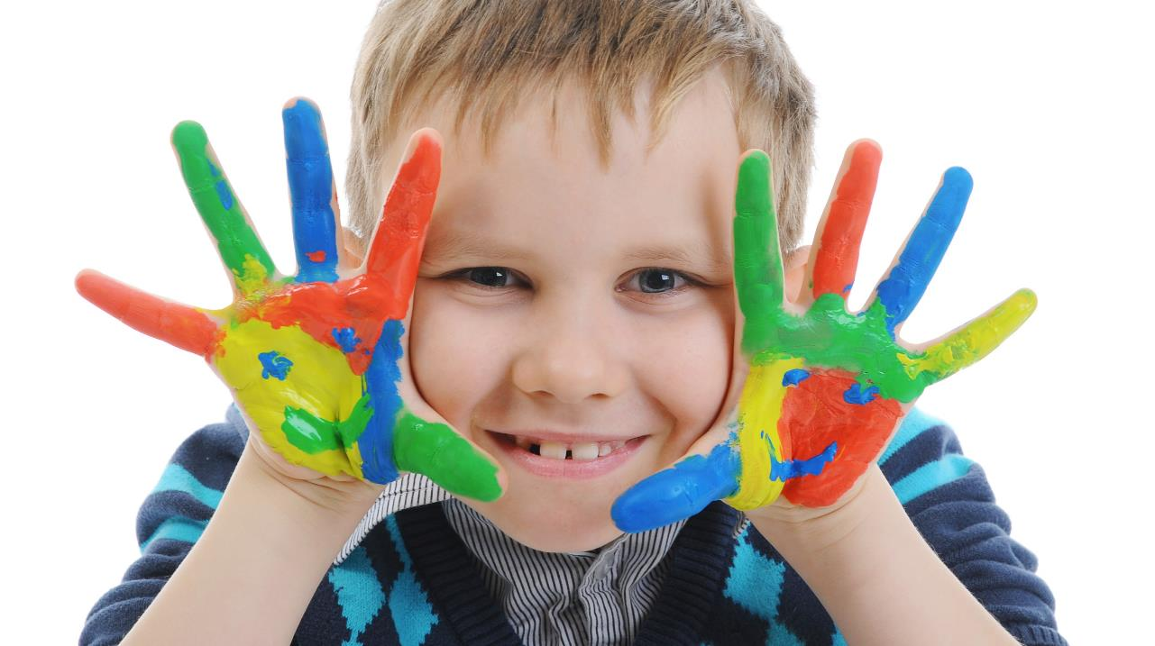
Enjoy your day!

