Slide 1

Unit 7: Toys
Lesson 4.1
Page 105

Slide 2
Lesson Outline
Warm-up
Vocabulary
Structure
Consolidation
Wrap-up

Slide 3
Objectives
By the end of this lesson, students will be able to…
Vocabulary: Pronounce and use the words related to the topic properly: eleven, twelve, thirteen, fourteen, fifteen, sixteen, seventeen, eighteen, nineteen, twenty
Structure: Do simple math by using:
Seven plus twelve is nineteen.
Twenty minus six is fourteen.

Slide 4

WARM UP

Slide 5




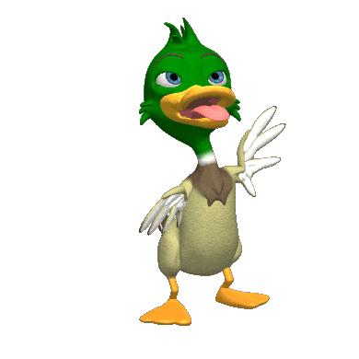

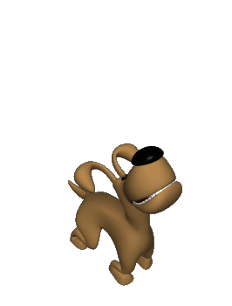




Listen to the number and choose it.
1
2
3
4
5
6
7
8
9
10
CLICK
NEXT

Slide 6
Listen to the number and choose it.
1
2
3
4
5
6
7
8
9
10
CLICK
NEXT

Slide 7
Listen to the number and choose it.
1
2
3
4
5
6
7
8
9
10
CLICK
NEXT

Slide 8
Listen to the number and choose it.
1
2
3
4
5
6
7
8
9
10
CLICK
NEXT

Slide 9
Listen to the number and choose it.
1
2
3
5
4
6
7
8
9
10
CLICK
NEXT

Slide 10
Listen to the number and choose it.
2
3
4
1
5
6
7
8
9
10
CLICK
NEXT

Slide 11
Listen to the number and choose it.
1
2
3
5
4
6
7
8
9
10
CLICK
NEXT

Slide 12
Listen to the number and choose it.
1
2
3
4
5
6
7
8
9
10
CLICK
NEXT

Slide 13
Listen to the number and choose it.
3
4
5
1
2
6
7
8
9
10
CLICK
NEXT

Slide 14
Listen to the number and choose it.
1
2
3
5
4
6
7
8
9
10
CLICK
NEXT

Slide 15

It’s time to learn …

Slide 16

New words
eleven, twelve, thirteen, fourteen, fifteen, sixteen, seventeen, eighteen, nineteen, twenty

Slide 17

Presentation

Slide 18






















Click A to hear the sound
Click on each picture to hear the sound.
Notes:
Click vào hình A. 1. Listen and point. Repeat để cho cả audio full chạy

Slide 19
Click A to hear the sound
/ɪˈlevn/
số 11
/twelv/
số 12
/ˌθɜːrˈtiːn/
số 13
/ˌfɔːrˈtiːn/
số 14
/ˌfɪfˈtiːn/
số 15
/ˌsɪksˈtiːn/
số 16
/ˌsevnˈtiːn/
số 17
/ˌeɪˈtiːn/
số 18
/ˌnaɪnˈtiːn/
số 19
/ˈtwenti/
số 20
Click on each picture to hear the sound.
Notes:
Click vào hình A. 1. Listen and point. Repeat để cho cả audio full chạy

Slide 20


Click on each picture to hear the sound.
/ɪˈlevn/
số 11
Notes:
Click vào hình A. 1. Listen and point. Repeat để cho cả audio full chạy

Slide 21


Click on each picture to hear the sound.
/twelv/
số 12
Notes:
Click vào hình A. 1. Listen and point. Repeat để cho cả audio full chạy

Slide 22


Click on each picture to hear the sound.
/ˌθɜːrˈtiːn/
số 13
Notes:
Click vào hình A. 1. Listen and point. Repeat để cho cả audio full chạy

Slide 23


Click on each picture to hear the sound.
/ˌfɔːrˈtiːn/
số 14
Notes:
Click vào hình A. 1. Listen and point. Repeat để cho cả audio full chạy

Slide 24


Click on each picture to hear the sound.
/ˌfɪfˈtiːn/
số 15
Notes:
Click vào hình A. 1. Listen and point. Repeat để cho cả audio full chạy

Slide 25


Click on each picture to hear the sound.
/ˌsɪksˈtiːn/
số 16
Notes:
Click vào hình A. 1. Listen and point. Repeat để cho cả audio full chạy

Slide 26


Click on each picture to hear the sound.
/ˌsevnˈtiːn/
số 17
Notes:
Click vào hình A. 1. Listen and point. Repeat để cho cả audio full chạy

Slide 27


Click on each picture to hear the sound.
/ˌeɪˈtiːn/
số 18
Notes:
Click vào hình A. 1. Listen and point. Repeat để cho cả audio full chạy

Slide 28

Click on each picture to hear the sound.
/ˌnaɪnˈtiːn/
số 19
Notes:
Click vào hình A. 1. Listen and point. Repeat để cho cả audio full chạy

Slide 29


Click on each picture to hear the sound.
/ˈtwenti/
số 20
Notes:
Click vào hình A. 1. Listen and point. Repeat để cho cả audio full chạy

Slide 30

Practice

Slide 31


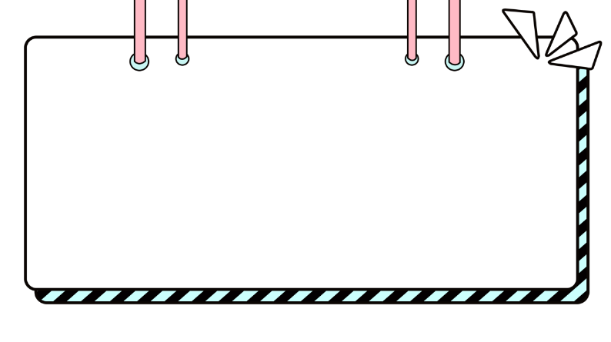
PLAYTIME

Slide 32

Choose the right option before the dog comes.

Slide 33



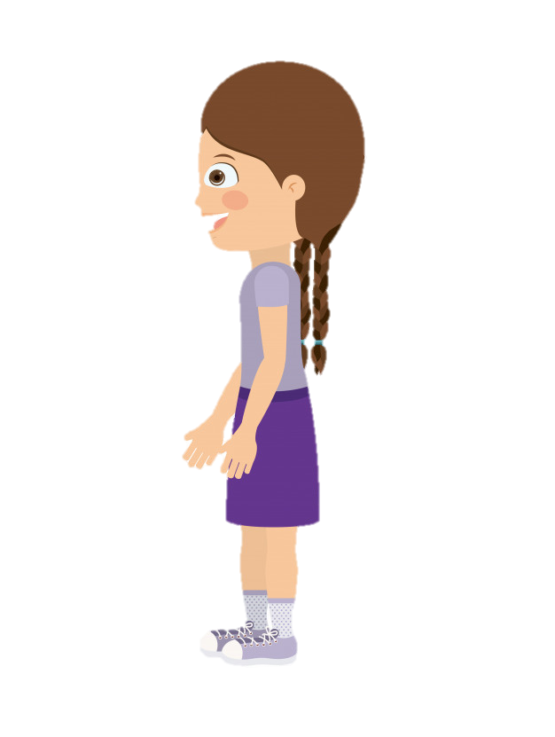
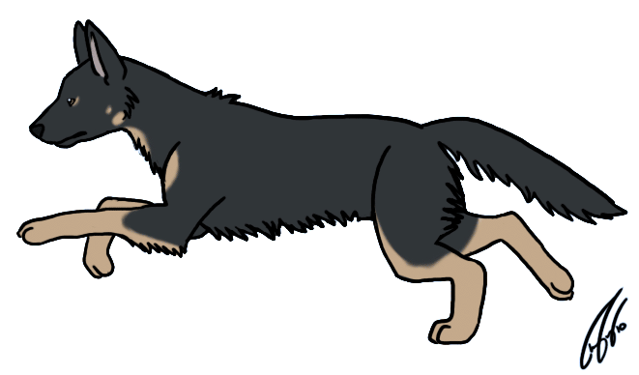
Choose the right word.
twelve
thirteen
eleven

Slide 34


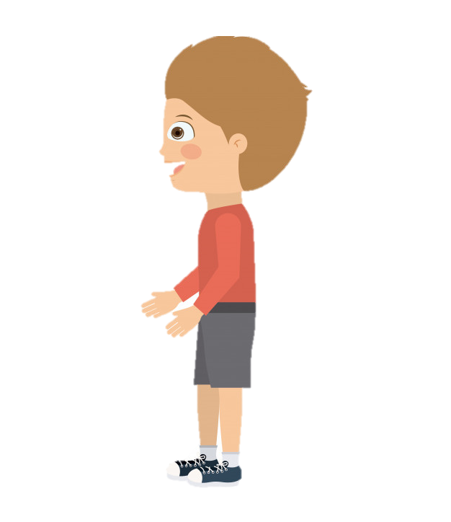
Choose the right word.
fourteen
fifteen
eighteen

Slide 35


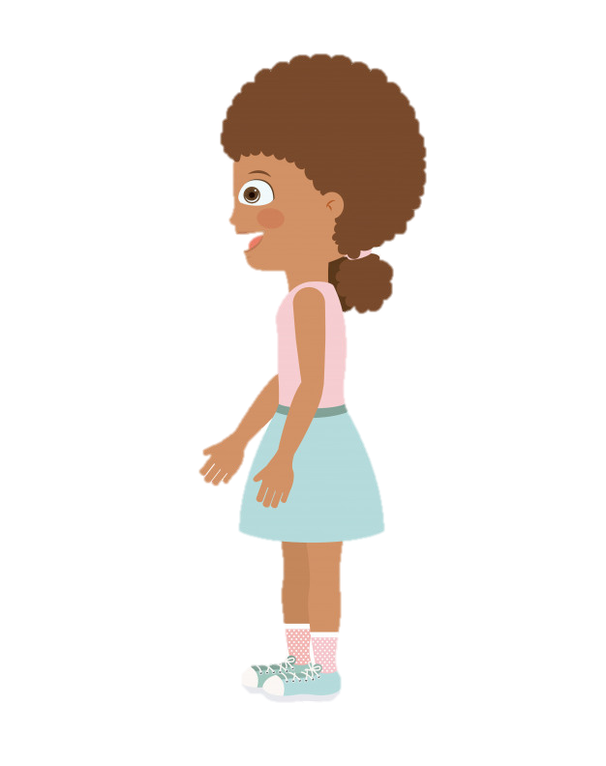
Choose the right word.
fifteen
sixteen
seventeen

Slide 36


Choose the right word.
twelve
thirteen
twenty

Slide 37


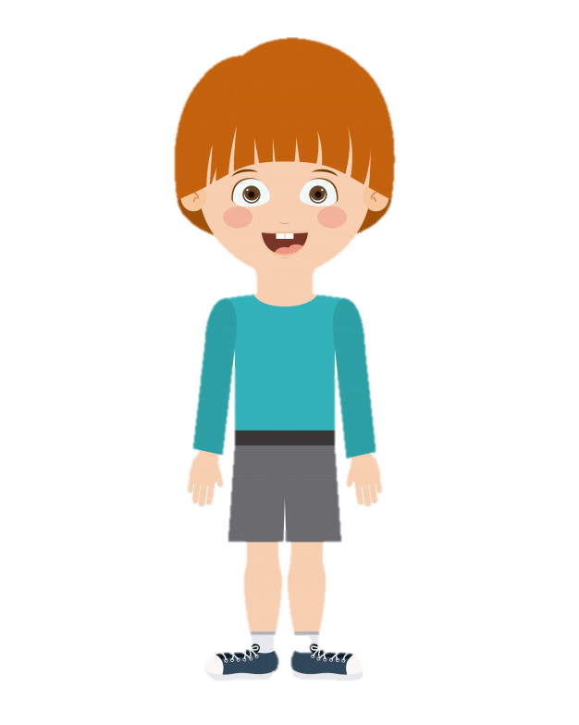
Choose the right word.
eighteen
twenty
nineteen

Slide 38

Choose the right word.
thirteen
fourteen
fifteen

Slide 39

Choose the right word.
twelve
fourteen
sixteen

Slide 40

Choose the right word.
twenty
twelve
thirteen

Slide 41

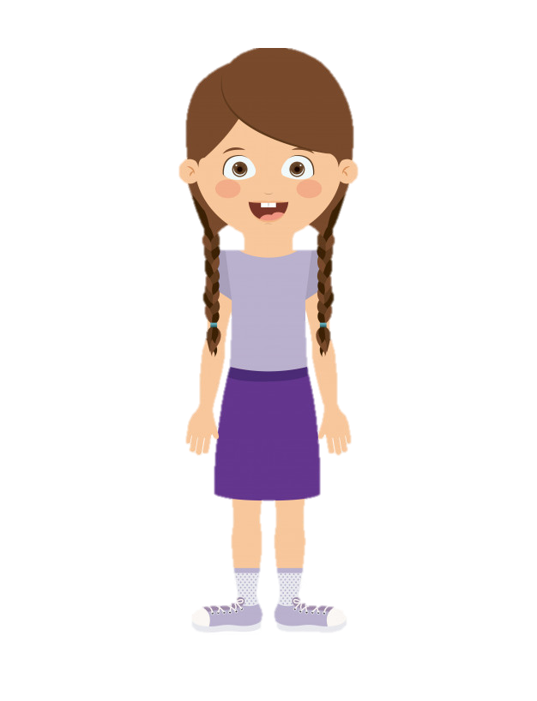
Choose the right word.
fifteen
nineteen
eighteen

Slide 42



Slide 43
Structures
Seven plus twelve is nineteen.
Twenty minus six is fourteen.

Slide 44

Presentation

Slide 45






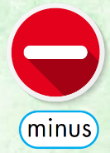


Slide 46

Practice

Slide 47


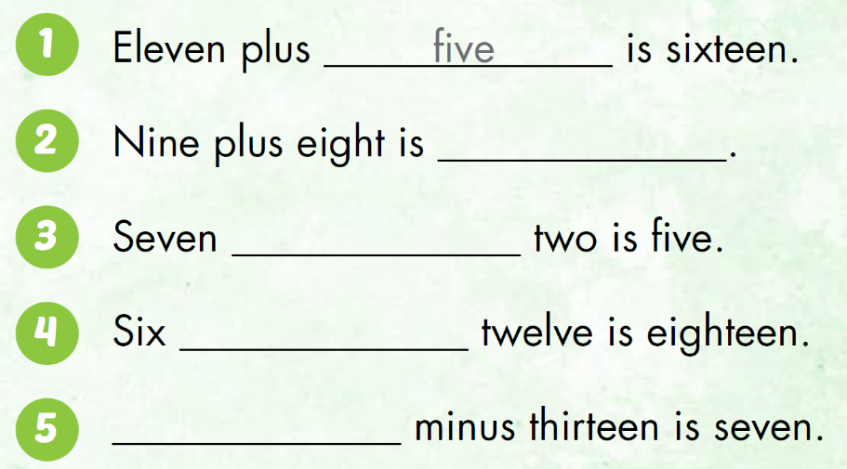

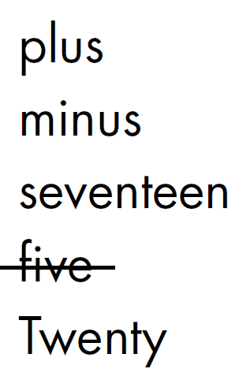
Now, work in pair to practice.
seventeen
minus
plus
Twenty

Slide 48

CONSOLIDATION

Slide 49

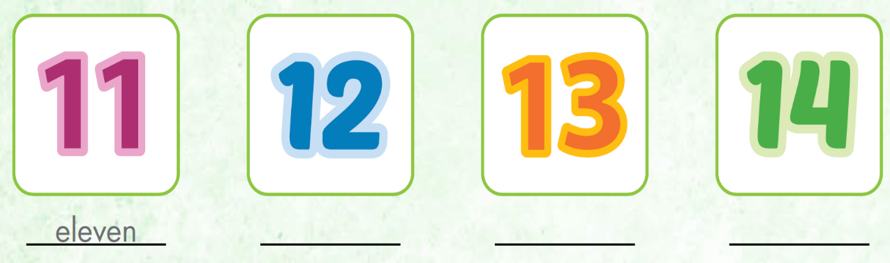
Extra Practice WB, P. 74
twelve
thirteen
fourteen

Slide 50
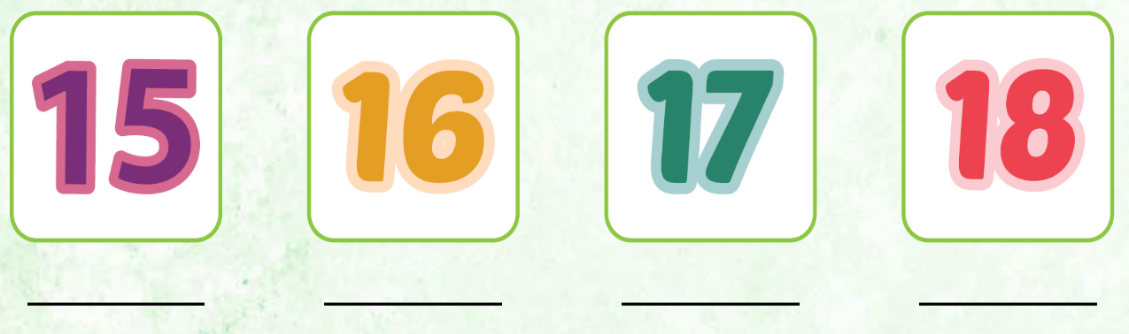
Extra Practice WB, P. 74
fifteen
sixteen
seventeen
eighteen

Slide 51
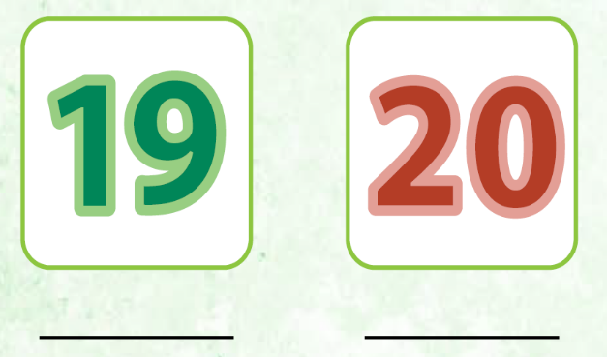
Extra Practice WB, P. 74
nineteen
twenty

Slide 52
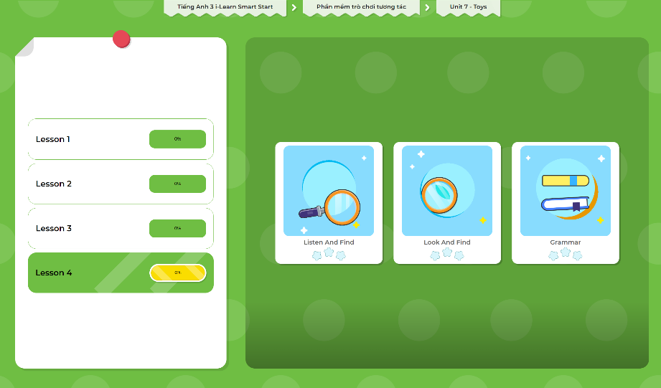
Extra Practice
DHA App
LET’S PLAY!
Click here to play the games

Slide 53

WRAP-UP

Slide 54
Today’s lesson
Vocabularies
eleven, twelve, thirteen, fourteen, fifteen, sixteen, seventeen, eighteen, nineteen, twenty
Structures/ Sentence patterns
Seven plus twelve is nineteen.
Twenty minus six is fourteen.

Slide 55
Homework
Practice the vocabularies and structure; and make sentences using them.
Do the exercises in Tiếng Anh 3 i-Learn Smart Start WB (page 74)
Prepare the next lesson (page 106 SB)
Play the consolidation games in Tiếng Anh 3 i-Learn Smart Start DHA App on www.eduhome.com.vn

Slide 56

Enjoy your day!

