Slide 1

Unit 4: HOME
Lesson 3.2
Page 59

Slide 2
Lesson Outline
Warm-up
Listening
Consolidation
Wrap-up

Slide 3
Objectives
By the end of this lesson, students will be able to ask where things are.
Vocabulary: Revision
mirror, picture, sofa, table, box, house.
Structure: Revision
Is the picture in the living room? Yes, it is.
Is the cat in the house? No, it isn’t.

Slide 4

WARM UP

Slide 5

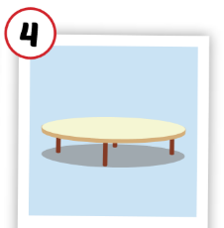
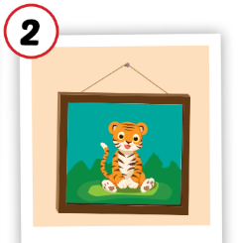

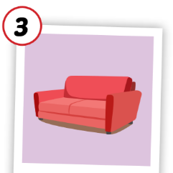
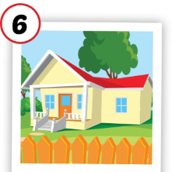
1
4
6
1
2
5
SPIN
5
2
3
4
3
6

Slide 6

It’s time to learn …

Slide 7

Listening

Slide 8

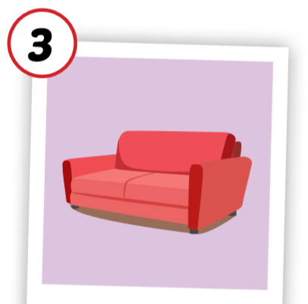
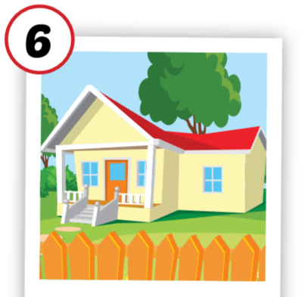

C. 1. Listen and repeat.
1
2
sofa
house

Slide 9


C. 2. Chant.
Click on the earphone to practice the chant.
/əʊ/, /aʊ/, /əʊ/
sofa
/əʊ/, /aʊ/, /əʊ/
house
/əʊ/, /aʊ/, /əʊ/

Slide 10

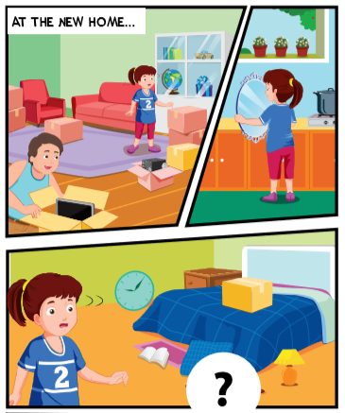
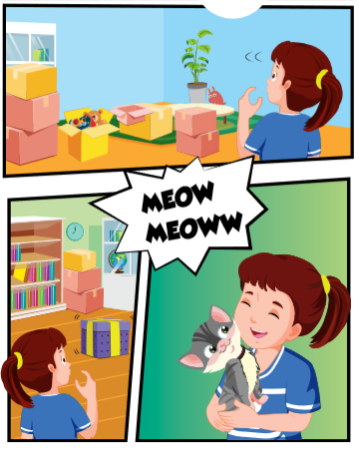

Slide 11


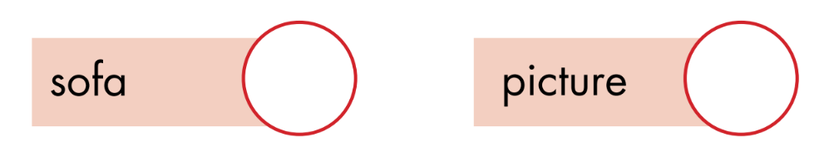
1
4
3
2

Slide 12


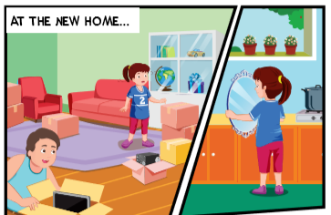
Can I help you, Daddy?
Yes, please, Lucy. Can you help me find some things?
Sure, Daddy.
Is the in the kitchen, Lucy ?
mirror
Yes, it is. Here you are ?

Slide 13
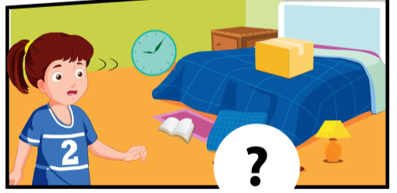
Is the in the bedroom ?
picture
Let me see. Yes, it is.
That’s great.

Slide 14
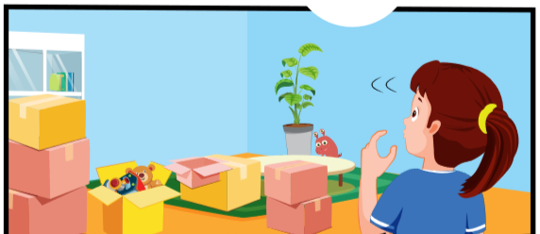
Is the in the living room ?
sofa
Oh, no, it isn’t.
That’s OK. We can find it later.

Slide 15
Is the in the living room ?
table
No, it isn’t.
OK. Do you see a box?
Yes.
Look in the box, Lucy.
Wow! Daddy! There’s a little cat.
It’s for you! Welcome to our new house!

Slide 16

Lucy: Can I help you, Daddy?
Mr. Brown: Yes, please, Lucy. Can you help me find some things?
Lucy: Sure, Daddy.
Mr. Brown: Is the mirror in the kitchen, Lucy?
Lucy: Yes, it is. Here you are.

Slide 17
Mr. Brown: Is the picture in the bedroom?
Lucy: Let me see. Yes, it is.
Mr. Brown: That’s great.

Slide 18
Mr. Brown: Is the sofa in the living room?
Lucy: Oh, no, it isn’t.
Mr. Brown: That’s OK. We can find it later.

Slide 19
Mr. Brown: Is the table in the living room?
Lucy: No, it isn’t.
Mr. Brown: OK. Do you see a box?
Lucy: Yes.
Mr. Brown: Look in the box, Lucy.
Lucy: Wow! Daddy! There’s a little cat!
Mr. Brown: It’s for you! Welcome to our new 2 house!

Slide 20

Workbook
p. 43

Slide 21
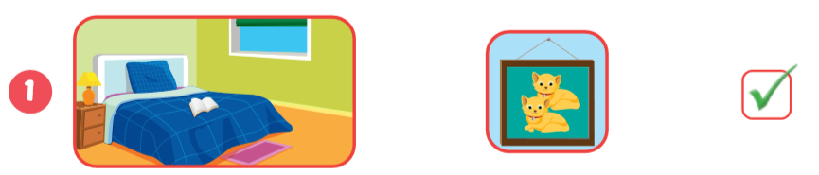
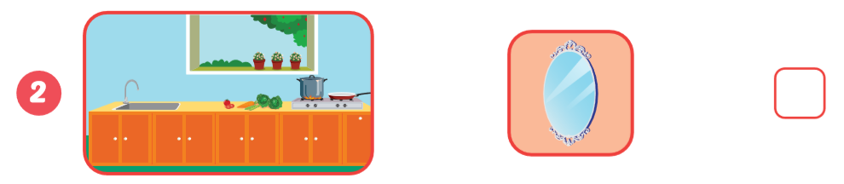


Slide 22
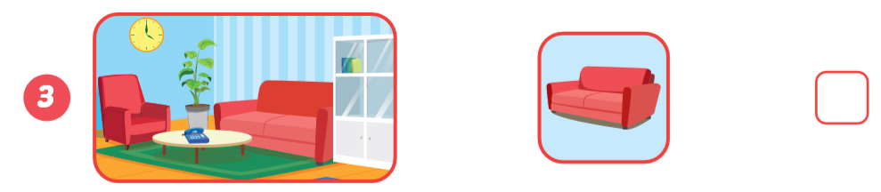

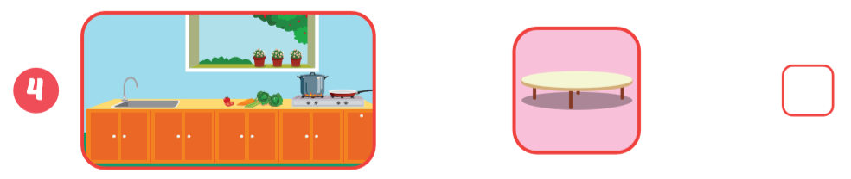

Slide 23

CONSOLIDATION

Slide 24
Look at the picture, ask and answer.
Is the cat in the bedroom?
Yes, it is.

Slide 25
Look at the picture, ask and answer.
Is the mirror in the bedroom?
No, it isn’t.

Slide 26

WRAP-UP

Slide 27
Lesson 3
Today’s lesson
Structures/ Sentence patterns
Revision
Is the picture in the living room? Yes, it is.
Is the cat in the house?
No, it isn’t.
Vocabularies
Revision
mirror, picture, sofa, table, box, house.

Slide 28
Homework
Review the vocabularies and sentence patterns.
Make sentences using them.
Do the exercise C on page 43 (WB)
Prepare the next lesson (page 60 SB)
Play the consolidation games in Tiếng Anh 3 i-Learn Smart Start DHA App on www.eduhome.com.vn
Do the exercises in Tiếng Anh 3 i-Learn Smart Start Notebook (page 30)

Slide 29

Enjoy your day!

Slide 30

Have a nice day!

