Slide 1

Unit 3: School
Lesson 3.1
Page 44

Slide 2
Lesson Outline
Warm-up
Vocabulary
Structure
Consolidation
Wrap-up

Slide 3
Objectives
By the end of this lesson, students will be able to identify days of a week and talk about their school timetables.
Vocabulary: Monday, Tuesday, Wednesday, Thursday, Friday, Saturday, Sunday
Structure: When do you have English? - I have English on Wednesdays and Fridays.

Slide 4

WARM UP

Slide 5

LET’S PLAY!
What’s missing?
Notes:
Put three or four FLASHCARDS (school subjects) on the board and tell your child to look at them. Ask them to close their eyes and take one card away. When your child opens their eyes, ask them to guess what is missing.

Slide 6

It’s time to learn …

Slide 7

New words
Monday,
Tuesday, Wednesday, Thursday,
Friday,
Saturday,
Sunday

Slide 8

Presentation

Slide 9


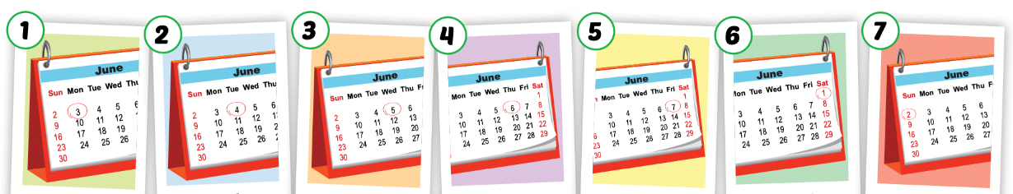
Listen and point.
Click the icon to hear the sound.

Slide 10
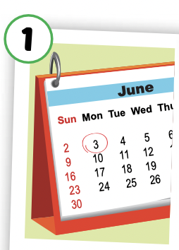
Listen and repeat.
Click each picture to hear the sound.
Monday
/ˈmʌndeɪ/
Thứ Hai

Slide 11
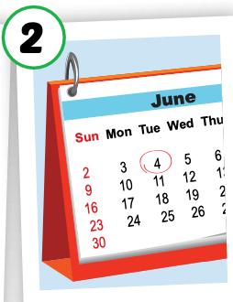
Listen and repeat.
Click each picture to hear the sound.
Tuesday
/ˈtuːzdeɪ/
Thứ Ba

Slide 12
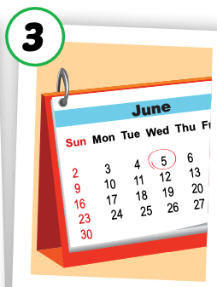
Listen and repeat.
Click each picture to hear the sound.
Wednesday
/ˈwenzdeɪ/
Thứ Tư

Slide 13
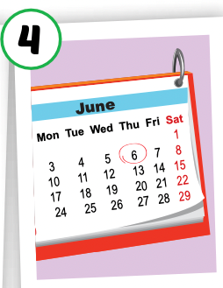
Listen and repeat.
Click each picture to hear the sound.
Thursday
/ˈθɜːrzdeɪ/
Thứ Năm

Slide 14
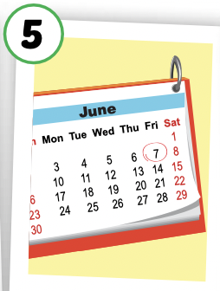
Listen and repeat.
Click each picture to hear the sound.
Friday
/ˈfraɪdeɪ/
Thứ Sáu

Slide 15
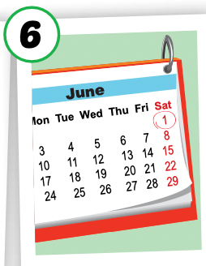
Listen and repeat.
Click each picture to hear the sound.
Saturday
/ˈsætərdeɪ/
Thứ Bảy

Slide 16
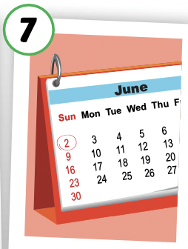
Listen and repeat.
Click each picture to hear the sound.
Sunday
/ˈsʌndeɪ/
Chủ Nhật

Slide 17

Practice

Slide 18

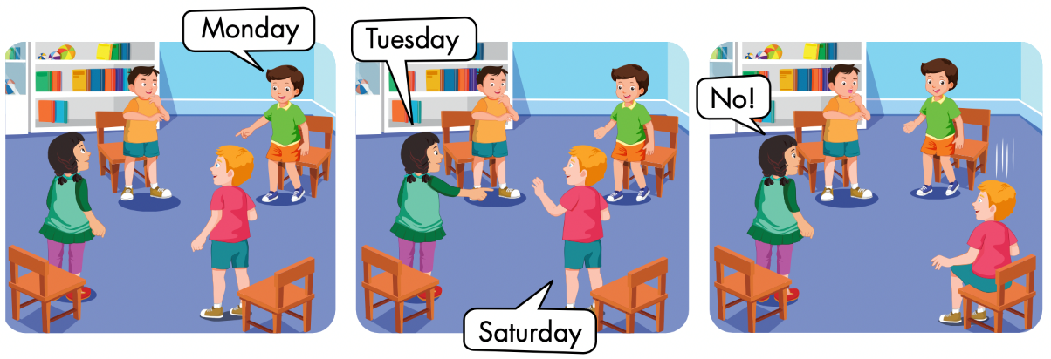

Slide 19
Let’s play!

Slide 20
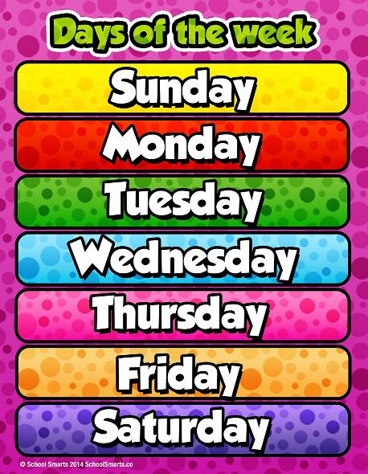
Days of the Week Game
Guess the day of the week

Slide 21
Say
the day
Click on
the number
Say
the number

Slide 22


1
2

Slide 23

2
1
3

Slide 24

3
4
1
2

Slide 25

2
1
3

Slide 26

1
2
3

Slide 27

3
1
2
5
4

Slide 28
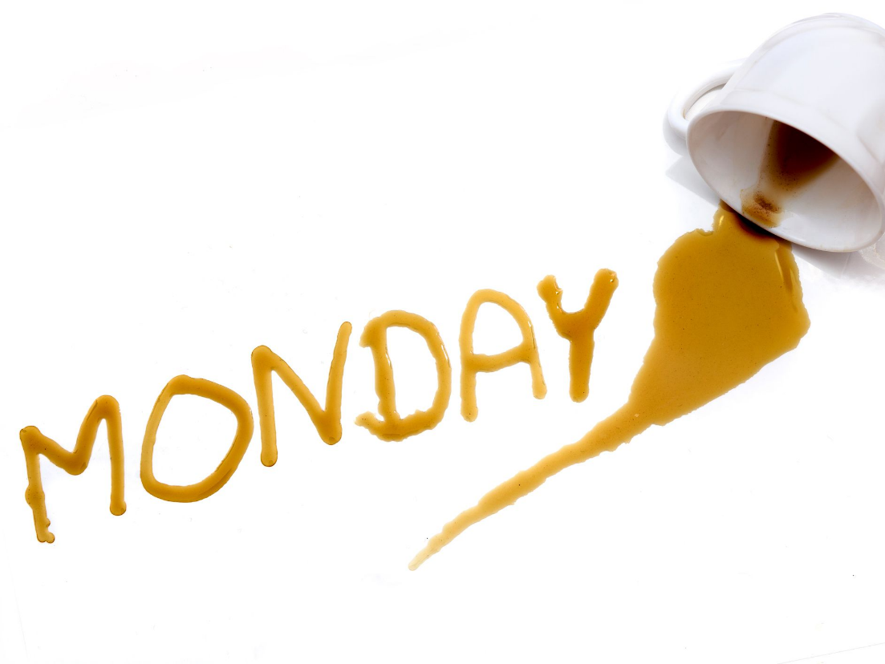
1
4
3
2

Slide 29

2
3
1

Slide 30
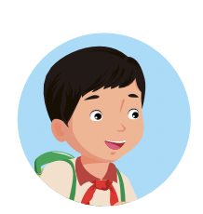
Good job!

Slide 31

Structures
When do you have English?
- I have English on Wednesdays and Fridays.

Slide 32
Presentation

Slide 33

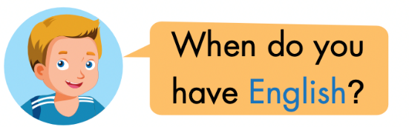
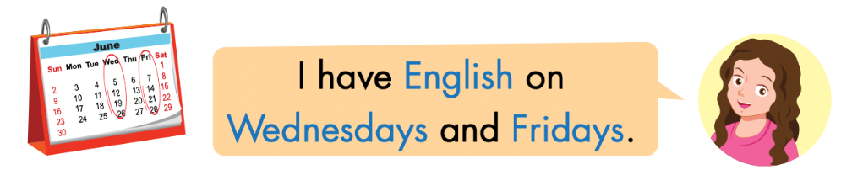
Click the icon to hear the sound.

Slide 34
Practice

Slide 35
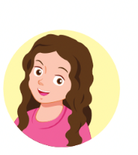
LET’S PRACTICE!
I have English on Mondays.
I have ……….. on ……….
English/ Monday
music/ Thursday
P.E./ Wednesday
math/ Tuesday

Slide 36
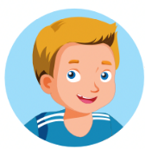

LET’S PRACTICE!
P.E./ Wednesday
English/ Monday
math/ Tuesday
music/ Thursday
When do you have English?
When do you have………….?
I have ……….. on ……….
I have English on Mondays.

Slide 37

Production

Slide 38

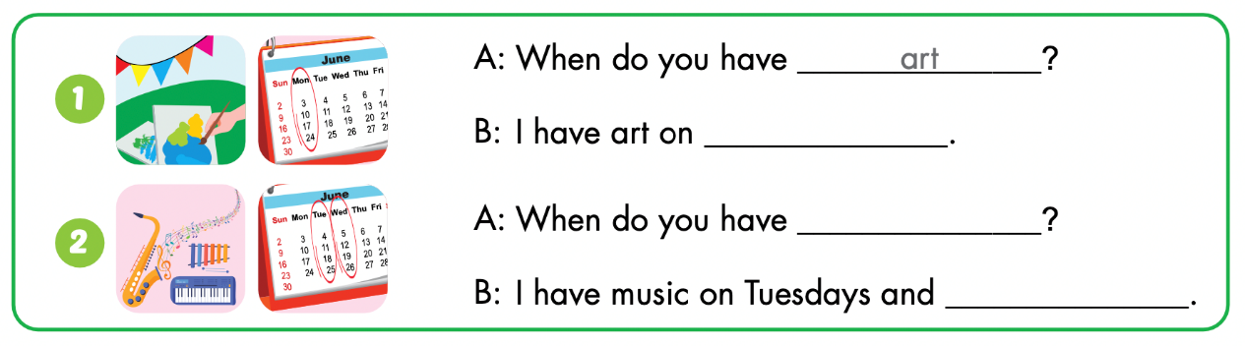

Slide 39
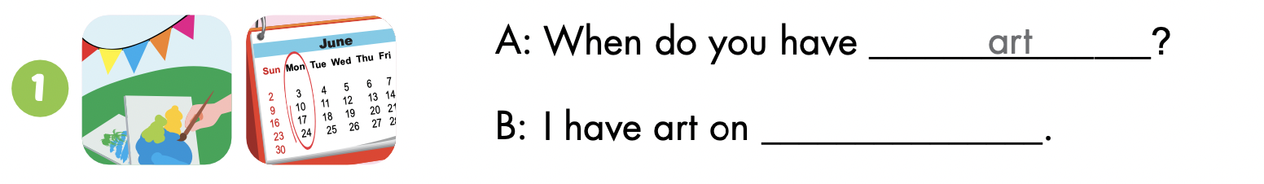
Monday

Slide 40
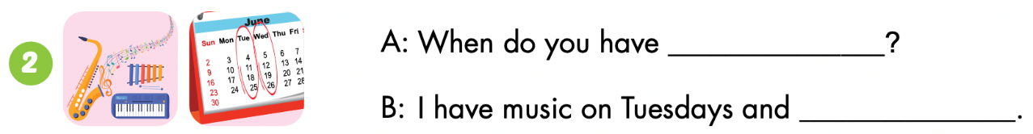
music
Wednesday

Slide 41

CONSOLIDATION

Slide 42
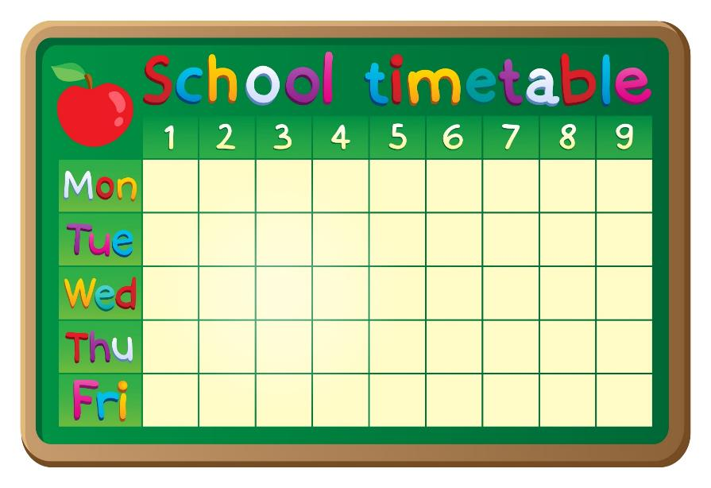
Let’s draw!

Slide 43

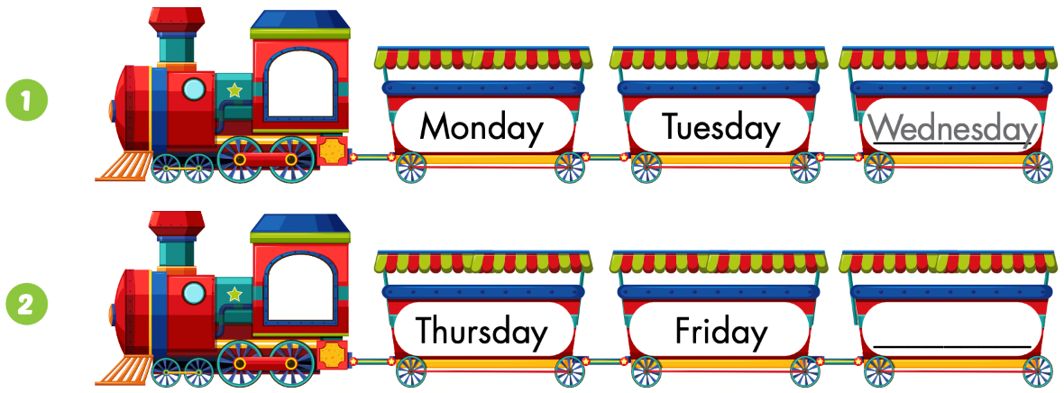
Extra Practice
WB p. 32
Saturday

Slide 44
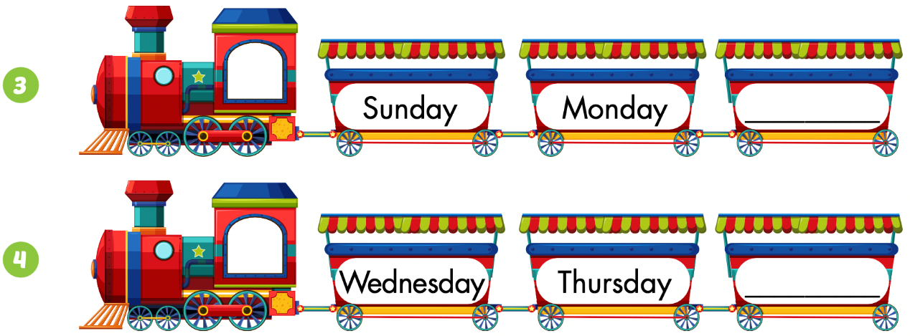
Tuesday
Wednesday

Slide 45
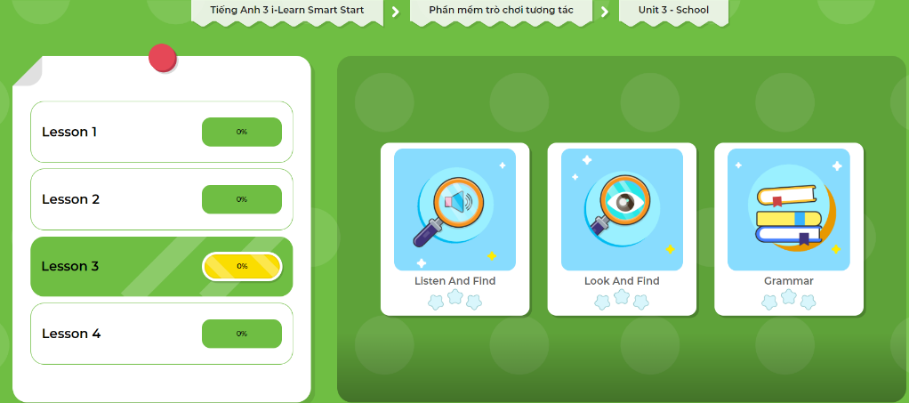
Extra Practice
DHA App
Let’s play!
Click here to play the game

Slide 46

WRAP-UP

Slide 47
Lesson 3
Today’s lesson
Vocabularies
Monday, Tuesday, Wednesday, Thursday, Friday, Saturday, Sunday
Structures/ Sentence patterns
When do you have English? - I have English on Wednesdays and Fridays.

Slide 48
Lesson 3
Homework
Practice the vocabularies/ structures and make sentences using them.
Do the exercises on page 32 WB
Do the exercises in Tiếng Anh 3 i-Learn Smart Start Notebook on page 24.
Prepare the next lesson (page 45 SB)
Play the consolidation games in Tiếng Anh 3 i-Learn Smart Start DHA App on www.eduhome.com.vn

Slide 49
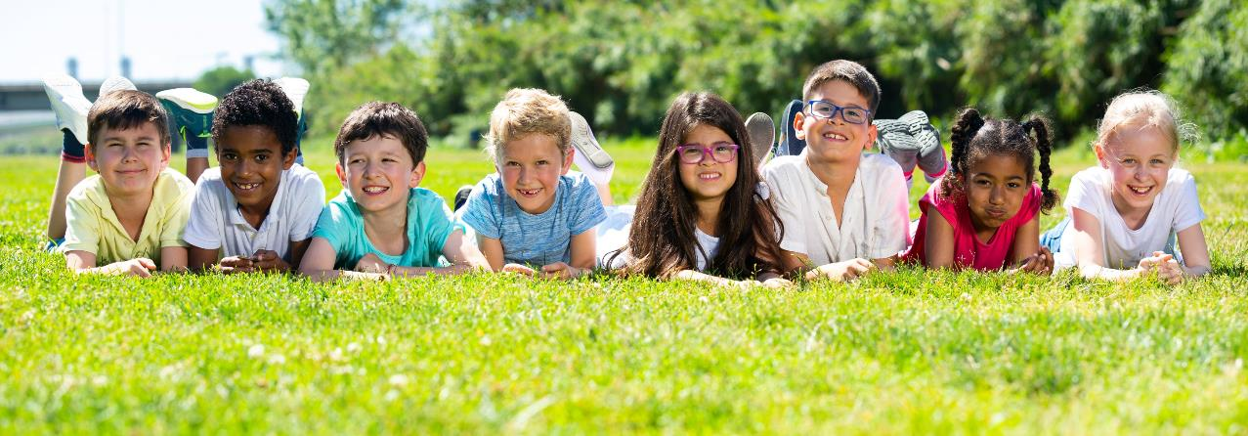
Have a nice day!

