Slide 1

Unit 3: WEATHER
REVIEW AND PRACTICE 1
Page 46

Slide 2
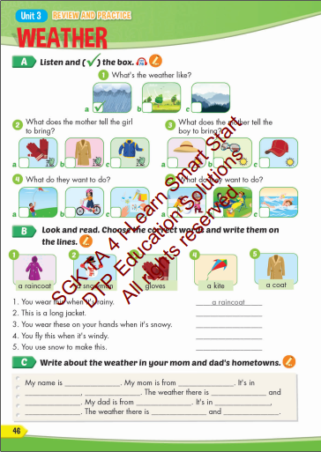
Lesson Outline
Warm-up
Practice
Consolidation
Wrap-up

Slide 3

WARM UP

Slide 4



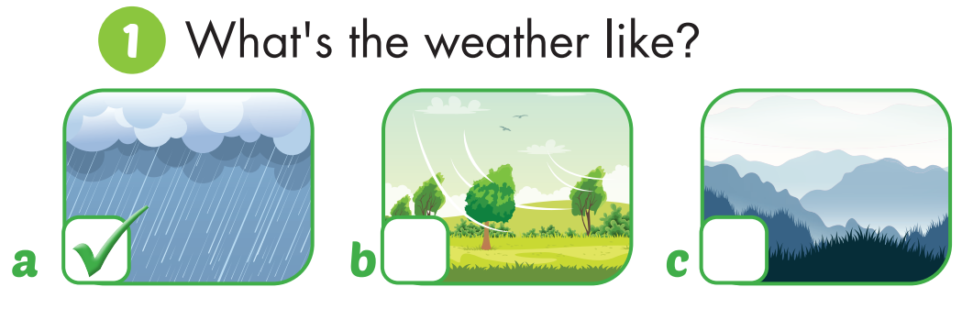

Slide 5
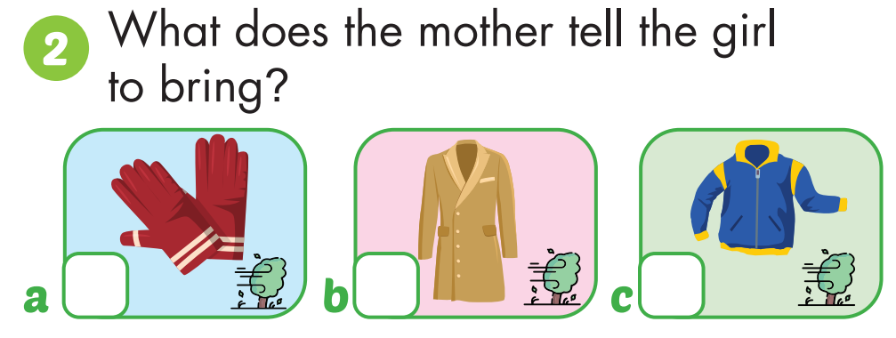


Slide 6
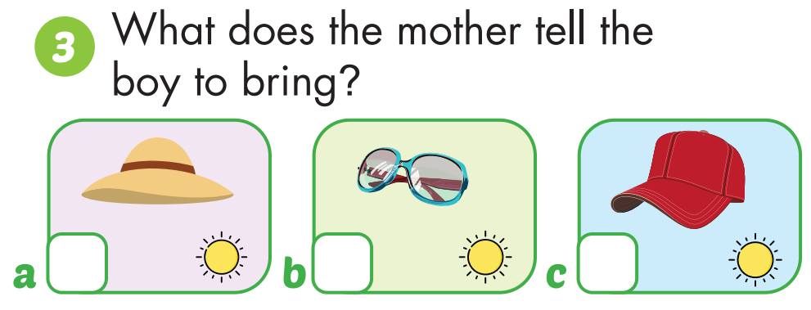

Slide 7
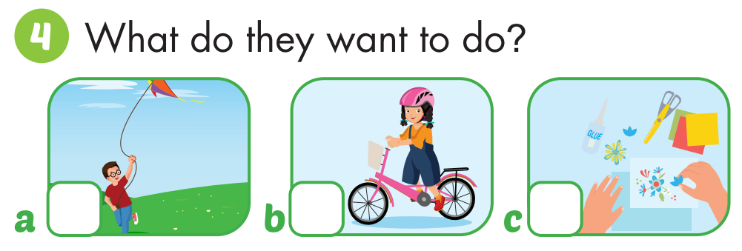

Slide 8
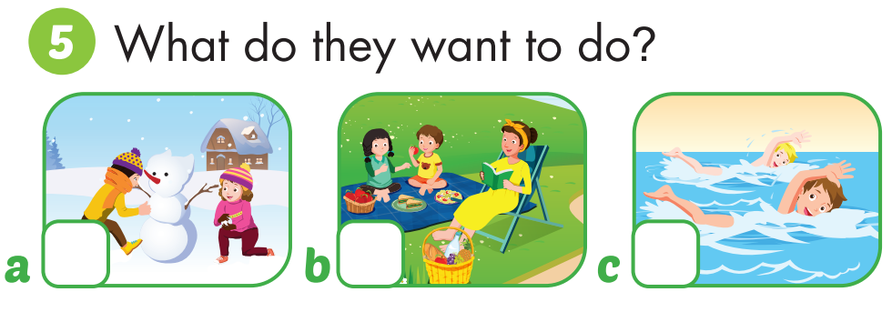

Slide 9

Practice

Slide 10
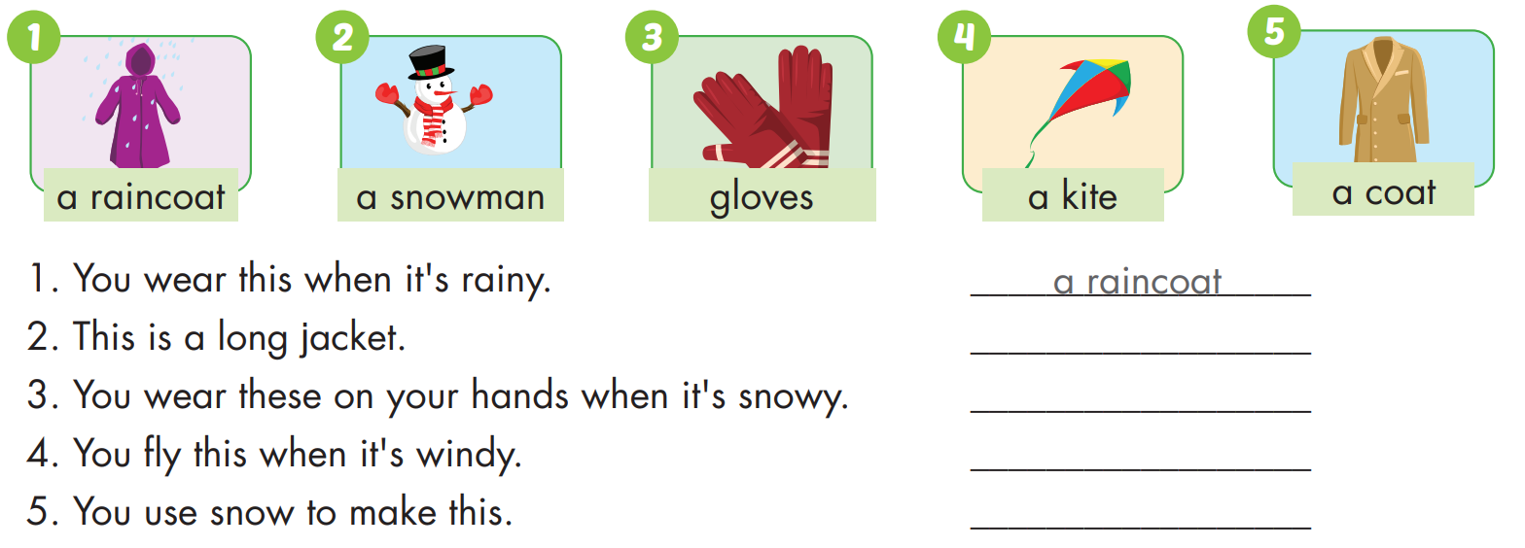

Slide 11
a coat
gloves
a kite
a snowman

Slide 12
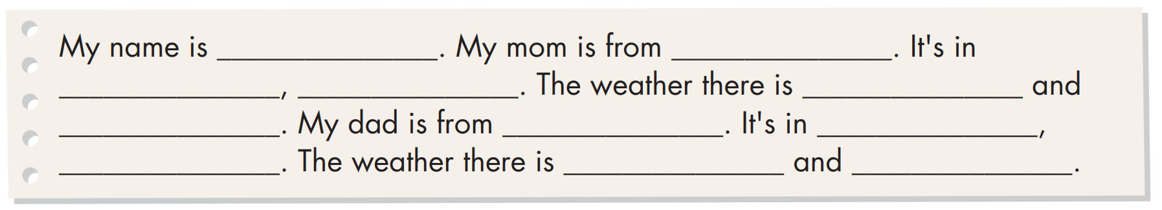
Practice

Slide 13

CONSOLIDATION

Slide 14

Workbook
p.30

Slide 15

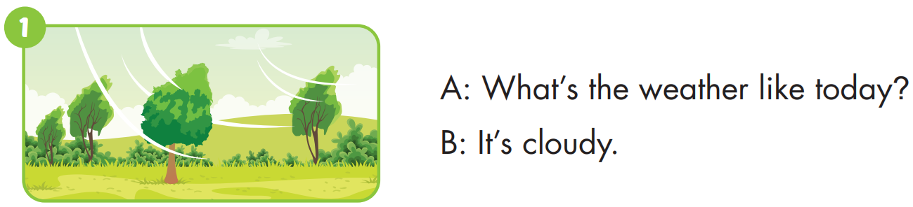


Slide 16
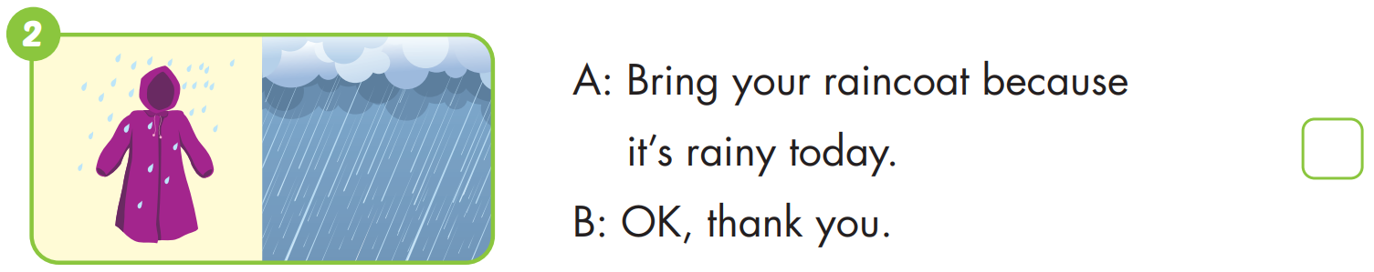

Slide 17
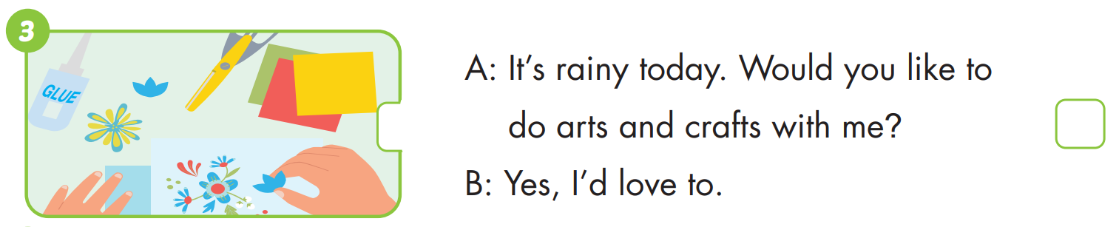

Slide 18
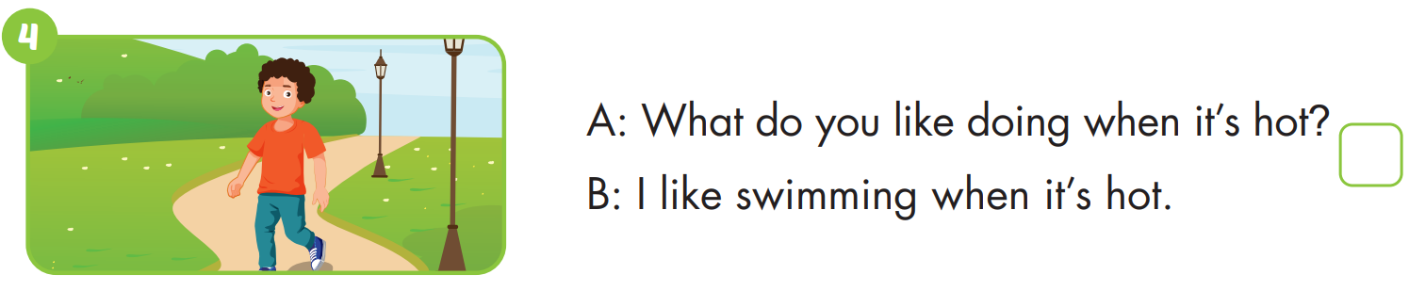


Slide 19
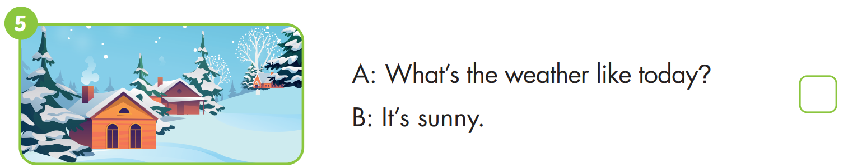

Slide 20
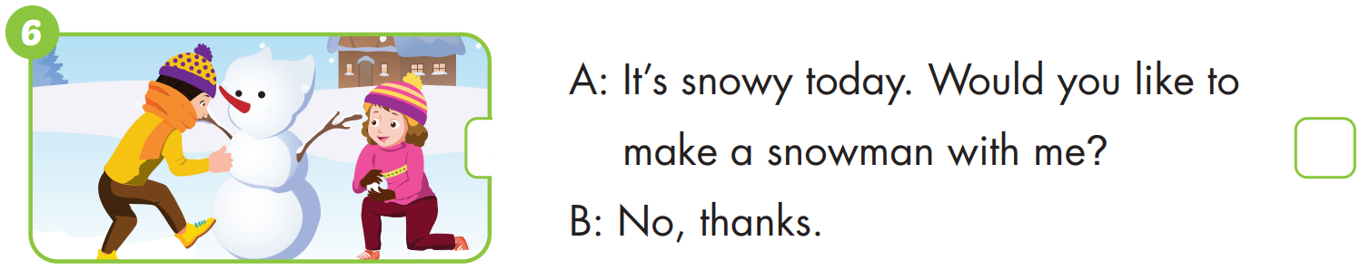

Slide 21




Crossword puzzles
4
1
U
2
1
2
Y
3
O
3
4

Slide 22
Crossword puzzles
4
1
U | M | B | R | E | L | L | A
 |  |  |  | Y
 |  |  | O
2
1
2
3
3
4

Slide 23
Crossword puzzles
4
1
U | M | B | R | E | L | L | A
R | A | I | N | Y
 |  |  | O
2
1
2
3
3
4

Slide 24
Crossword puzzles
4
1
U | M | B | R | E | L | L | A
R | A | I | N | Y
 | G | L | O | V | E | S
2
1
2
3
3
4

Slide 25
Crossword puzzles
4
1
U | M | B | R | E | L | L | A
 |  |  | A
 |  |  | I
R | A | I | N | Y
 |  |  | C
 | G | L | O | V | E | S
 |  |  | A
 |  |  | T
2
1
2
3
3
4

Slide 26

WRAP-UP

Slide 27
Today’s lesson
Vocabularies
sunny, rainy, snowy, cloudy, windy, foggy.
Structures/ Sentence patterns
What's the weather like today?
It's sunny.

Slide 28
Homework
Practice the vocabularies and structure; and make sentences using them.
Do the exercises in Tiếng Anh 4 i-Learn Smart Start WB (page 31).
Do the exercises in Tiếng Anh 4 i-Learn Smart Start Notebook (page 20).
Prepare the next lesson (page 48 SB).
Play the consolidation games in Tiếng Anh 4 i-Learn Smart Start DHA App on www.eduhome.com.vn

Slide 29

Enjoy your day!

