Slide 1



Unit 1
What’s your address?
Lesson 1

Slide 2
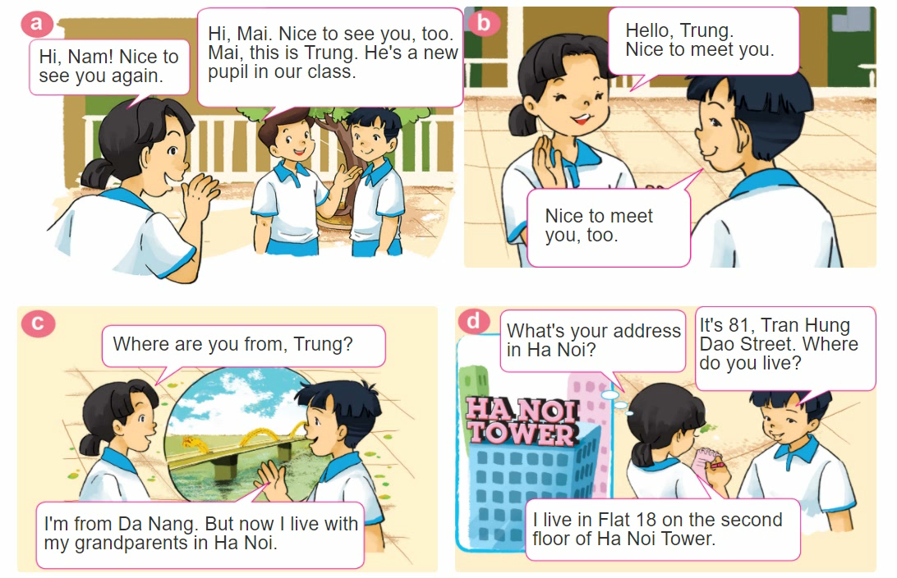
1. Look, listen and repeat.

Slide 3
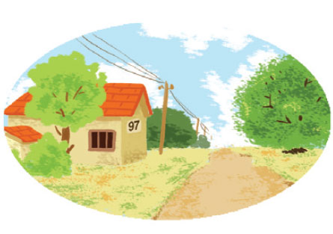

2. Point and say
97, Village Road
It's __________________.
What's your address?
97, Village Road

Slide 4
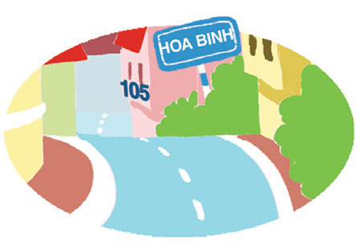
2. Point and say
75, Hai Ba Trung Street
It's __________________.
What's your address?
75, Hai Ba Trung Street

Slide 5
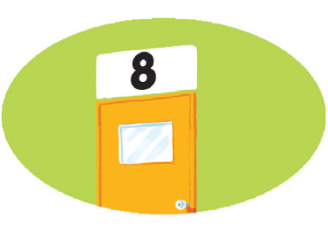
2. Point and say
flat 8, second floor, City Tower
It's ______________
_____________.
What's your address?
flat 8, second floor,
City Tower

Slide 6

3. Let’s talk
Where are you from?
I’m from _______.
What’s your address?
It’s _______.
Where do you live?
I live in/at/on _______.

Slide 7
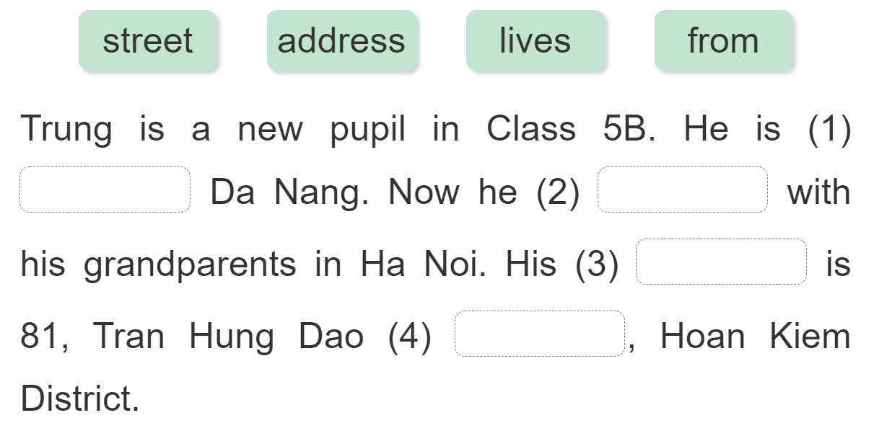
5. Read and complete.
from
lives
address
street

Slide 8
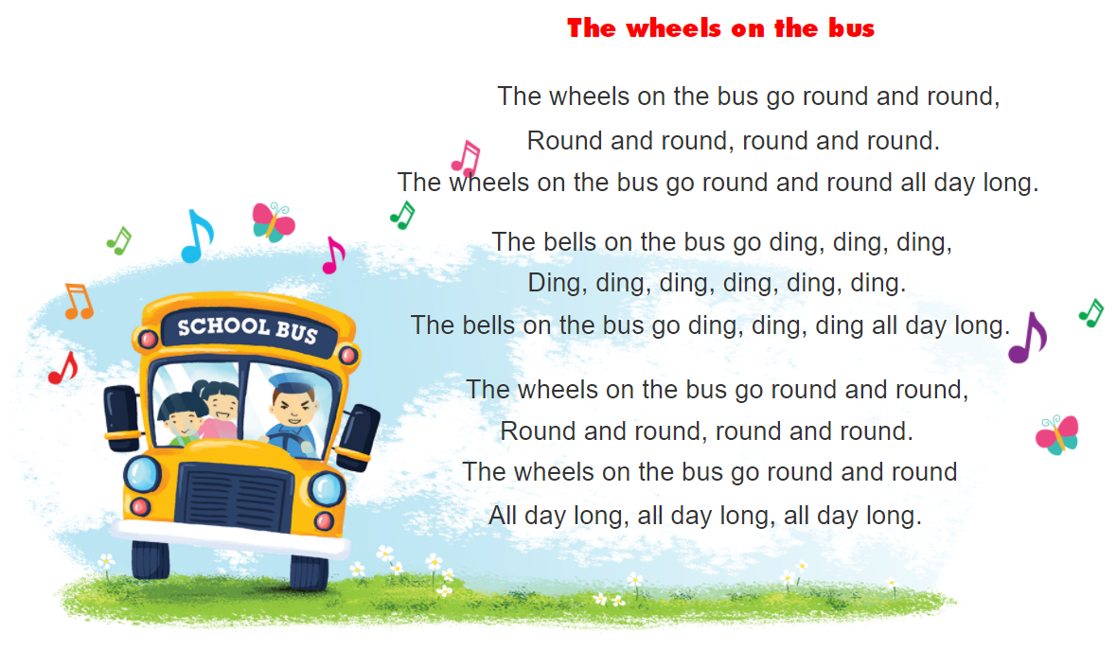

6. Let’s sing
https://www.youtube.com/watch?v=KZU9aBsZwxE&t=1s

