Slide 1
Unit 6
HOW MANY LESSONS
DO YOU HAVE TODAY?
Lesson 3

Slide 2
PRONUNCIATION

Slide 3
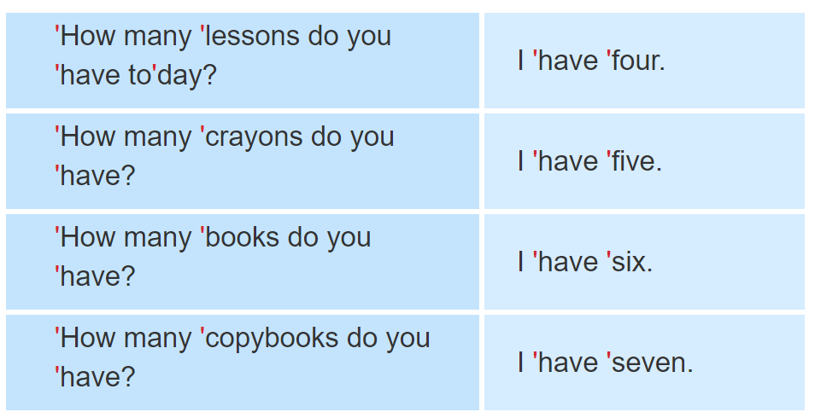

1. Listen and repeat.

Slide 4
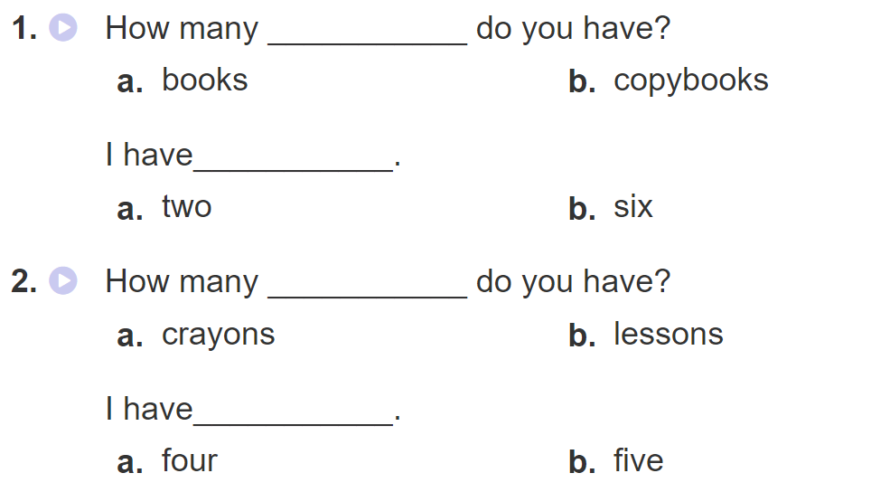
2. Listen and circle a or b. Then say the sentences aloud.

Slide 5
PRACTISE

Slide 6
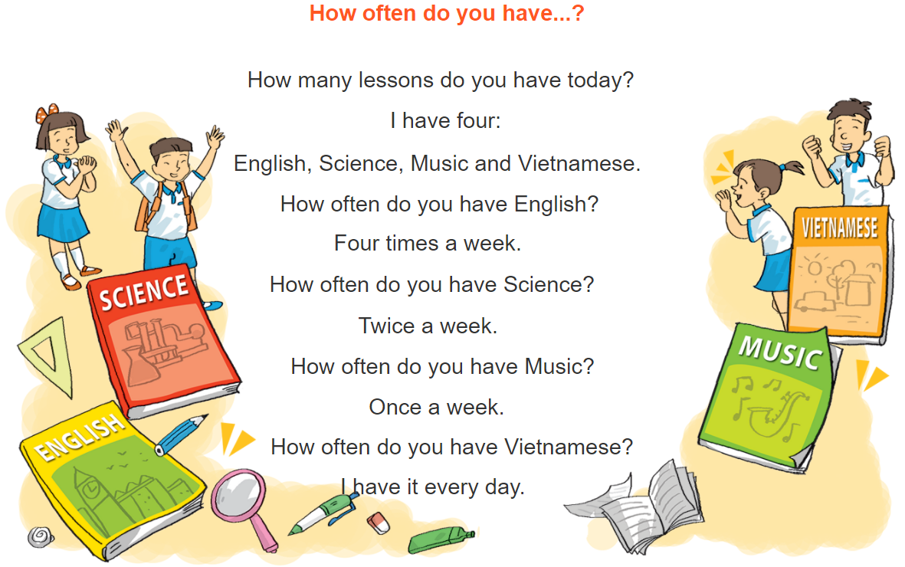
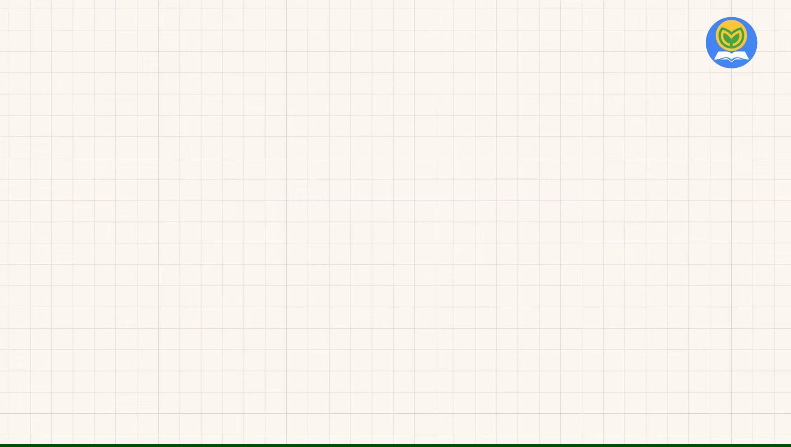


3. Let’s chant

Slide 7
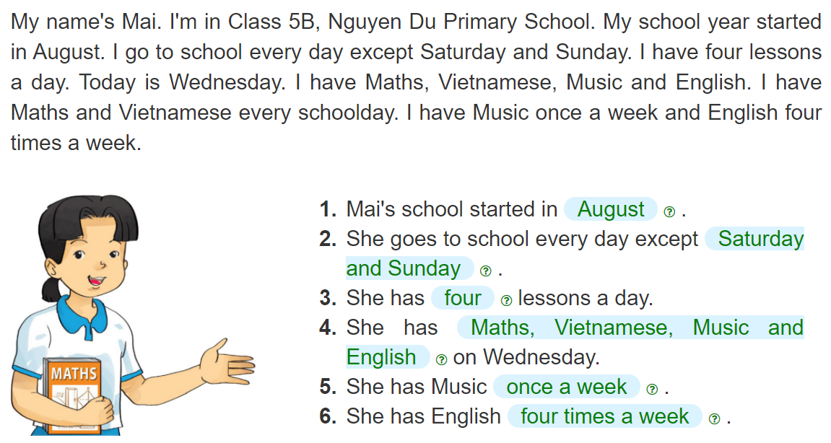
4. Read and complete
__________
__________
______________
______
________________________________________
________
______________
_____________________

Slide 8
5. Write about your school and lessons.
My school started in_________________.
I go to school _________________.
I have_______ lessons a day. I have _______________
_____________________________________________
on Wednesday. I have Music_____________________.
I have English _____________________.

Slide 9
6. Project
Write a letter to a pen friend to talk
about your timetable.

