Slide 1

Unit 3: School
Lesson 3.3
Page 46

Slide 2
Lesson Outline
Warm-up
Practice
Speaking
Consolidation
Wrap-up

Slide 3
Objectives
By the end of this lesson, students will be able to talk about their school timetables.
Vocabulary: Monday, Tuesday, Wednesday, Thursday, Friday, Saturday, Sunday
Structure: When do you have English?
- I have English on Wednesdays and Fridays.

Slide 4

WARM UP

Slide 5
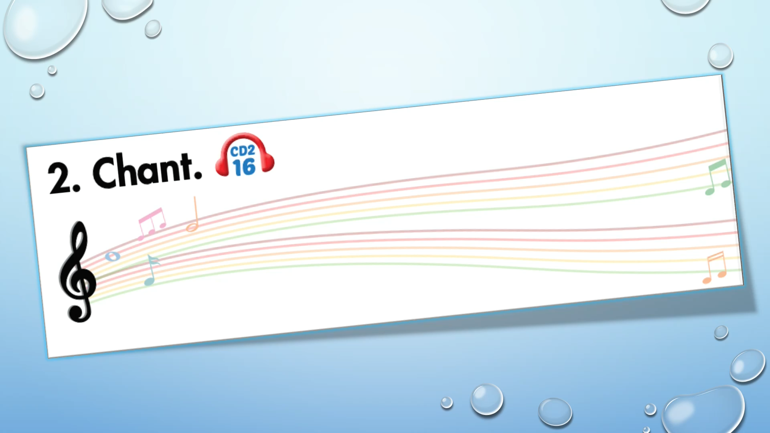

Slide 6

It’s time to learn …

Slide 7

Structures
When do you have English?
- I have English on Wednesdays and Fridays.

Slide 8

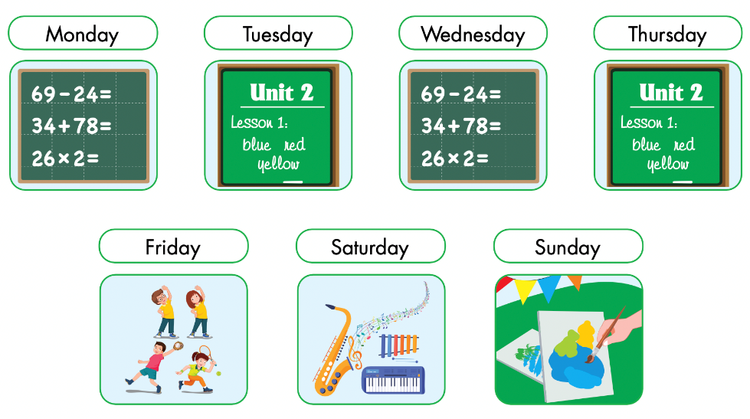

Slide 9
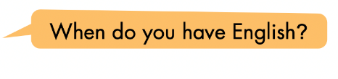
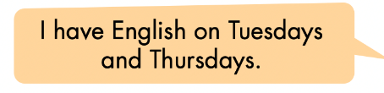
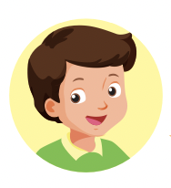
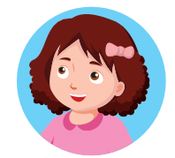
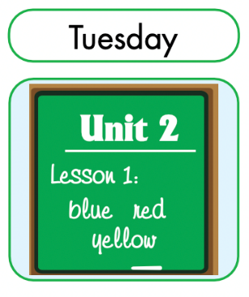
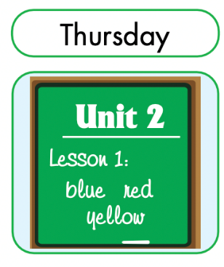
Teacher models first!
English

Slide 10
Divide the class into two teams.
Have Team A ask the question and Team B answer it.
Swap roles and repeat.

Slide 11

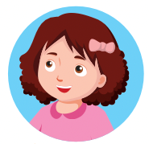
math
English
art
P.E.
music

Slide 12

Speaking

Slide 13
Pairwork

Slide 14
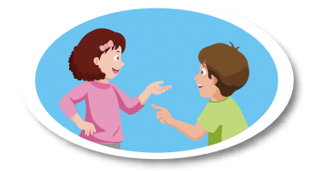
DEMONSTRATION
Have some pairs demonstrate the activity in front of the class

Slide 15

Production

Slide 16

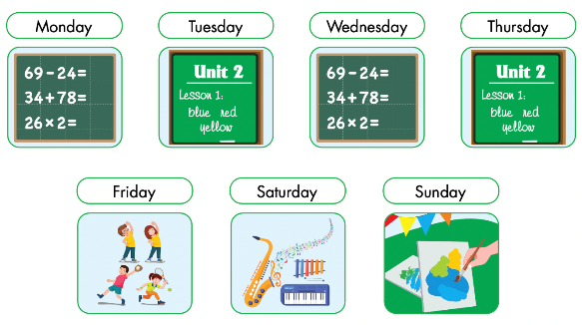
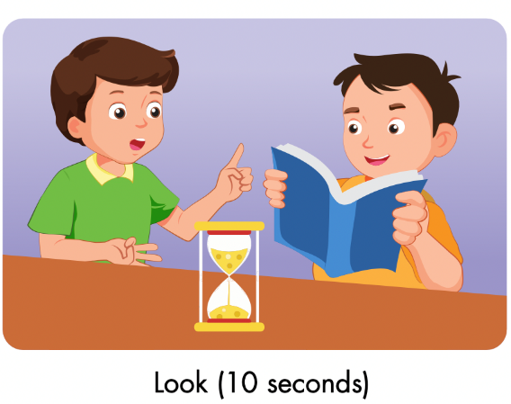
Notes:
Divide the class into pairs.
Have Student A look at Part E for ten seconds, then close their book.

Slide 17
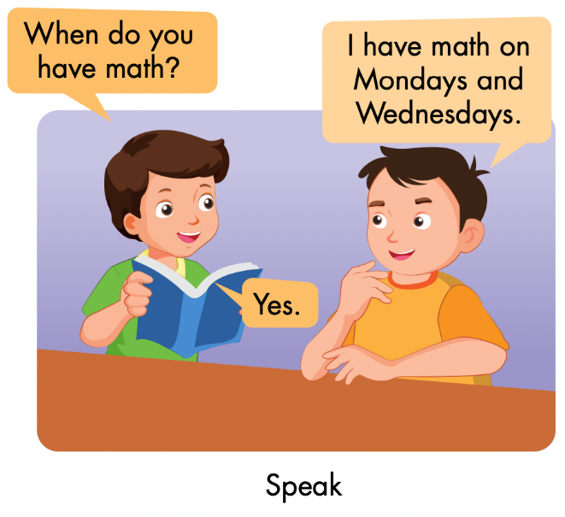
Notes:
Have Student B ask questions about Part E using the useful language from the lesson and have Student A answer.
Have students swap roles and repeat.
Afterwards, have some pairs demonstrate the activity in front of the class.

Slide 18
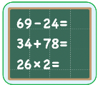
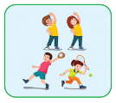
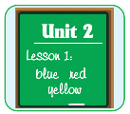




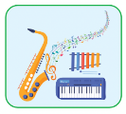
School timetable | Monday | Tuesday | Wednesday | Thursday | Friday
School timetable game

Slide 19
How to play
Read the questions
Look at the timetable
Answer the questions

Slide 20
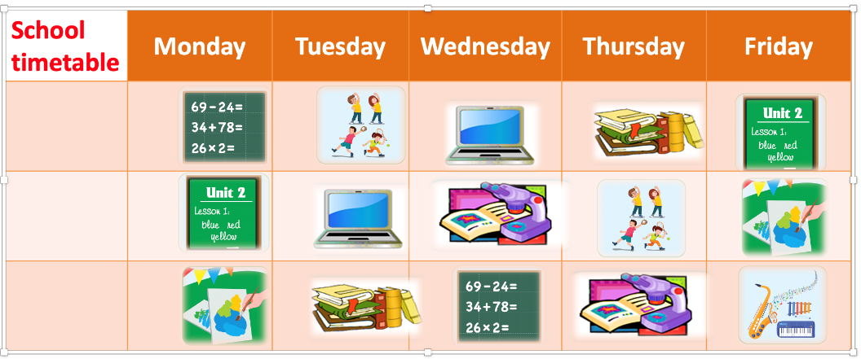
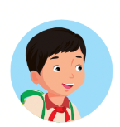
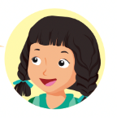
When do you have math?
I have math on
____________________.
Monday and Wednesday

Slide 21
When do you have English?
I have English on
_______________ .
Monday and Friday

Slide 22
When do you have P.E.?
I have P. E. on
________________ .
Tuesday and Thursday

Slide 23
When do you have art?
I have art on
______________ .
Monday and Friday

Slide 24
When do you have music?
I have music on __________ .
Friday

Slide 25

CONSOLIDATION

Slide 26

Spelling Game
Divide the class into two teams
Have one member from each team come up to the whiteboard
Say a day (Thursday) and the first student to spell it correctly gets a point for their team.

Slide 27
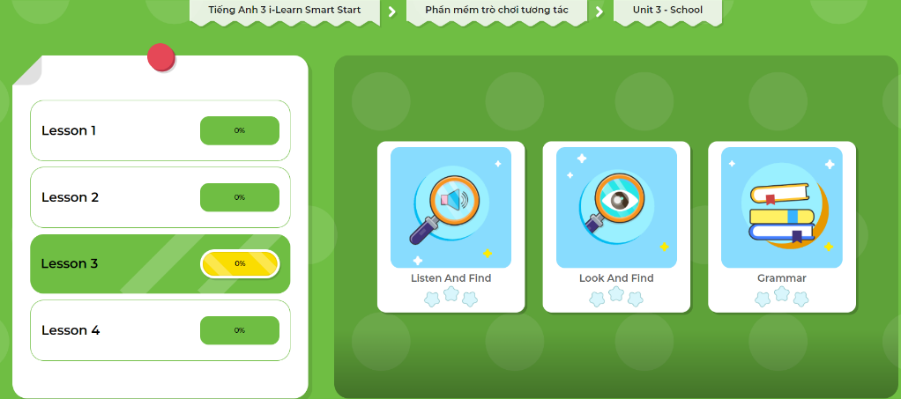
Extra Practice
DHA App
Let’s play!
Click here to play the game

Slide 28

WRAP-UP

Slide 29
Lesson 3
Today’s lesson
Structures/ Sentence patterns
When do you have ………..?
- I have ……… on ………..
When do you have art?
- I have art on Mondays.

Slide 30
Lesson 3
Homework
Practice the vocabularies/ structures and make sentences using them.
Do the exercises on page 33 WB
Do the exercises in Tiếng Anh 3 i-Learn Smart Start Notebook on page 24.
Prepare the next lesson (page 47 SB)
Play the consolidation games in Tiếng Anh 3 i-Learn Smart Start DHA App on www.eduhome.com.vn

Slide 31
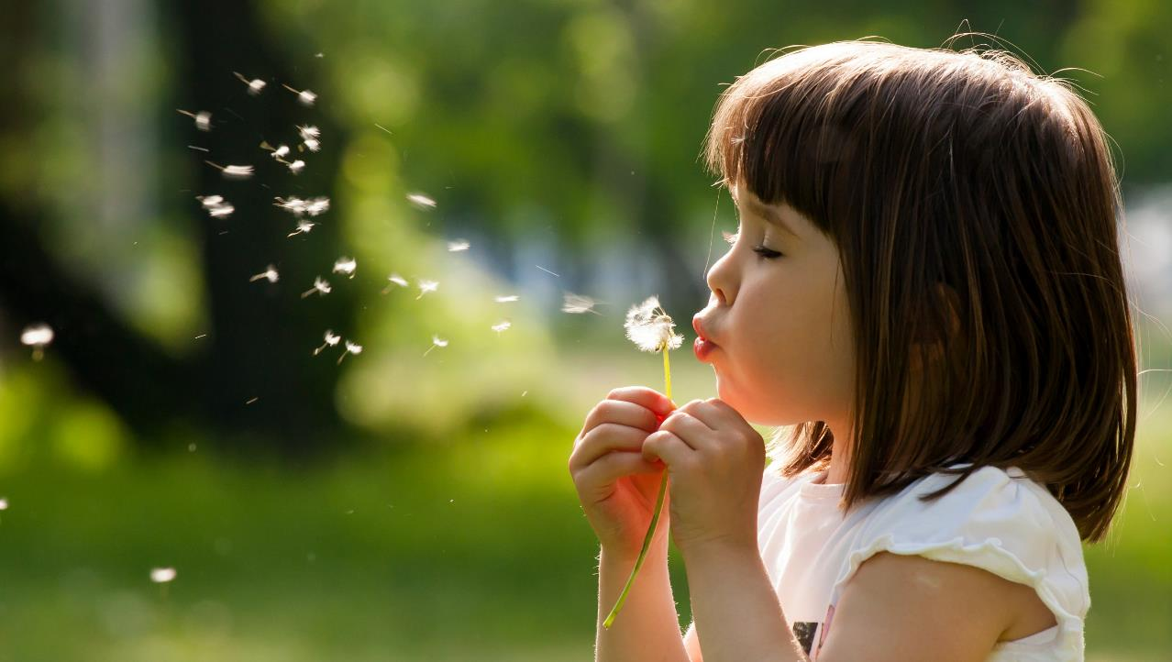
Enjoy your day!

