Slide 1

Unit 2: Family
Lesson 1.3
Page 26

Slide 2

It’s time to learn …

Slide 3

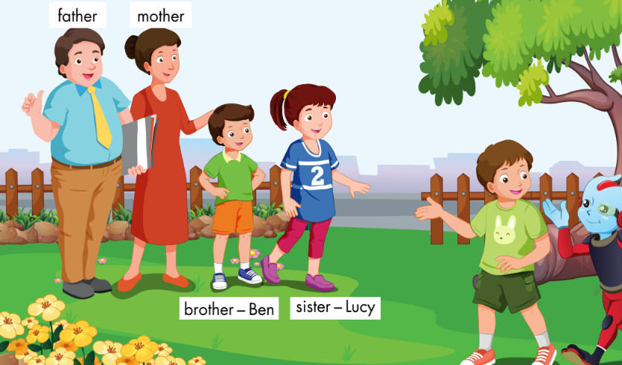
E
1. Point and say.
Notes:
Have the class look at the picture.
Ask them what they can see in the picture.
Ask them to point to the picture and say the family words and spell the names.
Remind them of the key structure: “This is my…” to introduce family members.
1. Point and say.
Divide the class into two pairs.
Demonstrate the activity using the speech bubbles.
Have the student A point to a person in the picture, have the student B introduce.
Swap roles and repeat.
Afterwards, have some pairs demonstrate the activity in front of the class.

Slide 4

Speaking

Slide 5
E
2. Role-play.
Example:
Tina: This is my brother, Ben.
Mark: Hello, Ben. I’m Mark.
Ben: Hello, Mark.
Notes:
2. Role-play.
Divide the class into groups of three.
Demonstrate the activity using the example.
Ask them to role-play the activity.
Swap roles and repeat.
Afterwards, have some pairs demonstrate the activity in front of the class.

Slide 6
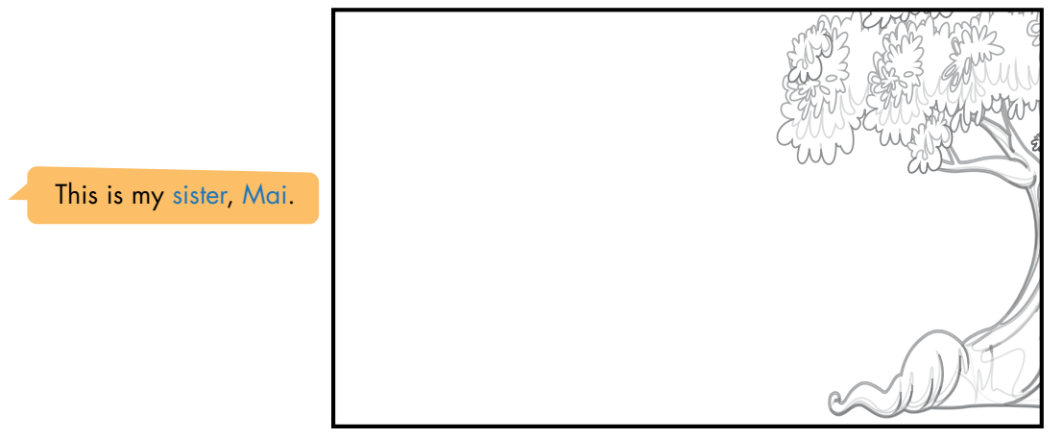
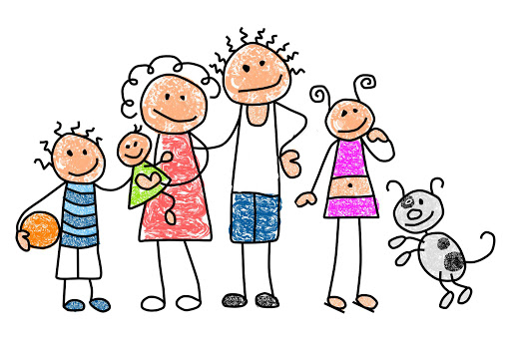
F
1. Draw your family. Point and say.
father
mother
sister
brother
Notes:
F. 1. Draw your family. Point and say.
Have the students look at the picture of the garden and draw their family.
Divide the class into pairs.
Have the student A point and say about their family.
Swap roles and repeat.
Afterwards, have some students demonstrate the activity in front of the class.

