Slide 1

Unit 2: Family
Lesson 1.2
Page 25

Slide 2

Phonics
/ʌ/

Slide 3




Click on the icon to hear the sound
brother
mother
/ʌ/
/ʌ/

Slide 4
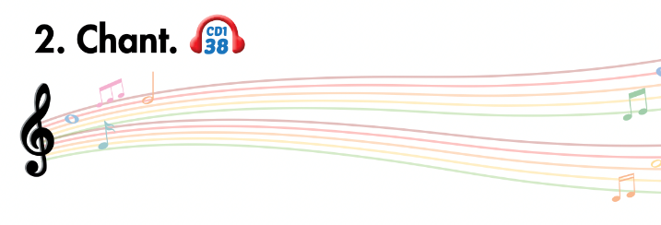
Listen and point
Listen and clap
Listen and chant

Slide 5

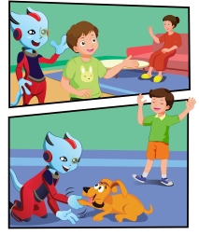
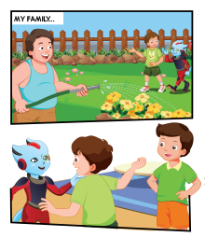
While-Listening
3.
1.
4.
2.

Slide 6

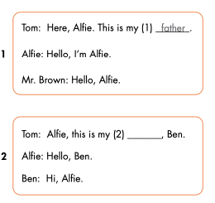
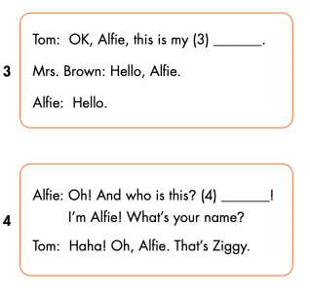
mother
brother
Hello

Slide 7

Speaking

Slide 8

mother
brother
Hello

Slide 9

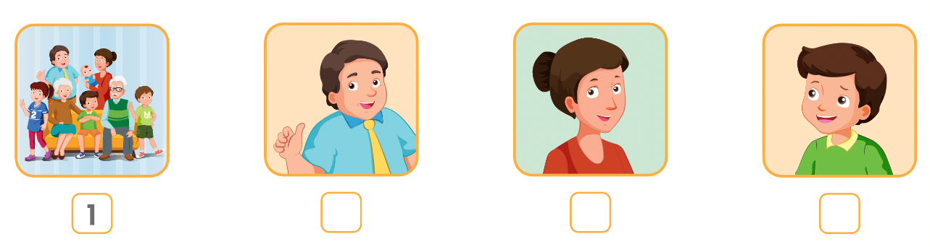
Extra Practice
WB p. 19
Click on the icon to hear the sound
4
2
3

Slide 10

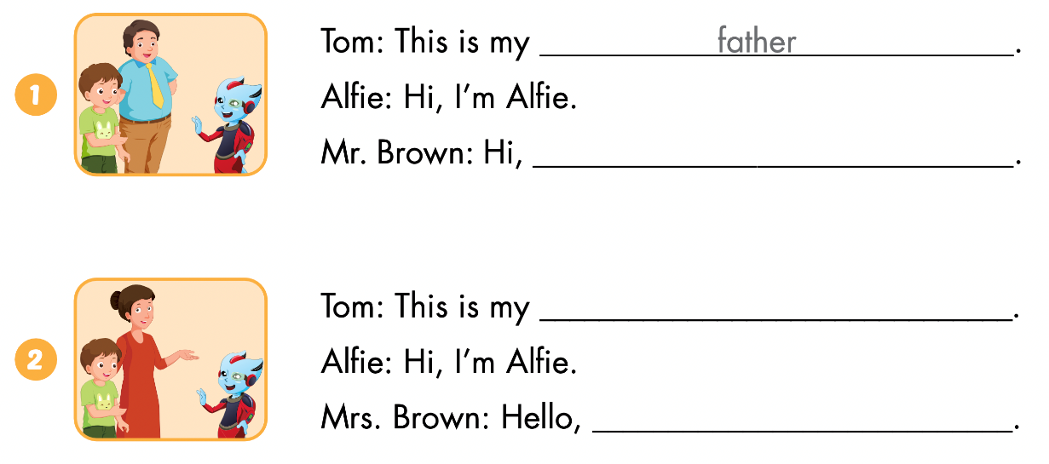
Alfie
mother
Alfie

Slide 11
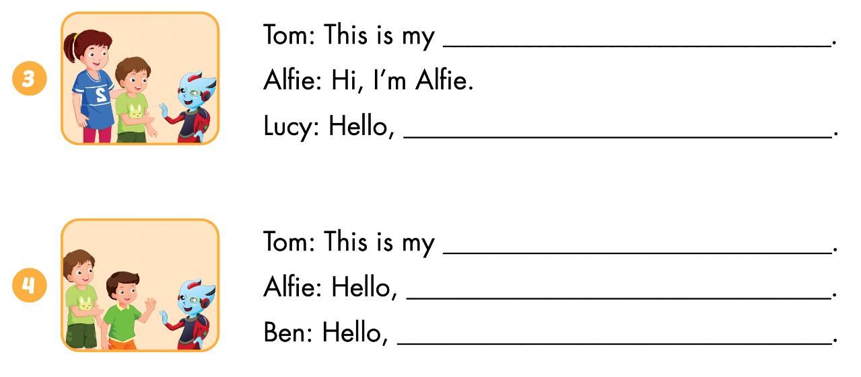
sister
Alfie
brother
I’m Alfie
Alfie

