Slide 1

Unit 8: Food
Lesson 4.3
Page 121

Slide 2
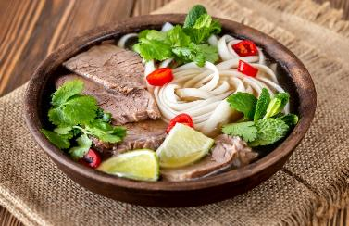
What food is behind these boxes?
Phở

Slide 3
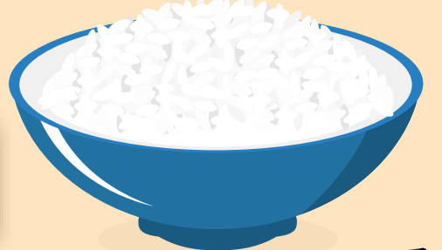
What food is behind these boxes?
Rice
rice

Slide 4
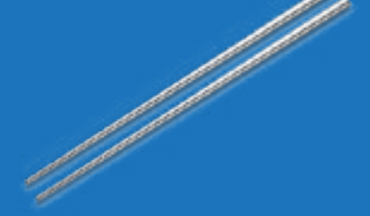
What is behind these boxes?
chopsticks
chopstick

Slide 5

Which country is behind these boxes?
Vietnam

Slide 6

It’s time to learn …

Slide 7
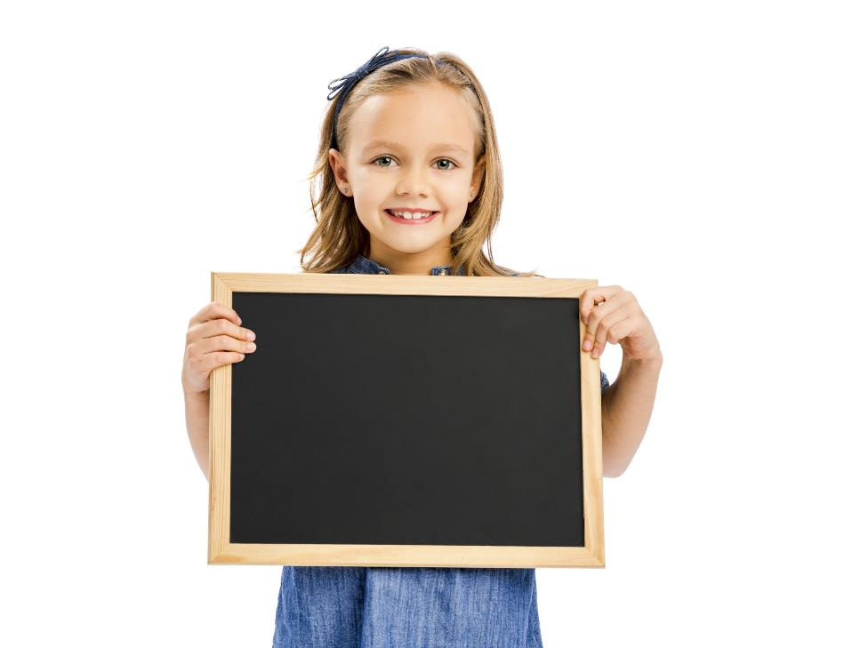
Reading

Slide 8

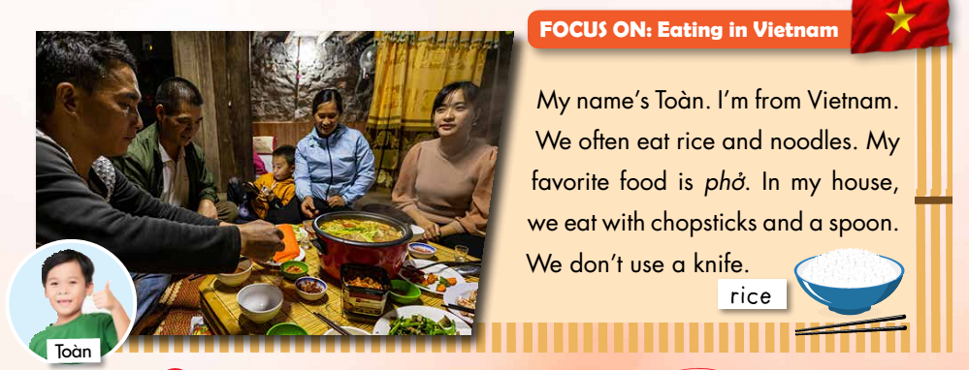

Slide 9
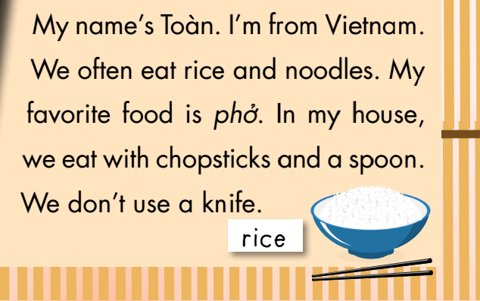


2. They often eat steak – False
3. His favourite food is phở – True
4. They don’t use a spoon - False
Notes:
Giáo viên hướng dẫn học viên cách làm câu hỏi True False

Slide 10
You have 5 minutes to read and remember the text.

Slide 11
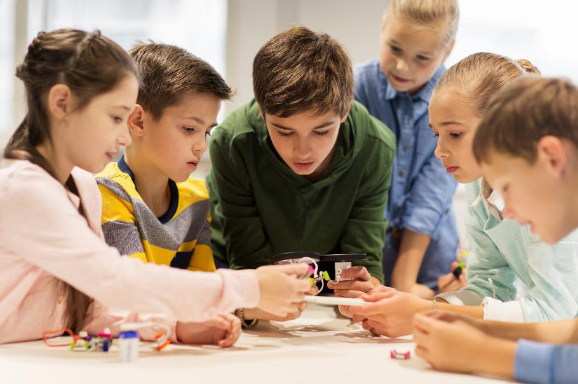
Let’s play a game

Slide 12
Continue the lesson
3
4
2
1
7
8
5
6
The class is divided into 2 groups.
Each group takes turn to choose the star.
Teacher click on each star chosen by students. Students answer the questions. If they have the correct answer, they earn the points for each question.
There is one lucky and one unlucky star
LUCKY STAR

Slide 13
They often eat steak.
TRUE
FALSE
10 POINT

Slide 14
They don’t eat noodles.
TRUE
FALSE
15 POINT

Slide 15

CONGRATULATION. YOU EARN 30 POINTS

Slide 16
His favorite food is phở.
TRUE
FALSE
10 POINT

Slide 17
They eat with chopsticks.
TRUE
FALSE
15 POINT

Slide 18

OH, NO.YOU LOSE 20 POINTS

Slide 19
They don’t use a spoon.
TRUE
FALSE
10 POINT

Slide 20
They use a knife.
TRUE
FALSE
15 POINT

Slide 21
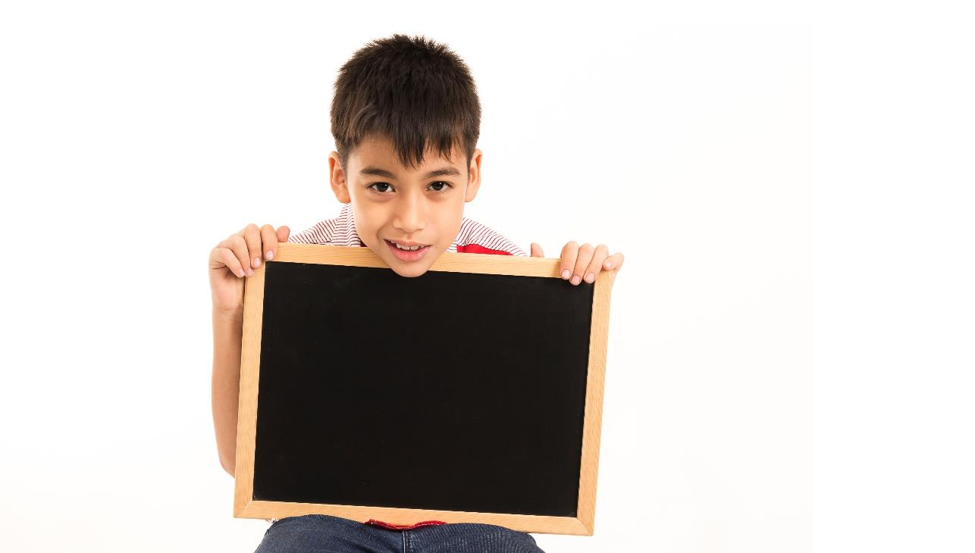
Writing

Slide 22
Matching – click on each box on the left to see the answer.
Pre-Writing
My favorite food is____
eat pizza
I don’t use a____
chopsticks
I eat fish with____
fork
I often _____
noodles

Slide 23

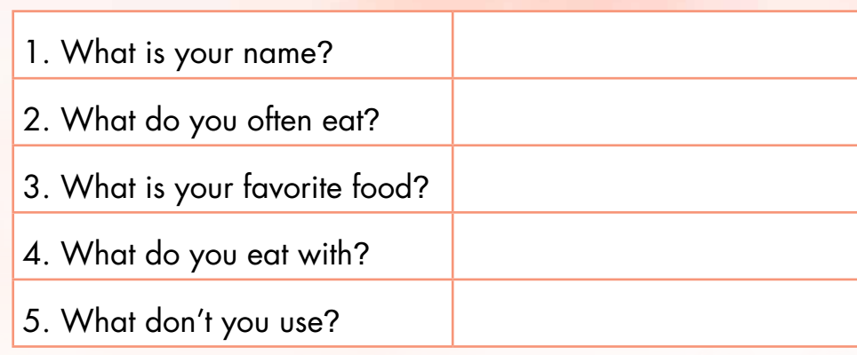
Answer the questions about you.
My name’s Linh
I often eat rice
It’s beef/fried noodles
with chopsticks and spoon
knife, fork

Slide 24
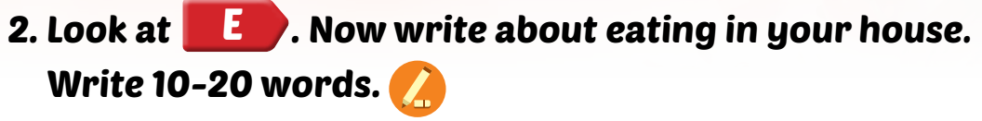



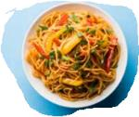
My name’s Linh. I’m from Viet Nam. I often eat
rice with chopsticks or a spoon. My favorite
food is beef. I don’t use a knife.

Slide 25

Hello, my name is……..I’m from……………………………………………………………………………………………………………………………………………………………………………………………………………..

